Slide 1
UNWORLDLY

Slide 2
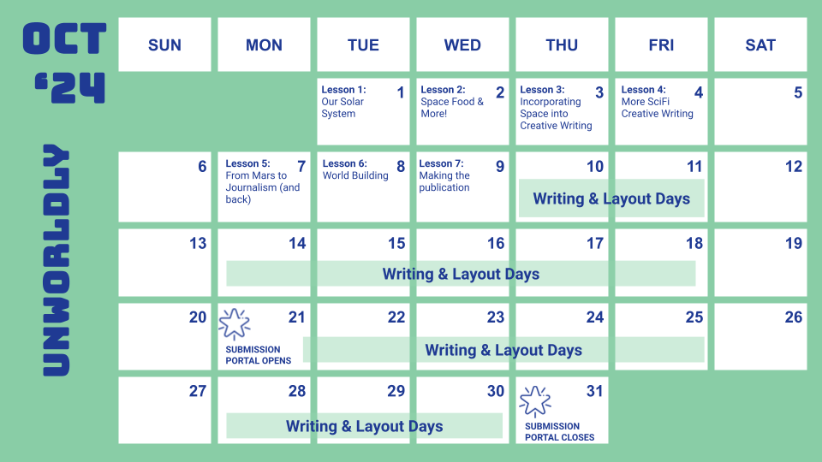
Unworldly Suggested Calendar

Slide 3
Featured Teacher Fellow
Unworldly is adapted from BreakFree Education Teacher Fellow Bill Laforme’s original content. Bill teaches at Kennedy School, a juvenile justice facility in Massachusetts.

Slide 4
Lesson 1
Our Solar System
Notes:
View Lesson 1 Lesson plan
View Lesson 1 Handouts. (PDF)

Slide 5
DO NOW
Do you know all the planets in our Solar System? Make a list of the ones you know.
Notes:
As students enter classroom, have the Do Now prompt on the screen for them to respond to on their handout, journals or piece of paper.

Slide 6
Agenda
Do Now: What planets do you know?
Introduction to Unworldly
Watch: Solar System & Asteroids
Read & Respond: Asteroid 16 Psyche
Discussion
Exit Ticket
Notes:
Review the agenda for the lesson

Slide 7
OBJECTIVES
Students will be able to:
Identify major objects in our Solar System
Understand future plans and motivations for Solar System exploration
Notes:
Review the objectives for the lesson, so students know what is expected of their learning

Slide 8
The Mission
Through Unworldly, we will learn about outer space and the potential benefits of its exploration. We will consider classic SciFi stories to understand creative world-building and will then practice journalism skills to create a newspaper from the perspective of future outer space settlers.
Along with writing creative articles there will be the opportunity to create art for the newspaper!
There’s a competition too!
Notes:
Outline the Unworldly initiative to students. Explain that after they look into our solar system and its exploration, they will be collaborating to create a newspaper as colonists of a new mars colony. Explain BreakFree initiatives to students and the component of the national competition, and distribute the Note to Students.

Slide 9
Dwarf Planets
Notes:
Show students the image outline of the Solar System.
Ask students how many planets they had on their list from the Do Now.
Image Source: CactiStaccingCrane, CC BY-SA 4.0 <https://creativecommons.org/licenses/by-sa/4.0>, via Wikimedia Commons

Slide 10
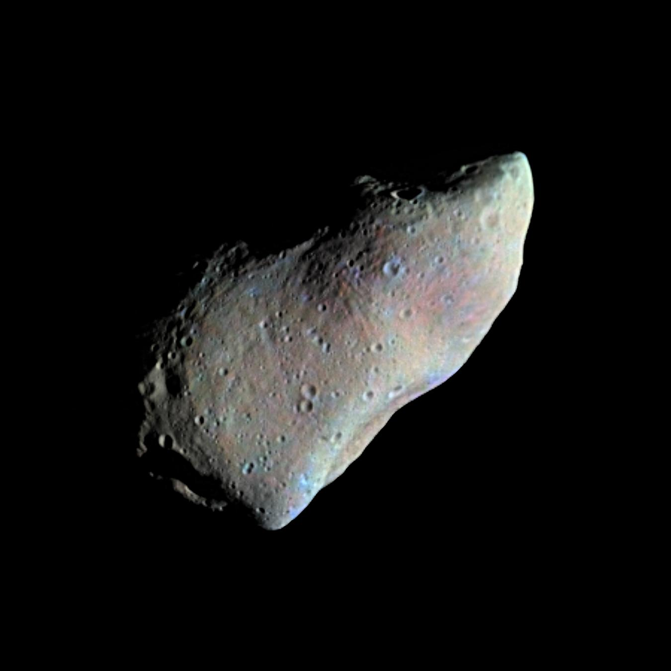
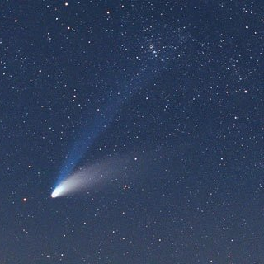
Besides planets…
What else is in our solar system?
Our solar system is made up of a star, eight planets, and countless smaller bodies such as dwarf planets, asteroids, and comets.
Picture of asteroid 951 Gaspra taken by the Galileo spacecraft from a range of 3,300 miles, 10 minutes before closest approach on October 29, 1991.
A comet is a group of particles bound together by ice. When a comet approaches the sun the ice melts and releases the particles from the main body in a very long tail that can stretch for millions of miles.
Notes:
Introduce the concept that there is a lot more in outer space than just planets.
Photo Source: Gaspara, NASA, Public domain, via Wikimedia Commons
Photo Source: Comet Hale-Bopp, Andy Roberts from East London, England, CC BY 2.0 <https://creativecommons.org/licenses/by/2.0>, via Wikimedia Commons

Slide 11
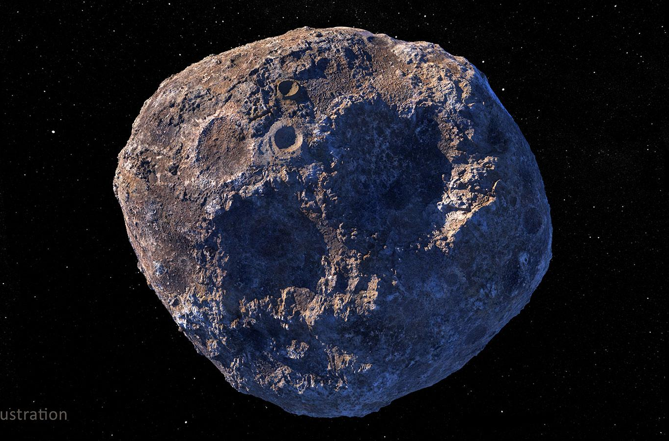
What can we find in asteroids?
What is an asteroid?
Asteroids are small, rocky objects that orbit the Sun.
Although asteroids orbit the Sun like planets, they
are much smaller than planets.
Why are companies interested in them?
It’s possible asteroids contain valuable metals that people want to mine.
The idea is ambitious, but could have huge payouts. Mining on Earth is prone to supply and environmental issues - and new tech (digital devices and electric vehicle batteries) requires more and more metals such as nickel, cobalt, and platinum.
Along with large amounts of iron, asteroids could also contain precious metals such as gold and silver.
Notes:
Define what an asteroid is.
Introduce why companies and explorers/researchers are interested in steroids.
To review, ask students to reflect on this information
Image Source: https://science.nasa.gov/solar-system/asteroids/16-psyche/

Slide 12
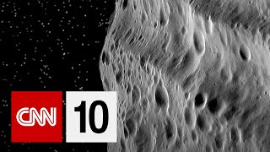
Can we mine asteroids?
Notes:
Watch a short video discussing whether, how, and why we should consider mining asteroids.
Video link: https://www.youtube.com/watch?v=wSbVK-PpHTc&embeds_referring_euri=https%3A%2F%2Fdocs.google.com%2F&embeds_referring_origin=https%3A%2F%2Fdocs.google.com&source_ve_path=Mjg2NjY&feature=emb_logo

Slide 13
Can we mine asteroids?
Let’s Discuss!
Why is Lewicki interested in mining asteroids?
What is the potential benefit?
What is the danger in mining asteroids?
How do international space laws come into play?
Notes:
Pose the questions to students as a way to review what they learned through the video.

Slide 14
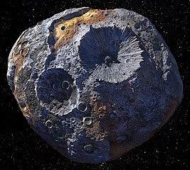
Asteroid 16 Psyche
Scientists think there might be an asteroid with metals worth more than all the money on earth!
It’s called Asteroid 16 Psyche and NASA is sending a spacecraft to research it!
Notes:
Introduce students to Asteroid 16 Psyche. Tell them they are going to reach an article about this asteroid.
Image Source: https://science.nasa.gov/solar-system/asteroids/16-psyche/

Slide 15
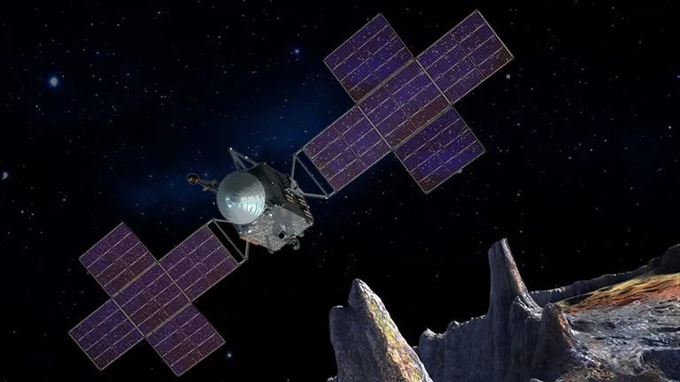
Asteroid 16 Psyche
Read the article!
Comprehension Questions
About how many miles is the asteroid Psyche from the Sun?
An Astronomical Unit is the distance between the Sun and what?
In what year was the asteroid Psyche discovered?
An artist's concept of the Psyche spacecraft.
Maxar/ASU/P. Rubin/NASA/JPL-Caltech
Notes:
Distribute the article and comprehension questions from Lesson 1 Handouts. (PDF)
Instruct students to read on their own, in groups, or as a class.
Discuss the comprehension questions.
Article and image Source: https://science.nasa.gov/solar-system/asteroids/16-psyche/

Slide 16
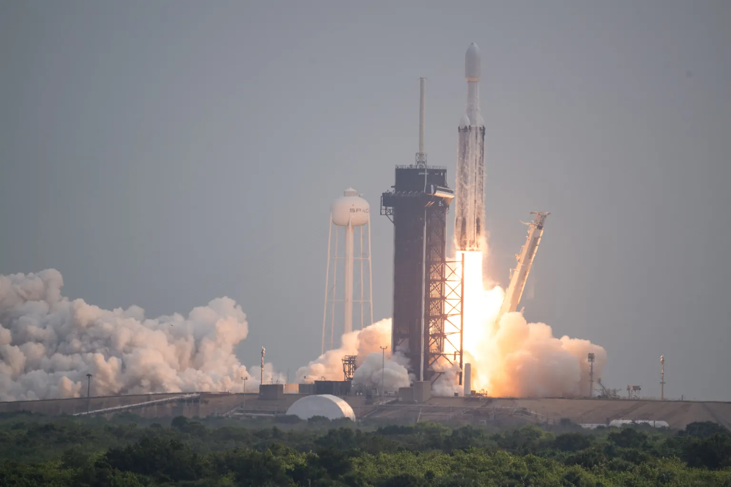
Asteroid 16 Psyche Mission
At the beginning of its approximately six-year journey, the Psyche spacecraft will spend about 100 days in initial checkout to make sure everything is functioning properly. About 2.5 years after launch, the spacecraft will fly by Mars for a gravity boost. About 5.5 years after launch, the cruise period will end, and around June 2029, the spacecraft will take photos of the asteroid Psyche. In August 2029, the spacecraft will drop into its first of 26 months of planned orbits around the metal-rich asteroid.
A SpaceX Falcon Heavy rocket with the Psyche spacecraft onboard launches at 10:19 EDT Friday, Oct. 13, 2023, from Launch Complex 39A at NASA’s Kennedy Space Center in Florida. Photo credit: NASA/Aubrey Gemignani
Notes:
Tell students that the Psyche spacecraft launched in October 2023 to carryout data0gathering and recognisance of Asteroid 16 Psyche.
Discuss how long the mission is going to take. (approximately 8 years)
Ask students if this sounds like a long time or not?
Photo Source: https://blogs.nasa.gov/psyche/

Slide 17
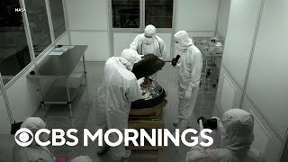
Asteroid Bennu - A Round Trip!
In 2023, NASA’s OSIRIS-REx spacecraft returned to Earth after a seven-year journey to get a sample of
asteroid Bennu.
Soon after the sample landed in the Utah desert, scientists reported they had found water as well as carbon in the asteroid sample–both of which are building blocks for life as we know it.
For more about this NASA mission, visit
https://science.nasa.gov/mission/osiris-rex/
Notes:
Watch a short video about NASA’s exploration of Asteroid Bennu.
Ask students what we learned from this mission.

Slide 18
Exit Ticket
What is asteroid mining? Does it seem possible? Explain.
Notes:
Before students leave class, ask them to complete the exit ticket on their handout, a piece of paper or their journals (or submit one through your virtual classroom).
Ask students to fill out their Daily Learning Log. (PDF)

Slide 19
Lesson 2
Space Food and More!
Notes:
View Lesson 2 Lesson plan here
View Lesson 2 handouts (PDF)

Slide 20
DO NOW
What is your favorite meal? Do you know all the ingredients and cooking methods for it?
Notes:
As students enter classroom, have the Do Now prompt on the screen for them to respond to on their handout, journals or piece of paper.

Slide 21
Agenda
Do Now: How well do you know your favorite foods?
Introduction to space food past & present
Read & Respond: Feeding Millions on Mars
Discussion
Exit Ticket
Notes:
Review the agenda for the lesson

Slide 22
OBJECTIVES
Students will be able to:
Explain the technologies, past, present and future, which help to sustain astronauts on missions.
Describe some of the history of the “Space Food” that early and current astronauts have used on missions.
Notes:
Review the objectives for the lesson, so students know what is expected of their learning

Slide 23
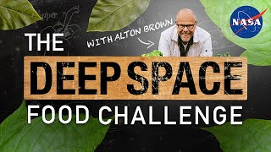
Eating in space… As easy as on Earth?
Do you think your favorite meal could be made in space?
Let’s learn about NASA’s Deep Space Food Challenge to create sustainable food sources!
Notes:
Watch a short video introducing the challenges around creating sustainable food sources in space.

Slide 24
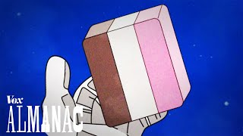
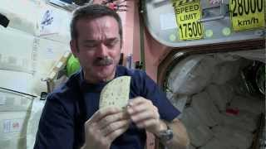
Space Food!
“Space Food” has a history going back to the 1960s. It has evolved a lot, from food in tubes and freeze dried products to familiar meals that taste more like home.
Let’s see what astronauts eat!
Notes:
Wwatch a couple more videos on space food.

Slide 25
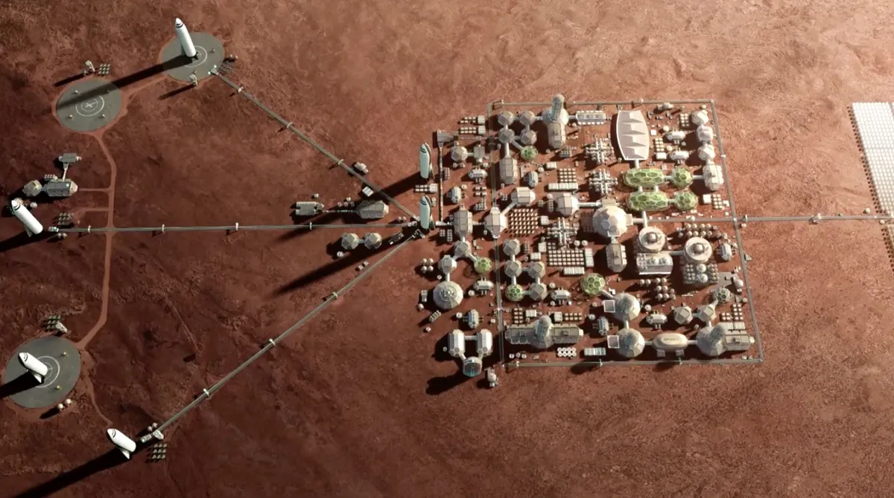
How to Feed a Mars Colony
Article Link
Read the article!
Comprehension Questions
How long would it take to grow a million-person population on Mars that doesn't rely on food from Earth?
What is identified as the major limiting factor for growing food on Mars?
What are the three main categories of food sources suggested by Cannon?
SpaceX aims to help establish a million-person city on Mars. What would all of those people eat? (Image credit: SpaceX)
https://www.space.com/how-feed-one-million-mars-colonists.html
Notes:
Distribute the article and comprehension questions from Lesson 2 handouts (PDF).
Instruct students to read on their own, in groups, or as a class.
Ask students to respond to the comprehension questions in their handout.
Discuss the comprehension questions.
image Source: SpaceX, https://www.space.com/how-feed-one-million-mars-colonists.html

Slide 26
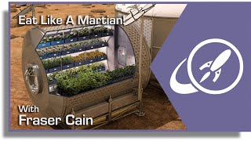
Optional Video
More on feeding a Mars colony
Notes:
If time allows and students are interested, watch the optional video further discussing how to feed a colony of 1 million people on Mars.

Slide 27
Exit Ticket
Questions to consider:
Would you be able to make your favorite foods on a Martian colony? What would you need to change?
Notes:
Before students leave class, ask them to complete the exit ticket on their handout, a piece of paper or their journals (or submit one through your virtual classroom).
Ask students to fill out their Daily Learning Log. (PDF)

Slide 28
Lesson 3
Moving to Mars:
Incorporating Space into Creative Writing
Notes:
View Lesson 3 Lesson plan here
View Lesson 3 handouts (PDF)

Slide 29
DO NOW
Reflect on a book or story that transported you to a different world. What was it? Describe the world. Share with a partner.
Notes:
As students enter classroom, have the Do Now prompt on the screen for them to respond to on their handout, journals or piece of paper.

Slide 30
Agenda
Do Now: Stories that transported us
Introduction to Ray Bradbury
Read & Respond: The Green Morning
Discussion
Exit Ticket
Notes:
Review the agenda for the lesson

Slide 31
OBJECTIVES
Students will be able to:
Identify Ray Bradbury as an important American Science Fiction author
Analyze the short story "The Green Morning”
Discuss and analyze the concept of world-building in Bradbury's storytelling
Notes:
Review the objectives for the lesson, so students know what is expected of their learning

Slide 32
Who is Ray Bradbury?
Ray Bradbury is known as one of the greatest Science Fiction writers of all time.
Most famously, he wrote Fahrenheit 451 and The Martian Chronicles. The Chronicles tell stories of humans settling on Mars and displacing the ancient natives, while they are also dealing with problems back home on Earth like the risk of nuclear war.

Slide 33
The Green Morning
“The Green Morning” is a classic science fiction story published in 1950 by Ray Bradbury in The Martian Chronicles. It was inspired by the 18th Century American story of Johnny Appleseed.
Before we begin, let’s review vocabulary and consider our thoughts on space travel!
Vocab & Agree/Disagree Handout
Did You Know? At the time Bradbury published the Martian Chronicles, not even a single satellite had been put into space yet!
Notes:
Photo Credit: Brenden Riley at https://www.flickr.com/photos/digitalsextant/4584512700

Slide 34
The Green Morning
Read the article!
Comprehension Questions
Why are trees so important to people on Mars?
Why does Benjamin Driscoll start planting trees?
How long did Benjamin Driscoll plant trees before it rained?
Did You Know? There was a real Johnny Appleseed! Learn more here.
If you enjoyed this short story, there’s plenty more! Try reading “The Million Year Picnic” from the Martian Chronicles, or some of its other stories.
Notes:
Distribute the article and comprehension questions from Lesson 3 handouts (PDF) .
Instruct students to read on their own, in groups, or as a class.
Ask students to respond to the comprehension questions in their handout.
Discuss the comprehension questions.
image Source: SpaceX, https://www.space.com/how-feed-one-million-mars-colonists.html

Slide 35
The Green Morning
Discussion!
What did we learn about the Mars Bradbury envisioned through this story? How would you describe it?
What was the atmosphere and temperature like?
How was the landscape described?
What type of food did they eat?
Who lived there?
What activities did people partake in?
What was the history of the planet?
In just a few pages, Bradbury built an entirely new world!
Notes:
Discuss the creative writing techniques of Bradbury. Encourage students to think about the ways in which Bradbury helped them to imagine the world of Mars while reading.
Tell students that they will get the chance to build a world together and then help others to imagine it through their newspaper articles they will be writing!

Slide 36
EXIT TICKET
Benjamin Driscoll got himself a job planting trees on Mars. If you lived on the settlement in the story, what job would you want to have?
Notes:
Before students leave class, ask them to complete the exit ticket on their handout, a piece of paper or their journals (or submit one through your virtual classroom).
Ask students to fill out their Daily Learning Log. (PDF)

Slide 37
Lesson 4
More SciFi
Creative Writing
Notes:
View Lesson 4 Lesson plan here
View Lesson 4 handouts here (PDF)

Slide 38
DO NOW
Describe how you envision the United States in 30 years. Be as descriptive as possible.
Notes:
As students enter classroom, have the Do Now prompt on the screen for them to respond to on their handout, journals or piece of paper.

Slide 39
Agenda
Do Now: Envisioning a future USA
Introduction to Octavia Butler
Read & Respond: Parable of the Sower excerpt
Discussion
Exit Ticket
Notes:
Review the agenda for the lesson

Slide 40
OBJECTIVES
Students will be able to:
Identify Octavia Butler as an important American Science Fiction author
Analyze an excerpt from The Parable of the Sower
Discuss and analyze the concept of world-building in Butler’s storytelling
Notes:
Review the objectives for the lesson, so students know what is expected of their learning

Slide 41
Who is Octavia Butler?
Octavia Butler is one of the greatest Science Fiction writers of all time.
She was the first science fiction writer to receive a prestigious MacArthur "genius" award and the first African American woman to win widespread recognition writing in that genre.

Slide 42
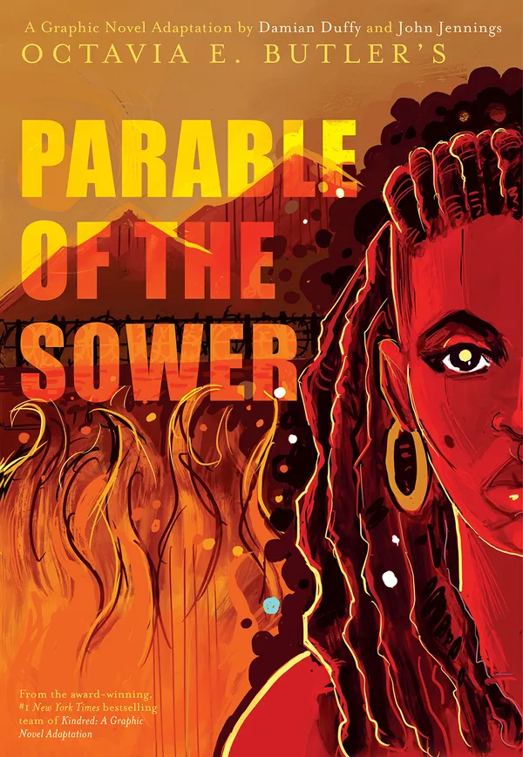
Parable of the Sower
Written in 1993, Parable of the Sower is a speculative fiction novel by American writer Octavia E. Butler. It is set in a post-apocalyptic Earth heavily affected by climate change and social inequality. The novel follows Lauren Olamina, a young woman who can feel the pain of others and becomes displaced from her home.
The cover of “The Parable of the Sower” graphic novel, an adaptation of the Octavia E. Butler book by Damian Duffy and John Jennings. Courtesy of Abrams Books.
Did You Know? In 2020 (27 years after it was written) Parable of the Sower finally landed on the New York Times bestseller list, due in part to the book's extreme relevance to current events.
Notes:
Photo Source: https://store.abramsbooks.com/products/parable-of-the-sower-1

Slide 43
Parable of the Sower
Read the article!
Comprehension Questions
What is the Window Wall?
What illegal business did the Yannis family run, and how did it help them and the neighborhood?
Why are people in the neighborhood upset about the money spent on space trips?
How does the protagonist view space exploration and colonization in contrast to her father's perspective?
The cover of “The Parable of the Sower” graphic novel, an adaptation of the Octavia E. Butler book by Damian Duffy and John Jennings. Courtesy of Abrams Books.
Notes:
Distribute the article from Lesson 4 Handouts and comprehension questions.
Instruct students to read on their own, in groups, or as a class.
Ask students to respond to the comprehension questions in their handout.
Discuss the comprehension questions.
image Source: SpaceX, https://www.space.com/how-feed-one-million-mars-colonists.html

Slide 44
The Green Morning
Discussion!
What did we learn about the world Butler envisioned through this story? How would you describe it?
How did the protagonist describe her neighborhood?
How were the people described?
What type of clothes were worn?
What were the politics of the society?
What activities did people partake in?
What societal challenges did you notice?
In just a few pages, Butler built an entirely new world!
Notes:
Discuss the world-building of this story and remind students that they will be building a world of their own!

Slide 45
EXIT TICKET
What kind of information can you provide a reader to help them understand the world of your characters?
Notes:
Before students leave class, ask them to complete the exit ticket on their handout, a piece of paper or their journals (or submit one through your virtual classroom).
Ask students to fill out their Daily Learning Log. (PDF)

Slide 46
Lesson 5
From Mars to Journalism (and back)
Notes:
View Lesson 5 Lesson plan here
View Lesson 5 handouts. (PDF)

Slide 47
DO NOW
What are some news outlets you are aware of? Do you have any favorites?
Notes:
As students enter classroom, have the Do Now prompt on the screen for them to respond to on their handout, journals or piece of paper.

Slide 48
Agenda
Do Now: News Outlets
Introduction: Making news & our Mars newspaper
Activity: Headlines & Leads
Discussion: News Beats
Exit Ticket
Notes:
Review the agenda for the lesson

Slide 49
OBJECTIVES
Students will be able to:
Describe the basic structure of a news article
Explain the most common “news beats”
Describe the key elements that should be included in an effective news article lead and headline
Notes:
Review the objectives for the lesson, so students know what is expected of their learning

Slide 50
Now What? The Mission
Through Unworldly, we will learn about outer space and the potential benefits of its exploration.
We will consider classic SciFi stories to understand creative world-building, and
We will practice creative writing and journalism skills to create a newspaper from the perspective of future outer space settlers.
Along with writing creative articles there will be the opportunity to create art for the newspaper
There’s a competition too!
Notes:
Remind students the trajectory of the Unworldly Initiative
Remind them that they have already learned about outer space and its exploration
Remind them that they have considered SciFi stories to see how they have incorporating ideas about outer space to build new and interesting worlds
Tell them that now we will move into the journalism and creative writing aspects of this initiative. They will learn journalism skills and then use those skills to collaborate and write a newspaper

Slide 51
Journalism: What is it?
Journalism is the practice of gathering, processing, and presenting news and information.
One of the most important aspects of journalism is crafting effective story leads - the opening sentence that captures the reader's attention and introduces the main idea of the article.

Slide 52
Story Leads & the Inverted Pyramid
Who, What, When, Where, Why, How…
These are the basic questions a news
story is supposed to answer,
right from the start.
Why do we use the inverted pyramid?
What goes in each level?

Slide 53
Story Leads: Guided Practice
Using the facts below, let’s create a one-sentence story lead!
*Remember: Only include the most important details.
Facts:
There was a car accident on Main Street.
One car turned at the intersection of Pine Street, striking the other.
The accident happened at 9pm
One driver was a middle aged woman.
She was taken to the hospital in an ambulance.
The other driver, a male teenager, was unharmed.
Police wrote him a summons for failing to signal.
Example: “A woman was injured in a car accident on Main Street tonight after she
collided with a motorist who allegedly failed to signal.”
Notes:
Walk students through crafting a story lead using the facts on the slide. Together, as a class, work to create a lead.
Discuss the example on the slide and how it compares to the one they created together.

Slide 54
Story Leads: Independent Practice
Try another one on your own:
Facts:
Who: The student council
What: Organizing a bake sale
When: This Saturday
Where: In the school cafeteria
How: To raise money for new sports equipment
Now write your own!
Example: This Saturday, the student council is turning up the heat in the school cafeteria with a sizzling bake sale to raise funds for shiny new sports equipment.
Notes:
Distribute Lesson 5 handouts. (PDF)
Ask students to complete the independent practice by writing a story lead for the facts on the slide.

Slide 55
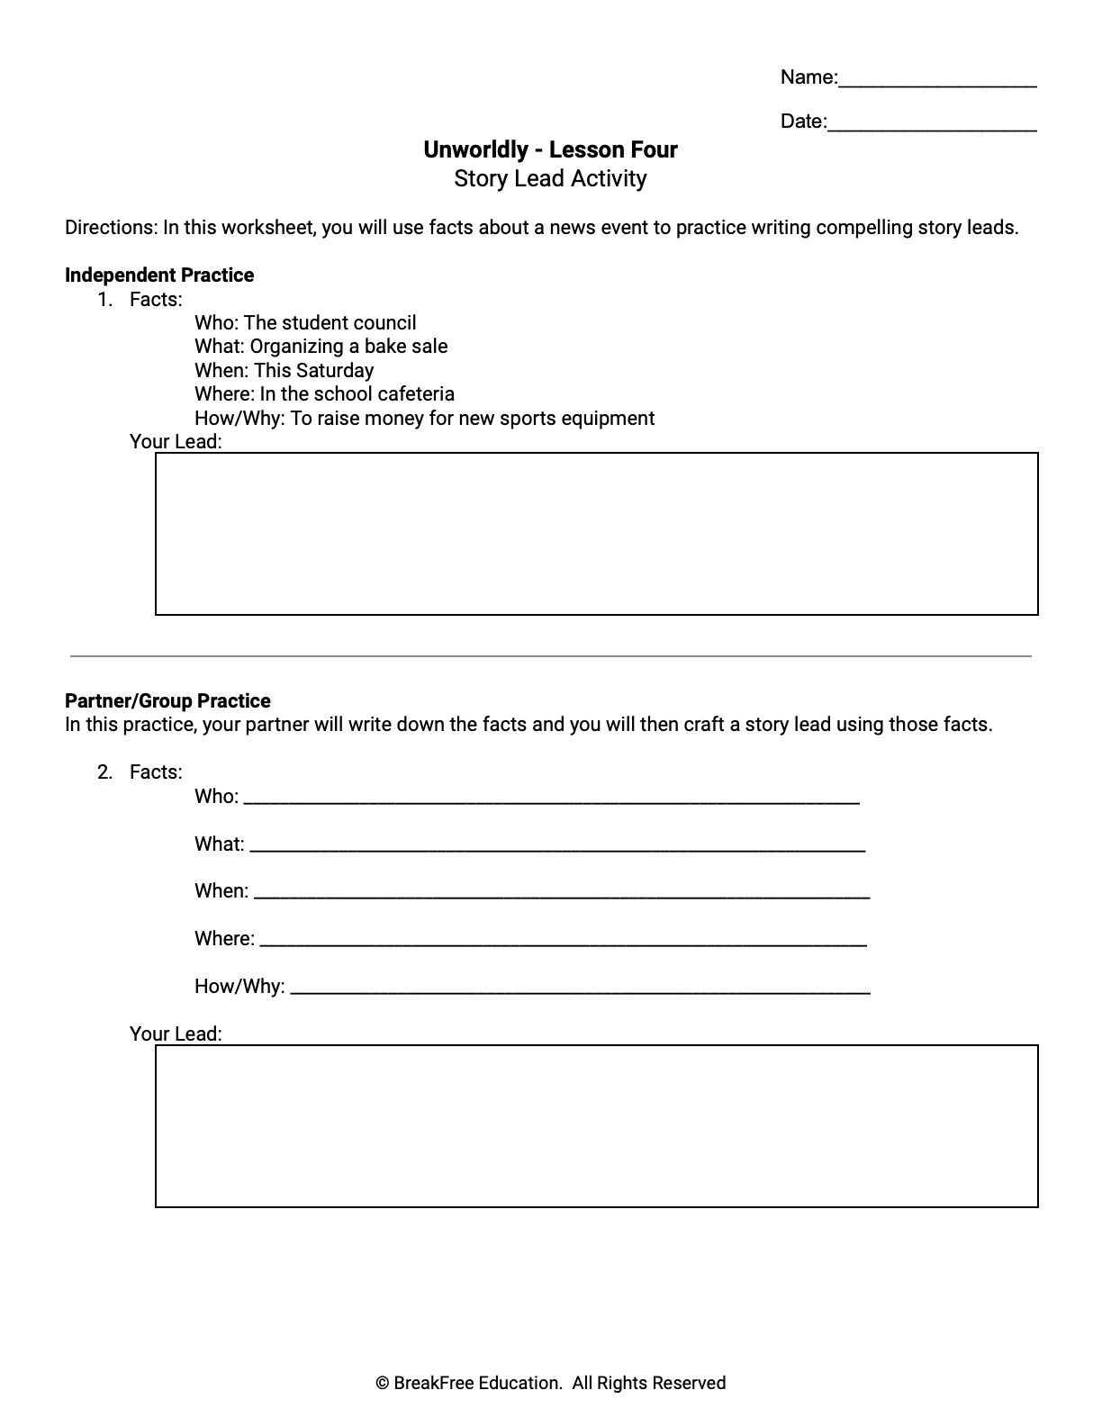
Story Leads: Partner/Group Practice
Work with a partner or group to complete the worksheet.
Pass your paper to a partner
Your partner will write down the facts and pass the paper back to you
You will then craft a story lead using those facts
Facts:
Who: _________________________________
What: ________________________________
When: ________________________________
Where: ________________________________
How/Why: _____________________________
Your Lead:
Notes:
Instruct students to work in groups or with a partner to follow the directions on the slide and complete their handout.

Slide 56
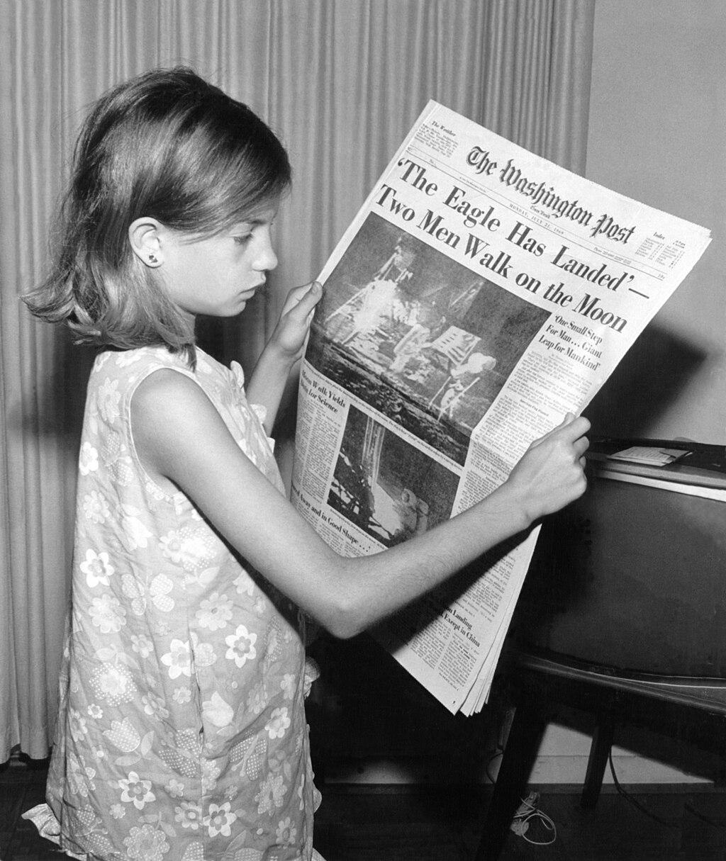
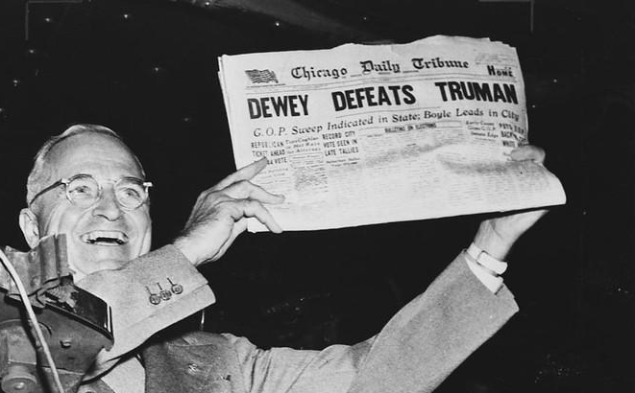
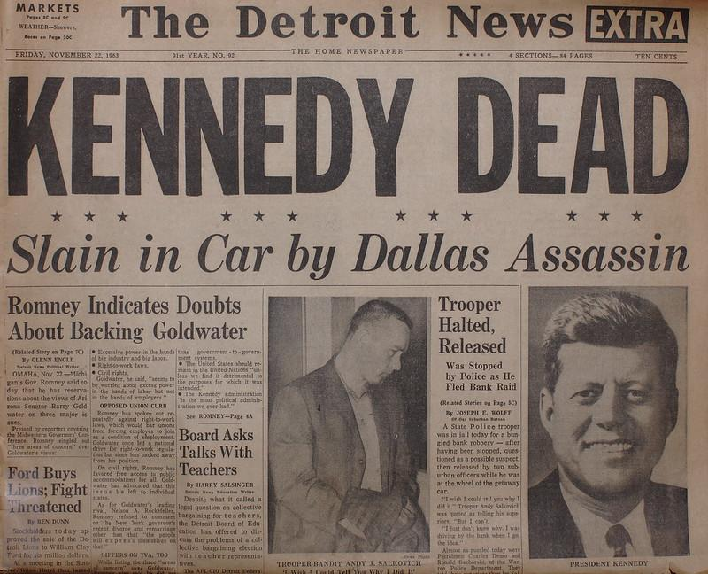
Headlines
A good and catchy headline can be the difference between your story going viral and nobody seeing it.
Famous Headlines:
Two Men Walk on the Moon
President Harry Truman showing one of the most famous newspaper headline mistakes ever.
Kennedy Dead, Slain in Car by Dallas Assasin
Notes:
Introduce the concept of newspaper headlines and review some examples
Photo Sources:
Kennedy - Ray Dumas at https://www.rd.com/wp-content/uploads/2019/10/killing-kennedy-tv-show-promotion-in-herald-square-new-york-america-06-nov-2013-scaled.jpg?fit=700,700
Truman - GPA Photo Archive, "Dewey Defeats Truman," November 3, 1948. Records of the U.S. Information Agency, National Archives at https://www.flickr.com/photos/iip-photo-archive/29855784945
Moon Landing - Jack Weir (1928-2005), Public domain, via Wikimedia Commons at https://commons.wikimedia.org/wiki/File:Land_on_the_Moon_7_21_1969-repair.jpg

Slide 57
Headlines - Do’s & Don'ts
Do
Keep it concise and to the point (6-8 words, generally).
Use strong, active verbs to make the headline engaging.
Include key information like who, what, when, where, and why.
Make it attention-grabbing to attract readers.
Check for spelling and grammar errors before publishing.
Don’t
Use vague language.
Include jargon or complex words readers may not understand.
Mislead readers with exaggerated claims.
Include information that isn’t in the story.
Add opinion to the headline.
Notes:
Review the Do’s and Don’ts for newspaper headlines.

Slide 58
Headlines - Examples
Effective Headlines:
"Local High School Wins State Basketball Championship"
"New Study Reveals Alarming Rise in Pollution Levels"
"Mayor Announces Plan to Improve Public Transportation"
Ineffective Headlines:
"Big Event Happening Soon!"
"City Faces Crisis"
"You Won't Believe What Happened Next!"
What makes these ineffective?
Notes:
Review and discuss the headline examples. Why are some effective and some ineffective?
Remind students: A well-crafted headline can draw readers in and make them want to read the full article. Take your time to create headlines that are accurate, clear, and compelling to ensure your newspaper captures the attention of your audience.

Slide 59
What Are News Beats?
In journalism, "beats" refer to specific topics or areas that reporters are assigned to cover regularly. These beats help journalists specialize in certain areas, becoming experts in that particular subject matter.
Some of the main news beats in a newspaper include:
Reporters covering these beats gather information, conduct interviews, and write stories to keep the public informed about important events and developments within these specific areas.
Politics
Crime
Education
Sports
Entertainment
Health
Business
Technology
Travel/Food
Notes:
Introduce what news “beats” are and discuss the main ones.

Slide 60
The Mission: Our Newspaper
Our mission is to create a newspaper from the perspective of future outer space settlers.
We will:
Work together to world-build our planet and settlement
In the next lesson, we’ll choose a real–or create a new–planet, as well as other aspects of our futuristic settlement
Each select a beat topic and write newspaper articles
You may also elect to create accompanying graphics
Be creative & have fun!
Notes:
Remind students that through this initiative, the goal is to create a class-wide newspaper from the perspective of settlers of an outer space colony
Review what is coming up in the next lessons.

Slide 61
EXIT TICKET
Question
What news beat would you be interested in covering for the newspaper project?
Notes:
Before students leave class, ask them to complete the exit ticket on their handout, a piece of paper or their journals (or submit one through your virtual classroom).
Ask students to fill out their Daily Learning Log. (PDF)

Slide 62
Lesson 6
World Building
Notes:
View Lesson 6 Lesson plan here
View Lesson 6 handouts (PDF)

Slide 63
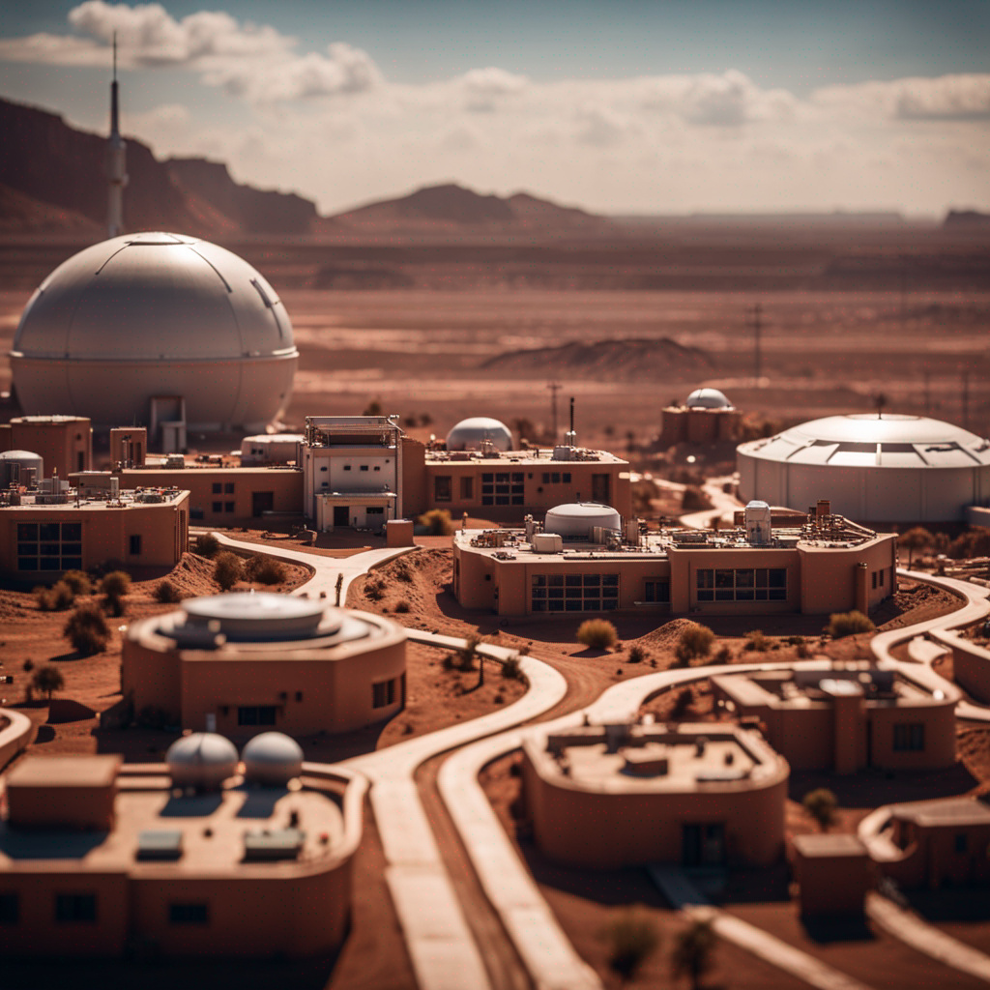
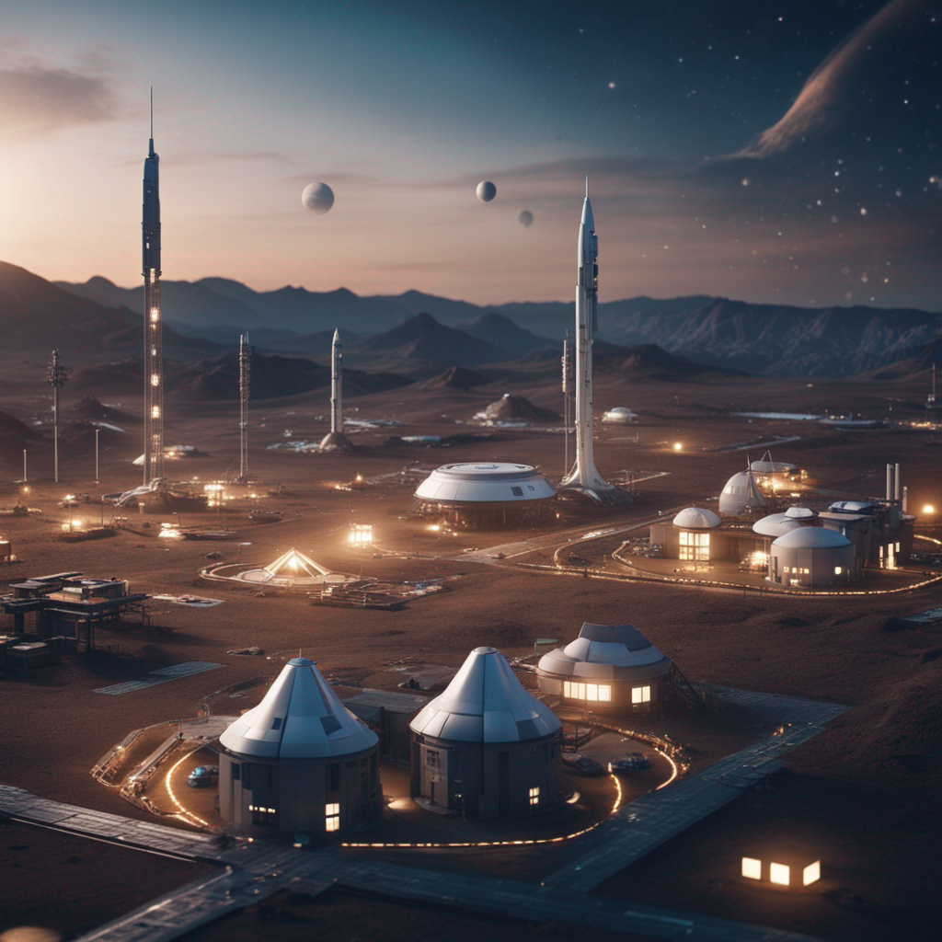
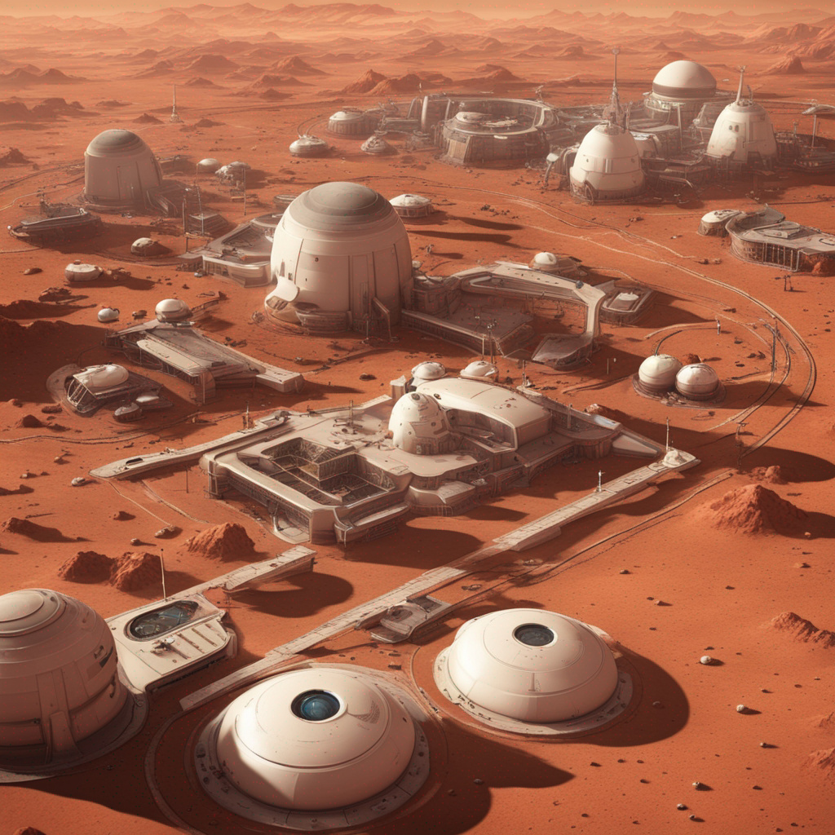
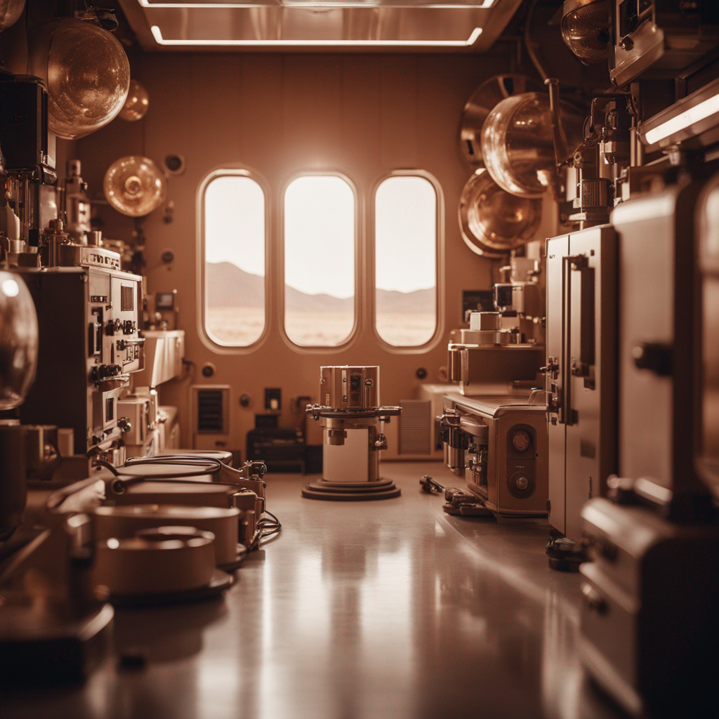
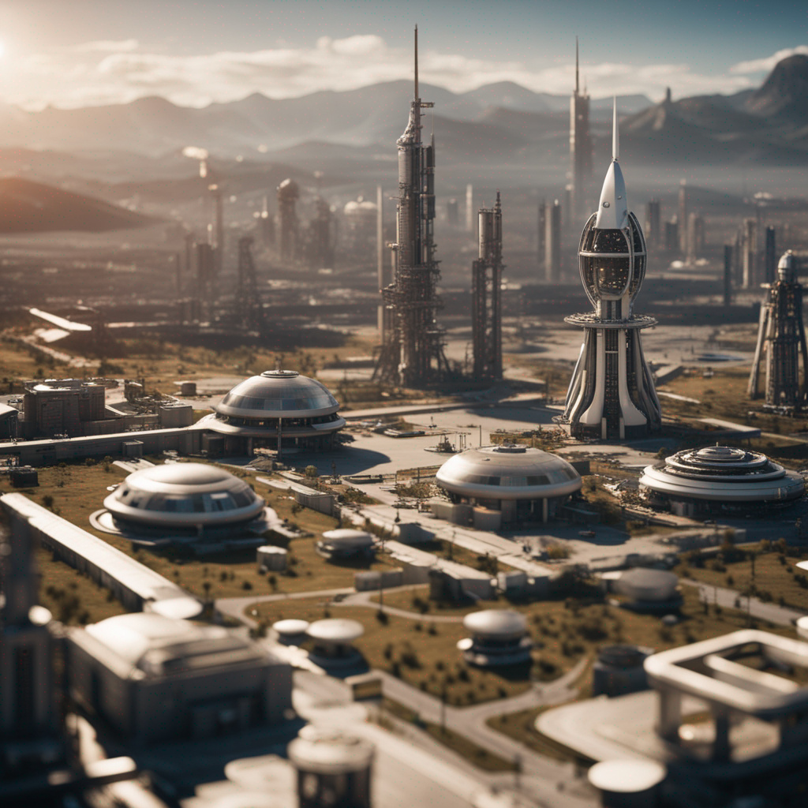
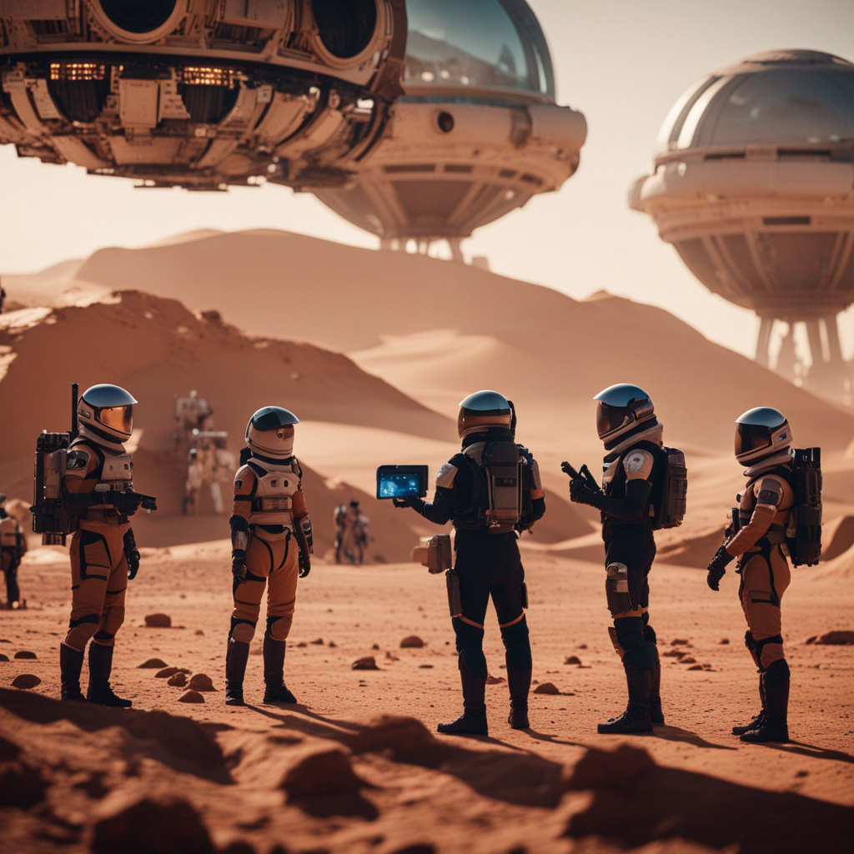
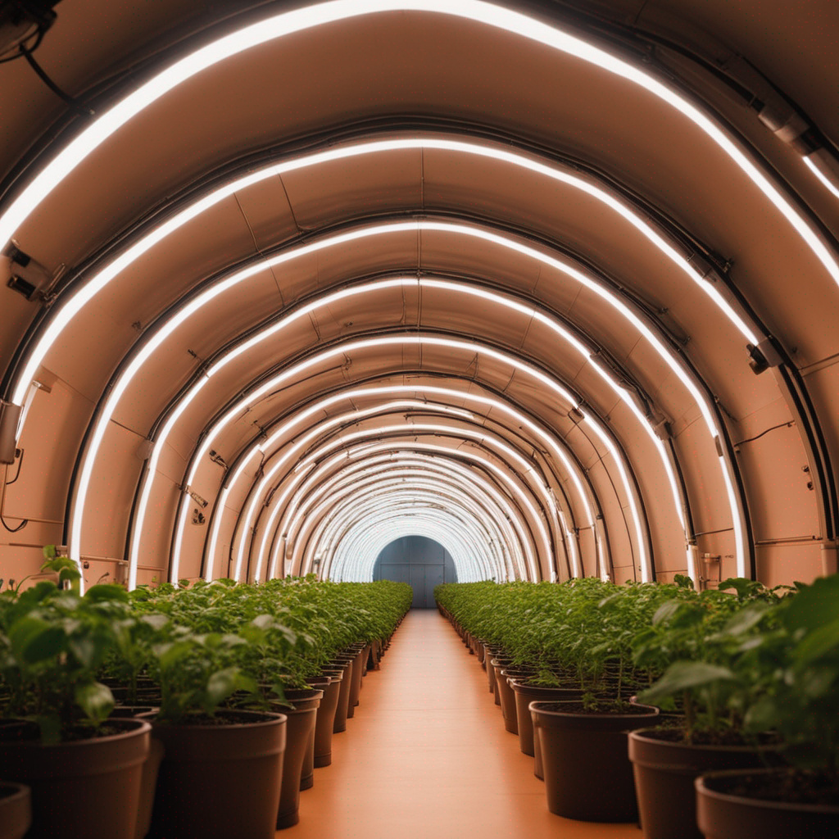
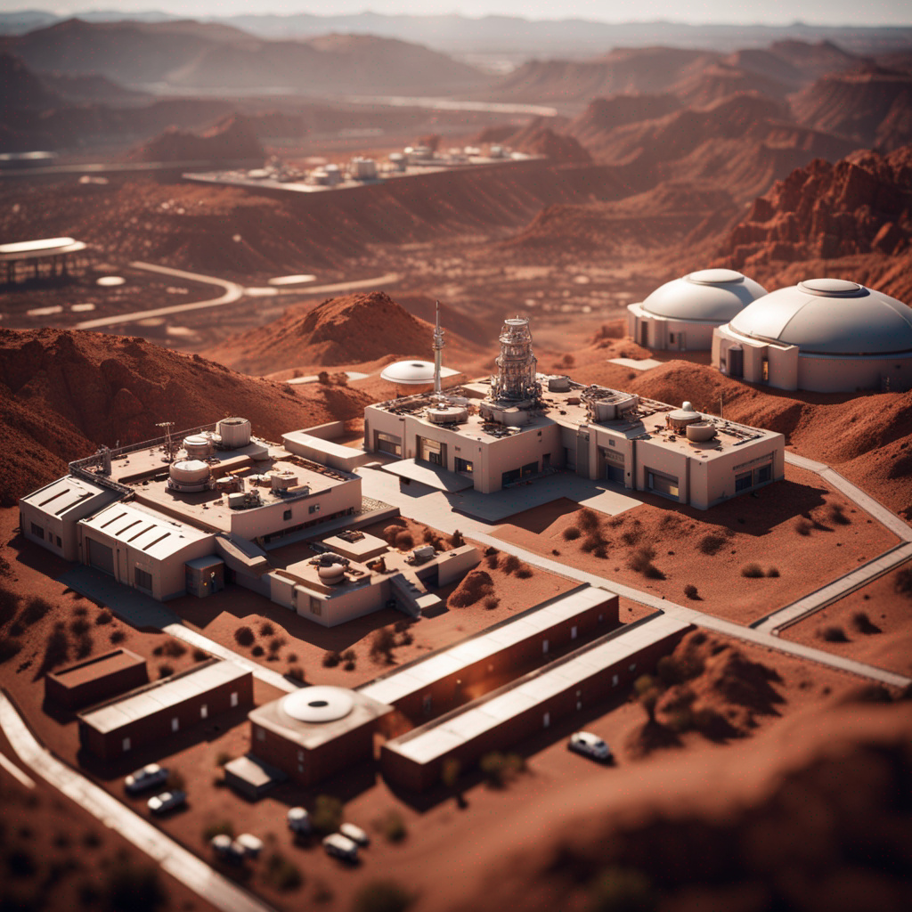
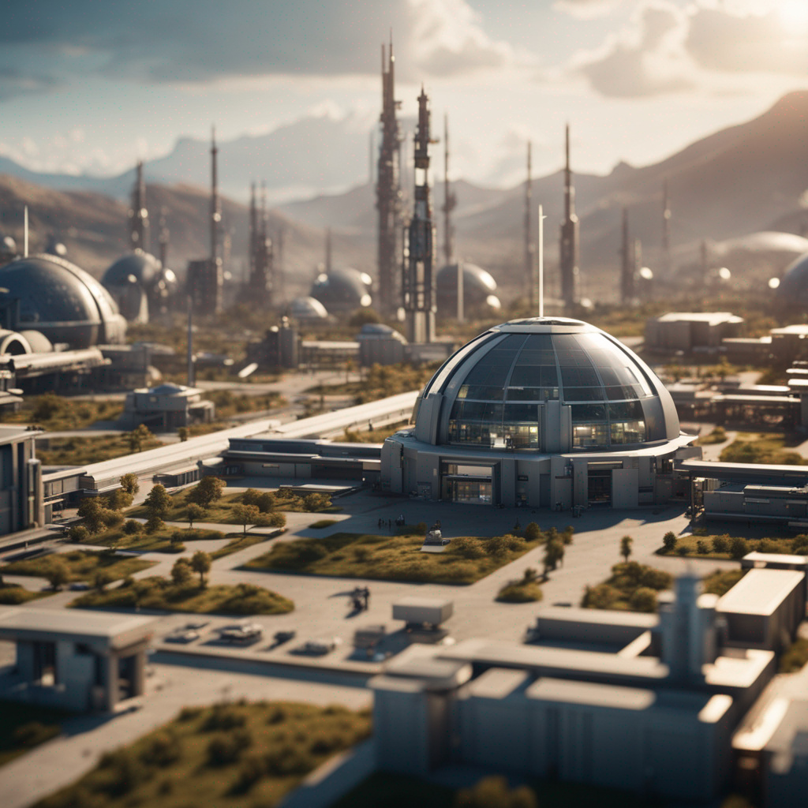
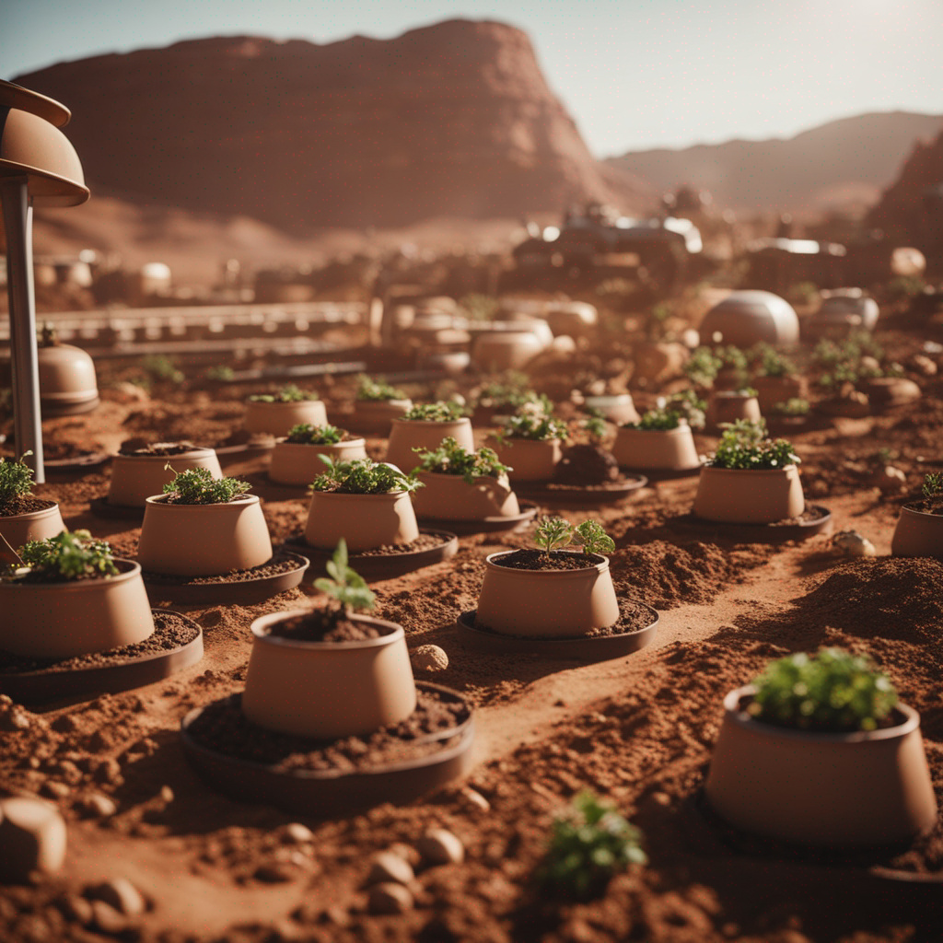
DO NOW
Consider the images. What do you see, think, and wonder?
Notes:
As students enter classroom, have the Do Now prompt on the screen for them to respond to on their handout, journals or piece of paper.
Image Source: Images created using Devianart

Slide 64
Agenda
Do Now: See, Think, Wonder - AI space settlement art
Introduction: World-Building
Activity: Building our World
Exit Ticket
Notes:
Review the agenda for the lesson

Slide 65
OBJECTIVES
Students will be able to:
Use their imagination and creativity to design a new world
Describe the key elements that should be considered when world-building for creative writing
Collaborate with peers to make collective decisions
Notes:
Review the objectives for the lesson, so students know what is expected of their learning

Slide 66
World-Building
World-building is the process of creating a detailed and immersive setting for a story. It is essential for bringing the narrative to life and making it more engaging for the readers.
We need to create a world together, so our newspaper is consistent and engaging!
Brainstorming Activity:
Imagine yourselves as pioneers on a new planet in outer space. What elements would be crucial for your survival and community development?
What essential resources, environmental conditions, and social structures are needed for a thriving community on a distant planet
Notes:
Introduce the concept of “world-building” and its importance in creative writing.
Explain why it is essential that students collectively build their world together, so that their newspaper is consistent and cohesive
Ask students to brainstorm what would be important for them, if they were pioneers on a new planet. Allow students to get their creative juices flowing!

Slide 67
World-Building: Key Elements
Planet Characteristics:
Defining the planet's climate, geography, flora and fauna establish a unique and believable setting.
Society & Culture:
Details like religion, professions, entertainment, technology, transportation, and architecture shape the daily lives of inhabitants in the story.
Government & Politics:
Government and interpersonal relationships help to build a rich and dynamic community within the narrative.
By understanding and incorporating these key elements, you can create captivating stories that transport readers to new and exciting worlds.
Notes:
Discuss the key elements to any form of creative world-building.

Slide 68
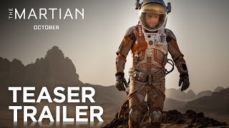
World-Building Examples
Think back to the stories we read earlier (Bradbury & Butler)... what type of worlds did the authors build with their writing?
What about the movie trailers here? What do you notice about these worlds?
Notes:
Remind students about the worlds they read about in the short stories by Ray Bradbury and Octavia Butler.
If time allows, watch the movie trailers and ask students to consider what they learned about the worlds of these stories/movies simply by watching the trailer.

Slide 69
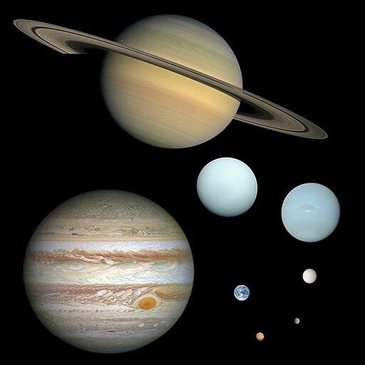
Building Our World
Let’s get started building our world! We’ll do this together so that our newspaper pieces are consistent. It’s okay if we don’t have answers to everything!
Planet Characteristics: The Basics
What planet is our settlement on? (existing or fictional)
What is the name of our settlement? What are the settlers called?
How long ago was our settlement started?
How far away from Earth is our settlement? How long does it take to get back and forth?
Notes:
Distribute Lesson 6 handouts (PDF)
As you discuss the questions on the slide, instruct students to write down the choices/decisions the class makes collectively
Note: Do your best to encourage debate and discussion among students as they consider possible answers to these questions. Where there is disagreement, it may help to leave the question and come back to it once other determinations are made, or it may not be a necessary detail to be determined at all. Remind students this is a fun and creative process, they are not limited on what they can come up with!
Image Source: CactiStaccingCrane, CC BY-SA 4.0 <https://creativecommons.org/licenses/by-sa/4.0>, via Wikimedia Commons

Slide 70
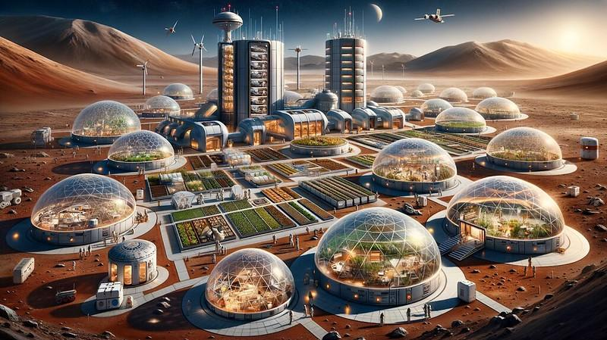
Building Our World
Planet Characteristics: The Environment
What is the geography? (what are common landscape elements–mountains, oceans, deserts, etc.)
What is the climate?
What is the weather?
What plants exist there?
What animals exist?
Notes:
Have students follow along using Lesson 6 handouts (PDF)
As you discuss the questions on the slide, instruct students to write down the choices/decisions the class makes collectively
Note: Do your best to encourage debate and discussion among students as they consider possible answers to these questions. Where there is disagreement, it may help to leave the question and come back to it once other determinations are made, or it may not be a necessary detail to be determined at all. Remind students this is a fun and creative process, they are not limited on what they can come up with!
Image Source: Fryer, Wesley. Mars Colony (AI Drawn). photo, 2 Nov. 2023. Flickr, https://www.flickr.com/photos/wfryer/53304684987/.

Slide 71
Building Our World
People & Customs
What is the population size?
What is the population age? (are there adults & children? Men & women? Are people born there or do they only arrive from Earth?)
What do people wear?
What do people eat?
What celebrations do the people participate in?
Notes:
Have students follow along using Lesson 6 handouts (PDF)
As you discuss the questions on the slide, instruct students to write down the choices/decisions the class makes collectively
Note: Do your best to encourage debate and discussion among students as they consider possible answers to these questions. Where there is disagreement, it may help to leave the question and come back to it once other determinations are made, or it may not be a necessary detail to be determined at all. Remind students this is a fun and creative process, they are not limited on what they can come up with!
Image Source: AI Drawn via Devianart

Slide 72
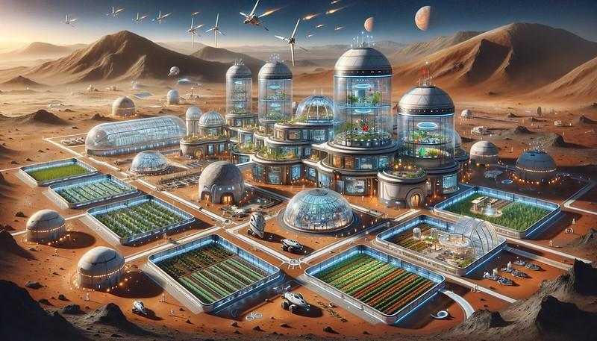
Building Our World
Society & Culture
What are the jobs people hold in our settlement?
What forms of entertainment are there?
What are the modes of transportation?
What technology do people use?
What does the architecture look like?
Is there a religion? Multiple religions?
Notes:
Have students follow along using Lesson 6 handouts (PDF)
As you discuss the questions on the slide, instruct students to write down the choices/decisions the class makes collectively
Note: Do your best to encourage debate and discussion among students as they consider possible answers to these questions. Where there is disagreement, it may help to leave the question and come back to it once other determinations are made, or it may not be a necessary detail to be determined at all. Remind students this is a fun and creative process, they are not limited on what they can come up with!
Image Source: Fryer, Wesley. Mars Colony (AI Drawn). photo, 2 Nov. 2023. Flickr, https://www.flickr.com/photos/wfryer/53304684957/in/photostream/.

Slide 73
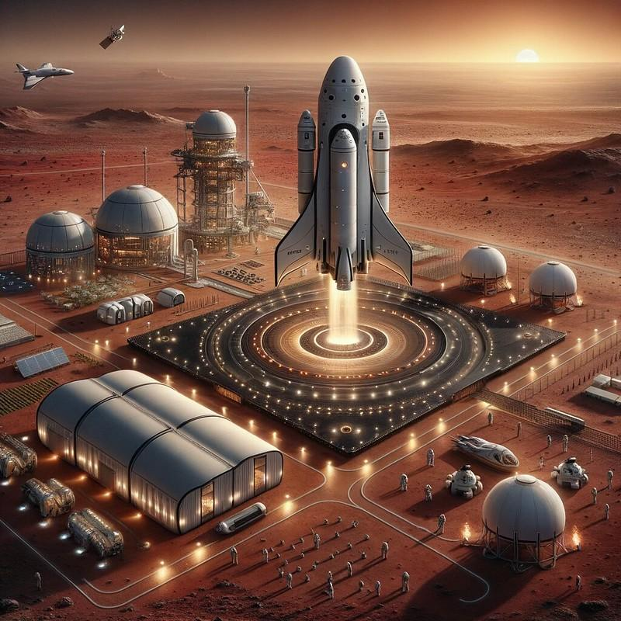
Building Our World
Government & Politics
How is our settlement governed? Who is in charge? (Mayor? President? How are they elected?)
Are there any political concerns? (Inequality? Crime? Hunger?)
Anything else?
Notes:
Have students follow along using Lesson 6 handouts (PDF)
As you discuss the questions on the slide, instruct students to write down the choices/decisions the class makes collectively
Note: Do your best to encourage debate and discussion among students as they consider possible answers to these questions. Where there is disagreement, it may help to leave the question and come back to it once other determinations are made, or it may not be a necessary detail to be determined at all. Remind students this is a fun and creative process, they are not limited on what they can come up with!
Image Source: Fryer, Wesley. Mars Landing 1 (AI Drawn). photo, 2 Nov. 2023. Flickr, https://www.flickr.com/photos/wfryer/53305742086/in/photostream/.

Slide 74
We have our world… now let’s tell others about it!
Newspapers inform and educate readers about current events and issues of concern happening within a community. Now that we’ve built our world it’s time to start thinking about what we want to share in our newspaper articles.
Possible creative news articles:
Interview a community member (politician, scientist, business leader, etc.)
Write about a safety issue (radiation leak, missing person, ship crash, etc.)
Write about the newest business in the settlement or a new artist/musician or a celebrity coming to visit.
Write a sports article involving the settlement.
Something mysterious has been found (ancient life, aliens, pyramids, etc.)
People are becoming unhappy or concerned with some part of life on the planet.
The next rocket is expected to bring something from Earth that everyone misses (maybe a type of food, a drum set, or chickens).
Notes:
Tell students, now that they have created details and collectively built their world, they get to move on to the creative writing portion of the project and write a newspaper article. Throw out examples of possible article ideas.
Ask students to brainstorm additional ideas out loud.

Slide 75
EXIT TICKET
Brainstorm ideas for the article you will write for our newspaper. Note: Tomorrow we will select our beats!
Notes:
Before students leave class, ask them to complete the exit ticket on their handout, a piece of paper or their journals (or submit one through your virtual classroom).
Ask students to fill out their Daily Learning Log. (PDF)

Slide 76
Lesson 7+
Making the publication
Notes:
View Lesson 7 Lesson plan here
View Lesson 7 handouts (PDF)

Slide 77
DO NOW
Consider the newspaper article headlines below and match them with the beat category they would fall under.
Headline
The 5 Best Day-Trips from Colony X
Snoop Dogg Visits Mars Colony
New Science Reveals Solutions to Human Lung Capacity
Three Wounded in Ice Storm
Settlers Elect New Town Mayor
The First Target Opens on Mars
Beat
Healthcare
Business
Weather
Entertainment
Politics
Travel/Food
Notes:
As students enter classroom, have the Do Now prompt on the screen for them to respond to on their handout, journals or piece of paper.
Answers:
F
D
A
C
E
B

Slide 78
Agenda
Do Now: Headlines & Beats
Introduction: Making our newspaper & Choosing our beats
Activity: Write your article!
Activity: Peer Review
Exit Ticket
Notes:
Review the agenda for the lesson

Slide 79
OBJECTIVES
Students will be able to:
Incorporate creative and imaginative elements in writing
Create a cohesive and engaging newspaper article
Utilize descriptive language to bring a fictional space colony to life
Notes:
Review the objectives for the lesson, so students know what is expected of their learning

Slide 80
Select Your Beat
Let’s review the list of possible beats and select which beat everyone wants to cover.
Remember: We need a variety of beats in our newspaper, so we can’t all write on the same topics. You may need to be flexible!
Politics
Crime
Education
Weather
Sports
Health
Business
Technology
Travel
Food
Entertainment
Other
Notes:
Remind students about the different newspaper beats
Ask students to go around the room and select the story beat they want to write their newspaper article under
Remind students that a variety of beats need to be covered in the newspaper.
If more than one student wants to cover a particular beat, perhaps the students can co-author the article
If students are unsure of what beat they want to cover, consider having a hat/bag from which students can draw a beat from

Slide 81
Write Your Article!
Based on the news beat you chose, use the handout to start writing your articles for our fictional news publication.
Remember: We are writing from the perspective of human settlers living on a new planet in the future.
Give your articles headlines and strong story leads.
Keep your articles short - Ideally under 300 words.
Consider artwork or photos to accompany your articles
When our articles are written, we will compile them into the newspaper!
Notes:
Distribute the Lesson 7 handouts (PDF) and instruct students to work through it to draft their article.
Remind students to consider the notes on the slide

Slide 82
Unworldly Newspaper Competition!
You will have the opportunity to write and contribute a story to our class’s newspaper.
We will enter our newspaper into BreakFree Education’s nationwide competition!
National winners will win a prize!
Notes:
Remind students about the BreakFree Education Unworldly Newspaper competition
Tell students that the competition is nationwide and that winners will receive prizes
Explain that your class/school will put their articles together to form a cohesive newspaper, and that newspaper will be submitted to the competition
Tell students the details of the newspaper competition
It will be 3-4 minutes long
It will be on a specific prompt (next slide)
They will submit both their written speech along with an audio recording of them presenting it
Our How-To guide also offers assistance in how to record students’ speeches
For additional competition information, view the guidelines here

Slide 83
Unworldly Newspaper Rubric
 | Exemplary (5) | Accomplished (4) | Emerging (3) | Developing (2) | Beginning (1)
Design & Layout | The newspaper layout is visually appealing, with a consistent and professional design that enhances the reading experience. | The newspaper layout is generally well-designed, with a coherent appearance that is easy to navigate. | The newspaper layout is somewhat organized, but could use improvement in consistency and visual appeal. | The newspaper layout lacks cohesion and visual appeal, making it difficult to read and navigate. | The newspaper layout is disorganized and unappealing, detracting from the overall quality of the work.
Creativity | The newspaper articles demonstrate a high level of creativity, with a wide variety of unique and engaging topics that effectively build a cohesive fictional world. | The newspaper articles are creative, with a good variety of topics that contribute to the fictional world. | The newspaper articles show some creativity, but the variety of topics and the cohesiveness of the fictional world could be improved. | The newspaper articles lack creativity, with a limited range of topics and a poorly developed fictional world. | The newspaper articles are not creative, with a lack of variety and a poorly constructed fictional world.
Clarity & Grammar | The newspaper articles are well-written, with clear and concise language, strong headlines, and engaging story leads that are free of grammatical errors. | The newspaper articles are generally well-written, with clear language, appropriate headlines, and story leads that have few grammatical errors. | The newspaper articles have some issues with clarity and grammar, with inconsistent language, headlines, and story leads that contain several errors. | The newspaper articles struggle with clarity and grammar, with language that is difficult to understand, inappropriate headlines, and story leads that contain numerous errors. | The newspaper articles are poorly written, with language that is unclear, inappropriate headlines, and story leads that are riddled with grammatical errors.
Collaboration | The newspaper articles demonstrate a high level of collaboration, with a clear and cohesive representation of the fictional world that is consistent across all articles. | The newspaper articles show good collaboration, with a generally cohesive representation of the fictional world, with only minor inconsistencies. | The newspaper articles exhibit some collaboration, but the representation of the fictional world is somewhat inconsistent across the articles. | The newspaper articles lack collaboration, with a poorly developed fictional world that is inconsistent and disjointed across the articles. | The newspaper articles show no collaboration, with a fictional world that is not cohesive or consistent across the articles.
Notes:
Review the rubric with students and remind them this is the rubric with which their newspapers will be scored for the competition. Encourage them to consider these categories when writing their articles.

Slide 84
Considerations for Designing Our Paper
Once our articles are written, we will need to compile them in an organized and well-designed full newspaper. Here are some considerations when it comes time to do this:
Use Word or Google Docs, with the stories and smaller images arranged in a two column format. Word wrap the images.
Use a Canva template or google template or word template
Elect one or two students to lead the layout and design process.
Give your publication a name and date (March 3, 2078?) and ideally, a logo or name at the top of its front page.
Notes:
Review the considerations for when designing the newspaper
Optional template links are provided.

Slide 85
Peer Review (Optional Activity)
We can help ourselves grow stronger in our writing when we seek and offer feedback!
Feedback is most helpful when it is honest and offers ways of improvement. Look at the difference between the examples and discuss why some are better than others.
Ex) “That’s really good!” | Ex) “That’s a great idea! The story is interesting and uses descriptive words that let the reader understand the world.”
Ex) “I didn’t like your writing.” | Ex) “Your headline is a little short and misleading. Could you use more specifics to help set the story’s subject?”
Notes:
Use the examples on this slide to discuss the importance of honest feedback.

Slide 86
Peer Review (Optional Activity)
Ideas you love
Positive criticisms
Questions you have
Ideas to make
it better
Notes:
Teacher notes
Use this printable activity to have students provide feedback for 2-3 peers then allow students time to reflect on the feedback and make changes to their articles. The heart is for things you liked about the article. The settings/gear wheel is for items that can be improved but worded in a positive way. The question mark is for items that did not make sense or need clarification. The lightning bolt is for suggestions to make the article better.
Once students draft their article and receive peer feedback, they can revise for their final version to be included in the newspaper.

Slide 87
EXIT TICKET
Share a brief summary of your article with a partner. Write down what your partner is writing about.
Notes:
Before students leave class, ask them to complete the exit ticket on their handout, a piece of paper or their journals (or submit one through your virtual classroom).
Ask students to fill out their Daily Learning Log. (PDF)

