Slide 1
UNLEASHED

Slide 2
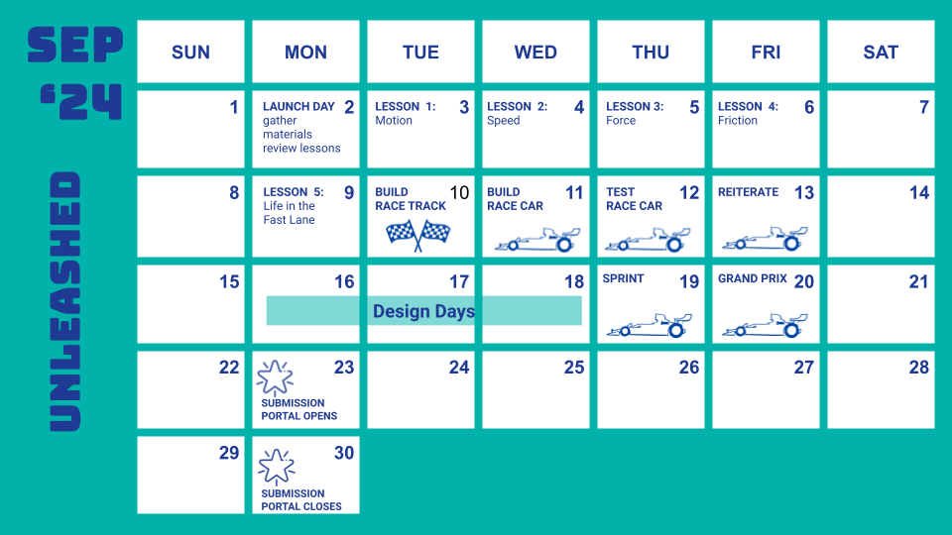
Suggested Calendar
Notes:
Teacher notes:
Please note, this is a suggested calendar. Feel free to adapt to fit your schedule.

Slide 3
Lesson 1
MOTION
Notes:
Unleashed Lesson 1:

Slide 4
DO NOW
Question:
What is motion?
Notes:
Teacher notes:
discuss as a class and/or have students keep a learning journal throughout this initiative
This question acts as a period knowledge check to see what students already know about motion.

Slide 5
OBJECTIVE
Students will
Define motion
Understand the importance of motion
Explain why motion is important in everyday life
Notes:
Teacher notes:
Review the objectives for the day, so students know what is expected of their learning

Slide 6
AGENDA
Do Now
Introduction of Motion (& class experiment)
Activity: Think - Pair - Share
Exit Ticket
Notes:
Teacher notes:
Review the agenda for the day

Slide 7
Introduction
Students will study the concepts of force and motion and get a glimpse of life in the fast lane with Formula 1 racing! The Unleashed initiative will showcase student knowledge through building a balloon powered race car.
Don’t forget, there’s a competition too!
Notes:
Explain to students that by the end of this unit, they will be asked to design and build a balloon powered race car. Anytime something sparks their imagination, they should make a note of it. Explain BreakFree’s monthly contest and pass out the Note to Students.

Slide 8
What is Motion?
MOTION is the change of position. Motion is everywhere you look - the earth revolving around the sun, closing a door, running or walking, air coming in and out of our lungs is all motion.
DID YOU KNOW: Any time your position changes, YOU are in motion.
Notes:
Teacher notes:
Explain the definition of motion and discuss other possibilities for what could be motion.
Other examples: running, cycling, jumping, swimming, eating, drinking, playing, writing, typing, moving cars, throwing ball, breathing, ticking of a clock, etc

Slide 9
Relative Motion
If you see a truck driving at 50 miles an hour, to you, the truck appears to be moving. However, if you were in a car also driving 50 miles an hour next to the truck, the same truck wouldn’t seem to move at all.
DID YOU KNOW: Motion is relative. It is always described in relation to a reference point.
Notes:
Teacher notes:
Explain relative motion and discuss what a reference point could be? Ask students if they can come up with another example.

Slide 10
Reference Point
The object that appears to not be moving (mailboxes, bikes, driveways, etc) is what is known as a reference point.
When you were in the hallway today, how did you know that you were moving?
You compared yourself to the walls, tiles, and even other classmates. Those were all reference points. They helped you to determine that you were in fact moving.
Notes:
Teacher notes:
Discuss what the references point might have been on their way to class.

Slide 11
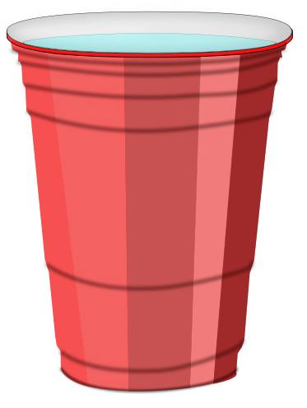
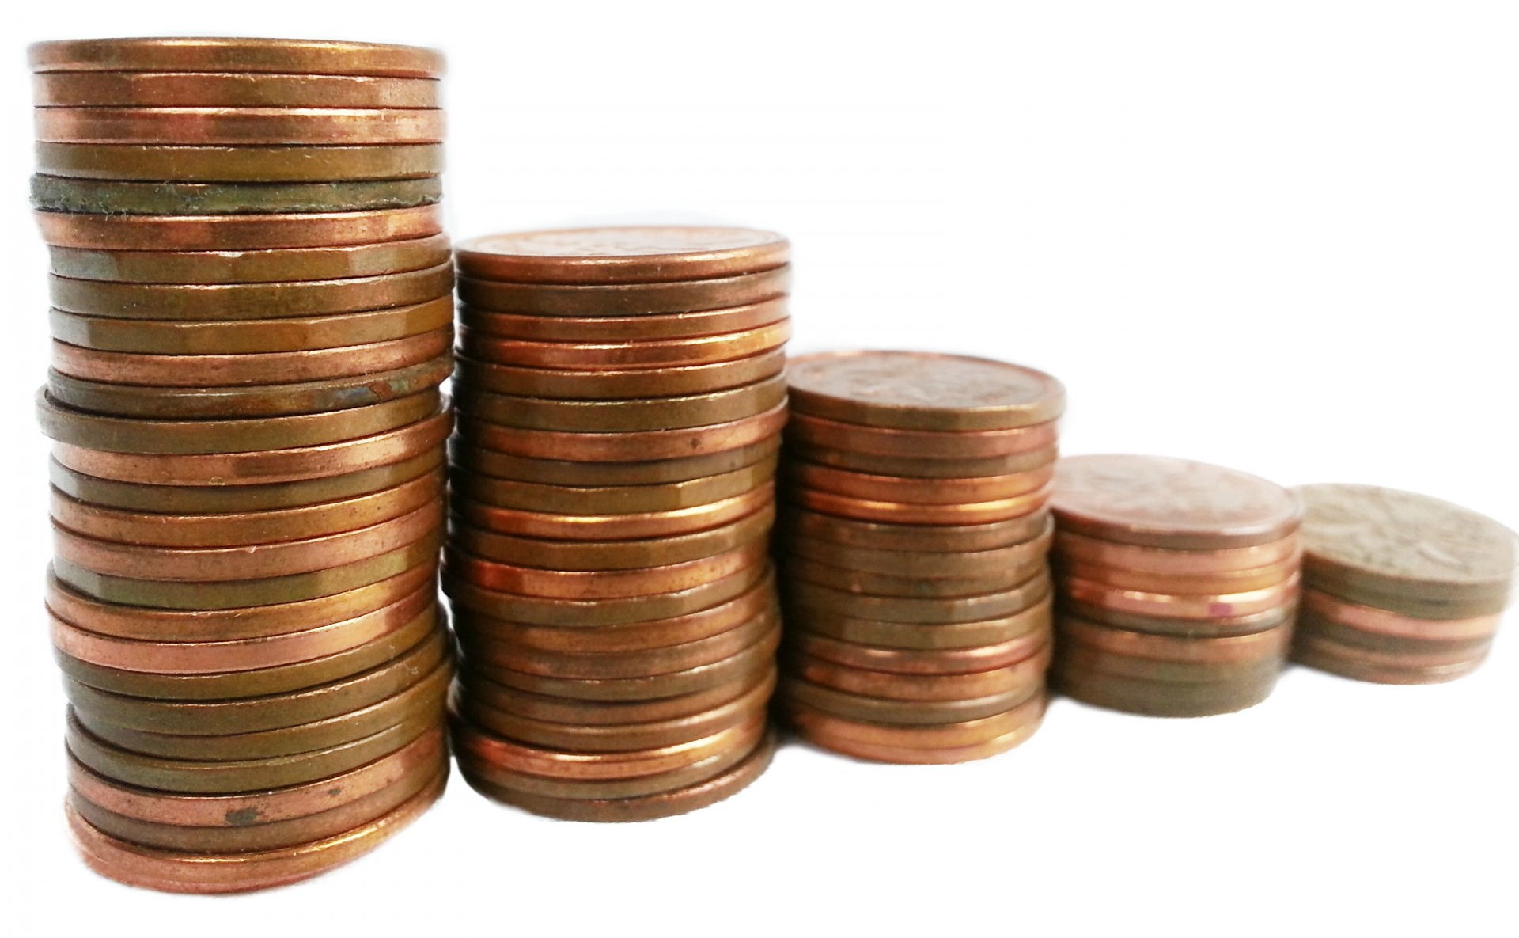
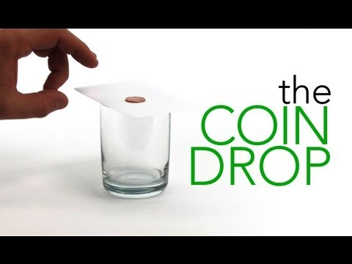
Experiment!
1. Gather the materials!
2. Watch this video!
3. Try it out then answer these questions!
A
Which object is not in motion?
B
What causes the penny to fall?
C
What is the reference point?
Notes:
Teacher notes:
Experiment: “Sir Isaac Newton has had a lock on this outcome since the 17th Century. The First Law of Motion (there are three) says something like this: “An object at rest stays at rest unless an outside force is strong enough to make it move. An object that is moving, will continue moving at the same speed in a straight line unless an outside force is strong enough to speed it up, slow it down, stop it, or cause it to change direction.” In the case of the Coin Drop activity, the penny is at rest sitting on top of the card. Watch it as long as you like but, on it’s own, the penny will not move from that spot. When you flick the card out from under the penny, you allow gravity (an outside force) to act on it and drop it into the glass. The bottom of the glass stops the penny from falling. However, if the penny were a lot heavier (had more mass) and were falling much faster, it could go right through the glass (and probably the table supporting it, too). So, why doesn’t the penny take off when the card is flicked? If you flick the card correctly, it simply slides out from between the glass and the penny. There’s not enough friction from the card to take the penny with it” (source).
Watch the video on the slide (also linked here).
Have students attempt the activity with one penny/coin then challenge themselves to see who can get the most pennies successfully in the jar.
Debrief the activity by asking students the following questions:
Which object is not in motion? Answer - penny, jar, index card
What causes the penny to fall? - gravity from the movement of the index card
What is the reference point? - the jar

Slide 12
ACTIVITY
THINK - PAIR - SHARE
THINK: think about motion and how it is used in everyday life. Come up with at least two examples on your own.
PAIR: Rotate through groups (as shown) discussing what you learned about motion and how motion is used in everyday life.
SHARE: share what you learned with the class.
(1) COUNT AWAY
(2) ODDS VERSUS EVENS
1
2
3
4
(3) NUMBERS UNITES
EXAMPLES
Notes:
Teacher notes:
assign a number to students 1, 2, 3, and 4.
Students will rotate through the groups sharing what they learned about motion in the following order:
Count Away (each group has a 1, 2, 3, and 4 represented)
Odds versus Evens: odds & evens together (one group has two 1s and two 3s, another group has two 2s and two 4s, etc)
Numbers Unite: All same numbers together (all 1s, all 2s, all 3s, all 4s)
Students can spend any length of time in each group. The teacher should rotate through the groups to ensure students are on topic. If you do not have enough students for four groups, you can split students into any number of groups that works best. The goal is to have students discussing what they found several times with different students.

Slide 13
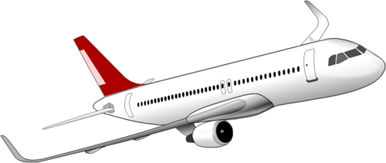
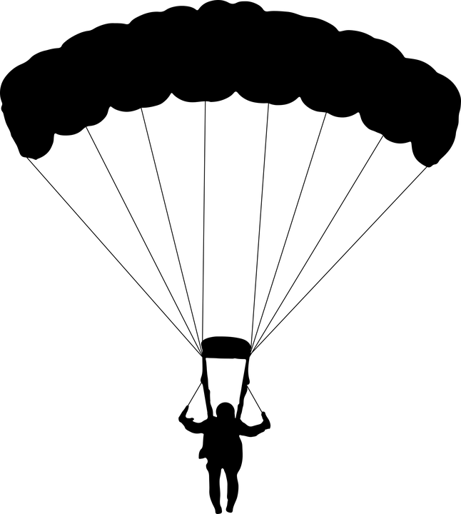
EXIT TICKET
Don’t forget to complete your daily learning log!!
Look at the image below, what is the reference point? Who appears to be moving, not moving, moving closer, moving farther away from the reference point.
Notes:
Teacher notes:
discuss as a class and/or have students keep a learning journal throughout this initiative
Ask students: what is the reference point? Remember, a reference point appears to not be moving.
Who is moving, not moving, moving closer to the reference point?
If the building is the reference point then the plane, people in the plane, person parachuting, two people on the ground are all moving in some from with closer to or farther away from the reference point (building)
Remind students to complete Daily Learning Log.

Slide 14
Lesson 2
SPEED
Notes:
Unleashed Lesson 2:

Slide 15
DO NOW
Question:
How do you determine the speed of an object?
Notes:
Teacher notes:
discuss as a class and/or have students keep a learning journal throughout this initiative
This question acts as a period knowledge check to see what students already know about motion.

Slide 16
OBJECTIVE
Students will
Define speed and velocity
Understand how to determine the speed of an object
Understand how to read a graph to determine the speed of an object
Notes:
Teacher notes:
Review the objectives for the day, so students know what is expected of their learning

Slide 17
AGENDA
Do Now
Introduction of Speed & Velocity
Activity: How fast is too fast?
Exit Ticket
Notes:
Teacher notes:
Review the agenda for the day

Slide 18
What is Speed?
SPEED is the distance something travels in a certain amount of time:
{
}
change in distance
change in time
speed =
DID YOU KNOW: Distance is measured in METERS, time is measured in SECONDS...so speed is measured in METERS PER SECONDS.
Notes:
Teacher notes:
Explain the definition of speed
Ask students if you can run 100 meters in ten seconds - what is your speed? Answer 10 meters per second
Tell students: this would be the runner’s AVERAGE speed. When something is in motion, it doesn't necessarily stay at the same speed the entire time. It can change speeds and move faster or slower between its stopping & starting points. The average speed is the total distance something has traveled divided by the total time it traveled. For example, an Olympic runner who completed the 100 meter dash in 10 seconds might have an average speed of 10 meters per second but that is her average speed. I’m sure she was going much faster near the finish line!

Slide 19
What is Velocity?
VELOCITY is just like speed except that it includes direction.
2 meters/second
2 meters/second
SPEED
VELOCITY
-2 meters/second
+2 meters/second
DID YOU KNOW: VELOCITY is speed in a certain direction so a change in velocity mean either a change in speed or direction.
Notes:
Teacher notes:
Explain the definition of velocity
Tell students: If you were jogging at 2 meters per second and all of a sudden you turned and jogged 2 meters per second in the opposite direction, your speed before and after would stay the same but your velocity would be different. You would be jogging 2 meters per second first, then negative 2 meters per second after turning around. The velocity would be equal in magnitude but opposite in direction.

Slide 20
Acceleration and Deceleration
ACCELERATION is the rate at which something changes directions. Whenever an object changes velocity, it is accelerating either by speeding up, slowing down, or changing direction. Positive acceleration is when an object is speeding up. Negative acceleration is when an object is slowing down because the velocity is in the opposite direction of the object's motion. Think of it like a gas pedal and break. Gas mean accelerating/gaining speed. Brake means decelerating/slowing down.
BRAKE
(decelerator)
GAS
(accelerator)
Notes:
Teacher notes:
Explain the definition of acceleration and deceleration
Tell students: Because velocity takes direction into account, so does acceleration. When your car goes around a corner (even if it keeps the same speed), you feel the acceleration as a force that seems to push you toward the outside corner.
Image:
gas and brakes by tezar tantular from the Noun Project

Slide 21
ACTIVITY: Graphing
Scientists have to graph the data they find in order to make sure the information is correct. Over the next few slides, you will learn how to read a graph AND how to create your own graphs. The following graphs have the distance along the left side vertically and the time along the bottom horizontally because we are learning about speed and velocity. BUT, graphs can include any information that needs to be studied.
REMEMBER: to calculate average speed, divide the total distance by the total time.
Notes:
Teacher notes:
Scientist all need to know how to graph the data they find.

Slide 22
ACTIVITY
1800
1600
1400
1200
1000
800
600
400
200
 | 0 | 20 | 40 | 60 | 80 | 100 | 120
This runner covered 1200 meters in 80 seconds.
What is their average speed?
Distance/Meters
Time/Seconds
Notes:
Teacher notes:
students will learn how to read a graph and graph on their own
Answer: 1200 / 80 = 15 meters per second

Slide 23
ACTIVITY
1800
1600
1400
1200
1000
800
600
400
200
 | 0 | 20 | 40 | 60 | 80 | 100 | 120
A
What distance did the runner cover?
Distance/Meters
B
How long did it take?
C
What is the average speed?
Time/Seconds
Notes:
Teacher notes:
students will learn how to read a graph and graph on their own
Answer: 1000 meters / 120 seconds - 8.33 meters per second

Slide 24
ACTIVITY
1800
1600
1400
1200
1000
800
600
400
200
 | 0 | 20 | 40 | 60 | 80 | 100 | 120
A
What distance did the runner cover?
Distance/Meters
B
How long did it take?
C
What is the average speed?
Time/Seconds
Notes:
Teacher notes:
students will learn how to read a graph and graph on their own
Answer: 1800 meters / 120 seconds - 15 meters per second

Slide 25
ACTIVITY
1800
1600
1400
1200
1000
800
600
400
200
 | 0 | 20 | 40 | 60 | 80 | 100 | 120
A
What distance did the runner cover?
Distance/Meters
B
How long did it take?
C
What is the average speed?
Time/Seconds
Notes:
Teacher notes:
students will learn how to read a graph and graph on their own
Answer: 600 meters / 80 seconds - 7.5 meters per second

Slide 26
ACTIVITY: Draw your own graph!
Draw a graph for the following: A runner ran 1400 meters in 300 seconds. A runner ran 800 meters in 120 seconds. A runner ran 1000 meters in 80 seconds.
REMEMBER: distance/meters goes along the left vertical side and time/seconds goes along the bottom horizontal side
Notes:
Teacher notes:
Have students draw one or three separate graphs to indication the running examples above. If drawing one graph, have students use a different color for each example to show the difference.

Slide 27
EXIT TICKET
Don’t forget to complete your daily learning log!!
Question
What is the average speed for a runner who covers 400 meters in 2 minutes?
Bonus points for creating your own graph to show your answer!
Notes:
Teacher notes:
discuss as a class and/or have students keep a learning journal throughout this initiative
Answer: 400 meters / 120 seconds = 3.33 meters per second
Remind students to complete Daily Learning Log

Slide 28
Lesson 3
FORCE
Notes:
Unleashed Lesson 3:

Slide 29
DO NOW
Question:
What makes the wheels on a bike turn?
Notes:
Teacher notes:
discuss as a class and/or have students keep a learning journal throughout this initiative

Slide 30
OBJECTIVE
Students will
Define force and gravity
Understand balanced and unbalanced forces
Understand the relationship between the pull from two objects
Notes:
Teacher notes:
Review the objectives for the day, so students know what is expected of their learning

Slide 31
AGENDA
Do Now
Introduction of Force
Activity: Tug of War
Exit Ticket
Notes:
Teacher notes:
Review the agenda for the day

Slide 32
What is Force?
FORCE is what makes something move. What makes a car speed up or a bike move - force! Force is a push or pull that changes the motion of an object. You apply force to the bike pedals in order to make it move.
DID YOU KNOW: The force powering a car to move is the engine.
Notes:
Teacher notes:
Explain the definition of force
Tell students: a force always has magnitude (size) and direction. Forces can set an object in motion or change the speed and direction. Movement doesn’t have to be moving from one location to another; it can also change the shape of something. Think about squeezing an empty soda can until it crumbles. You did not throw it into the garbage can but you did cause motion by changing its shape.

Slide 33
Net Force
Sometimes there is more than one force working on an object. The combination of forces on an object is called Net Force. For example, if you pull a magnet off of the fridge there are two forces working, the magnetic force holding the magnet to the fridge and your force pulling it away.
DID YOU KNOW: Force, like velocity and acceleration, has direction. To calculate the net force of an object, you need to take in to account the direction. If the forces are in the same direction - add. If the forces are in opposite directions - subtract.
Notes:
Teacher notes:
Explain the definition of net force
Ask students for other examples of net force on objects

Slide 34
Inertia
Matter/an object doesn’t like change. If an object is in motion - it likes to stay in motion. If an object is at rest - it likes to stay at rest. INERTIA is an object/matter’s resistance to change in motion.
DID YOU KNOW: Sir Isaac Newton created three laws of motion to describe the motion of all objects in the universe. The first law states that “an object in motion will remain in motion and on object at rest will remain at rest unless there is net force acting on the object”.
Notes:
Teacher notes:
Explain the definition of Inertia
Tell students: for example, a soccer ball is lying in an open field. It will remain sitting there (at rest) until an outside force acts on the object (wind, foot kicking it, etc). Once the ball is in motion, it will remain in motion unless an outside force acts on it (like the friction between the ball and the grass, air resistance, gravity, orr it hits something - another player’s foot, the net, etc).

Slide 35
Momentum
Momentum is a measure of how difficult it is to change the inertia of an object. Objects with more mass have more inertia. Think about catching a tennis ball versus catching a basketball. If they have the same velocity (direction & speed), it will be easier to stop the tennis ball because the tennis ball has less mass than the basketball.
Notes:
Teacher notes:
Explain the definition of Inertia
Tell students: think about pushing a shopping cart and pushing a car. If you apply the same amount of momentum/force to both, the shopping cart will zoom off, but the car won’t budge. So a larger mass will accelerate less if the same amount of momentum is applied.

Slide 36
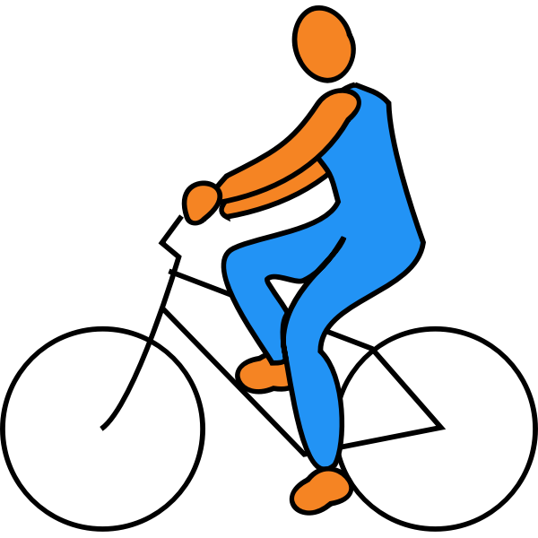
Balanced & Unbalanced Forces
Balanced Forces cancel each other out so there is no acting force. Unbalanced Forces has a net force in one direction.
Unbalanced Forces
Balanced Forces
Notes:
Teacher notes:
Explain the definition of balanced & unbalanced forces
Explain the images
When you are coasting on a bike with the wind at your back, the net force is in the same direction, so you accelerate forward (speed up!). This is unbalanced force
When you are coasting on a bike against the wind, the net force is pushing in the opposite direction, so you decelerate (slow down!) This is balanced force

Slide 37
Unbalanced Force
Matter/an object doesn’t like change. If an object is in motion - it likes to stay in motion. If an object is at rest - it likes to stay at rest. INERTIA is an object/matter’s resistance to change in motion.
DID YOU KNOW: Sir Isaac Newton created three laws of motion to describe the motion of all objects in the universe. The first law states that “an object in motion will remain in motion and on object at rest will remain at rest unless there is net force acting on the object”.
Notes:
Teacher notes:
Explain the definition of Inertia
Tell students: for example, a soccer ball is lying in an open field. It will remain sitting there (at rest) until an outside force acts on the object (wind, foot kicking it, etc). Once the ball is in motion, it will remain in motion unless an outside force acts on it (like the friction between the ball and the grass, air resistance, gravity, orr it hits something - another player’s foot, the net, etc).

Slide 38
Vocabulary
Can you define the following terms?
Force
D
Unbalanced Forces
A
Net Force
E
Balanced Forces
B
C
Inertia
F
Momentum
Notes:
Teacher notes:
Discuss these vocabulary words and ensure that students understand and can define them

Slide 39
ACTIVITY: Tug of War
Balanced versus Unbalanced Forces
Notes:
Teacher notes:
Tug-of-war is a great way to demonstrate balanced and unbalanced forces. There are two ways to facilitate this activity:
Using an actual rope: Group students for each round. Some examples are: Girls vs. Boys, Tall vs. Short, and an Uneven # of students for each side. 3. Have students compete using traditional Tug of War rules. Compete multiple times if needed. 4. Pass out printable and use the discussion questions to review how each round illustrated the concepts of balanced and unbalanced forces.
Using a whiteboard: Place a line across the middle of your desk or table to represent a tug-of-war rope. Working with a dilemma that can be considered from multiple perspectives or stances, such as should women in the WNBA be paid as much as men in the NBA? Identify the two opposing sides of the dilemma you are exploring (e.g. Yes and No). Use these to label each end of the “tug-of-war rope”. Generate as many tugs, or reasons that pull you toward each side of the dilemma. Write these on individual sticky notes. Each sticky note would represent a person. Once all students have submitted their answers, examine the scenario on the board and discuss how the concepts of balanced and unbalanced forces are represented.

Slide 40
EXIT TICKET
Don’t forget to complete your daily learning log!!
Question
When you jump, why do you move but the Earth doesn’t?
Notes:
Teacher notes:
discuss as a class and/or have students keep a learning journal throughout this initiative
Answer: While the force you apply to the Earth is equal to the force Earth applies to you, you have different accelerations because your mass is different. The force Earth applies on you is large enough to send you into the air, but the force you apply to the Earth is not big enough to send Earth moving away in the other direction. Short answer - because your mass does not Earth’s mass.
Remind students to complete Daily Learning Log

Slide 41
Lesson 4
FRICTION
Notes:
Unleashed Lesson 4:

Slide 42
DO NOW
Question:
If you kick a soccer ball down a field, why does it stop rolling?
Notes:
Teacher notes:
discuss as a class and/or have students keep a learning journal throughout this initiative

Slide 43
OBJECTIVE
Students will
Define friction
Understand all types of friction
Discover and label the types of friction
Notes:
Teacher notes:
Review the objectives for the day, so students know what is expected of their learning

Slide 44
AGENDA
Do Now
Introduction of friction
Activity: Ok Go - Rube Goldberg
Exit Ticket
Notes:
Teacher notes:
Review the agenda for the day

Slide 45
Friction
Newton’s first law of motion says that an object in motion will stay in motion unless stopped by a force. If you slide a notebook across the table, it eventually slows down and stops. Why? Friction! Friction is the force that opposes the movement between touching surfaces and always goes against the direction of motion.
DID YOU KNOW: We have in our own bodies - where are joints connect.
Notes:
Teacher notes:
Explain the definition of friction
Tell students: rougher surfaces have more friction. Sandpaper is harder to slide than normal paper because it has a rough surface and thus more friction. We can also help things move easier by minimizing the friction by greasing things down. Our bodies produce fluid around our joints to lower the friction when moving.

Slide 46
Static Friction
Static Friction is the force of friction between surfaces not in motion. Static friction is the result of molecules on one surface adhering to another surface.
For example, a concrete block on the sidewalk - two unmoving surfaces.
Notes:
Teacher notes:
Explain the definition of net force
Ask students for other examples of static friction

Slide 47
Sliding Friction
Sliding Friction is also known as Kinetic Friction! It is the force that affects surfaces in motion. Because the surfaces are not always bonded like they are in static friction, sliding friction is less powerful than static friction.
For example: pushing a box creates a resistance to motion that is sliding friction
Notes:
Teacher notes:
Explain the definition of net force
Ask students for other examples sliding friction

Slide 48
Rolling Friction
Rolling Friction is when the friction between surfaces rolls freely like a wheel or a ball. Rolling friction is weaker than sliding friction which is why it is easier to move something on wheels!
For example, the friction between the wheels of a skateboard and the sidewalk is rolling friction.
Notes:
Teacher notes:
Explain the definition of net force
Ask students for other examples of rolling friction

Slide 49
Magnetic Forces
Magnetic force is a material that is either attracted to or repelled by iron, steel, or other magnets. Magnets have a positive and negative charge.
+
-
+
+
-
+
-
-
DID YOU KNOW: Opposite charges attract (pull together)- like charges repel (push away).
Notes:
Teacher notes:
Explain the definition of net force
Ask students for other examples of net force on objects

Slide 50
Centripetal Forces
Centripetal Force is the force that causes an object to follow a curved of circular path and is directed inward toward the center of rotation. The moon moves in a circular path around the earth and is affected by the centripetal force of gravity.
DID YOU KNOW: If you swing a yo-yo around in a circle, tension from the string is the centripetal force that keeps the yo-yo in circular motion. This is also what helps keep the roller coaster on the track!
Notes:
Teacher notes:
Explain the definition of net force
Ask students for other examples of centripetal force

Slide 51
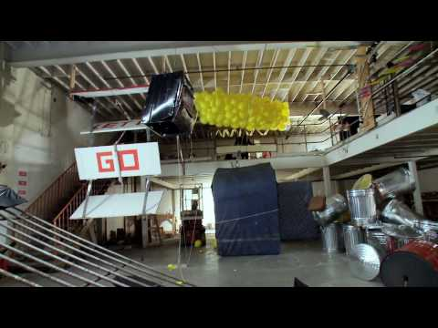
ACTIVITY: Ok Go!
Watch this video and label the types of friction you see being used? How many can you find?
Notes:
Teacher notes:
students will watch this video (perhaps several times) and label all the types of friction they can find
You can watch the youtube link on the slide or you can access the same video in Google Drive linked here
There are numerous examples of friction shown in the video and students can find them all if they want (frame by frame)! Just make sure that each answer is linked to a type of friction - static (unmoving), sliding, and rolling or force - magnetic or centripetal. Students can complete a handout (access a pdf copy or make a copy of the digital version).

Slide 52
ACTIVITY
THINK - PAIR - SHARE
THINK: think about the video - how many types of friction can you find?
PAIR: Rotate through groups (as shown) discussing the types of friction you found
SHARE: share what you learned with the class.
(1) COUNT AWAY
(2) ODDS VERSUS EVENS
1
2
3
4
(3) NUMBERS UNITES
EXAMPLES
Notes:
Teacher notes:
assign a number to students 1, 2, 3, and 4.
Students will rotate through the groups sharing what they learned about friction from the video - how many types of friction can they find?
Count Away (each group has a 1, 2, 3, and 4 represented)
Odds versus Evens: odds & evens together (one group has two 1s and two 3s, another group has two 2s and two 4s, etc)
Numbers Unite: All same numbers together (all 1s, all 2s, all 3s, all 4s)
Students can spend any length of time in each group. The teacher should rotate through the groups to ensure students are on topic. If you do not have enough students for four groups, you can split students into any number of groups that works best. The goal is to have students discussing what they found several times with different students.

Slide 53
EXIT TICKET
Don’t forget to complete your daily learning log!!
Question
Which force causes objects to have a circular motion?
Notes:
Teacher notes:
discuss as a class and/or have students keep a learning journal throughout this initiative
Answer: centripetal force
Remind students to complete Daily Learning Log

Slide 54
Lesson 5
LIFE IN THE FAST LANE
Notes:
Unleashed Lesson 5:

Slide 55
DO NOW
Question:
What would you invent to improve something that already exists?
Notes:
Teacher notes:
discuss as a class and/or have students keep a learning journal throughout this initiative

Slide 56
OBJECTIVE
Students will
Understand diversity in racing
Explore notable race car drivers
Apply knowledge gained to create a plan for a race car
Notes:
Teacher notes:
Review the objectives for the day, so students know what is expected of their learning

Slide 57
AGENDA
Do Now
Introduction to diversity in racing
Introduction to Formula 1 Racing
Introduction to NASCAR Racing
Introduction to notable Race Car drivers
Activity: Select a brand, Plan your build
Exit Ticket
Notes:
Teacher notes:
Review the agenda for the day

Slide 58
Diversity of Auto Racing
Less than 1% of people in motorsports come from minority backgrounds.
Formula One driver Lewis Hamilton created a project, the Hamilton Commission, to help understand the lack of diversity and create opportunities to improve it. According to the Commission, “we can’t improve diversity if we don’t also create more inclusive cultures in the workplace.The research team found that people from Black, other minority ethnic backgrounds and women in motorsport often had to endure banter that crossed the line and which they found offensive.”
“If motorsport organisations are to accelerate increases in diversity, leaders will have to look inwards at their workplace cultures, practices and behaviours to ensure they are inclusive for all people.”
Source: The Hamilton Commission
Notes:
Teacher notes:
Share the information on the slide with students to highlight the lack of diversity in racing.

Slide 59
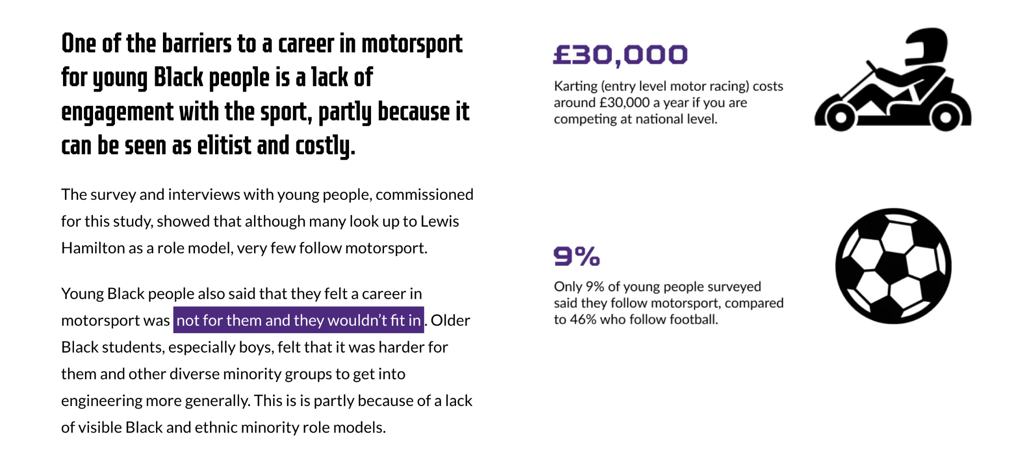
Diversity of Auto Racing
Did You Know? £30,000 is equal to about $39,000
Source: The Hamilton Commission
Notes:
Teacher notes:
Share the information on the slide with students to highlight the lack of diversity in racing.

Slide 60
Diversity of Auto Racing
The Hamilton Commission recommends three strands of action to improve diversity in motorsports:
Support and empowerment: those in leadership positions should support Black children to excel in STEM subjects, and empower them to choose – and succeed in – fulfilling careers
Accountability and measurement: those in leadership positions should acknowledge the unfairness that exists and commit to change – the first step being to collect data to form a benchmark from which to improve.
Inspiration and engagement: those in leadership positions should work harder to show Black children that STEM subjects, engineering and motorsport ARE for them, and to excite them about the opportunities that they offer.
Source: The Hamilton Commission
Notes:
Teacher notes:
Share the information on the slide with students to highlight the lack of diversity in racing.

Slide 61
Formula 1 Racing
Notes:
Teacher notes:
Show the video on the slide to students in introduce them to Formula 1 racing.

Slide 62
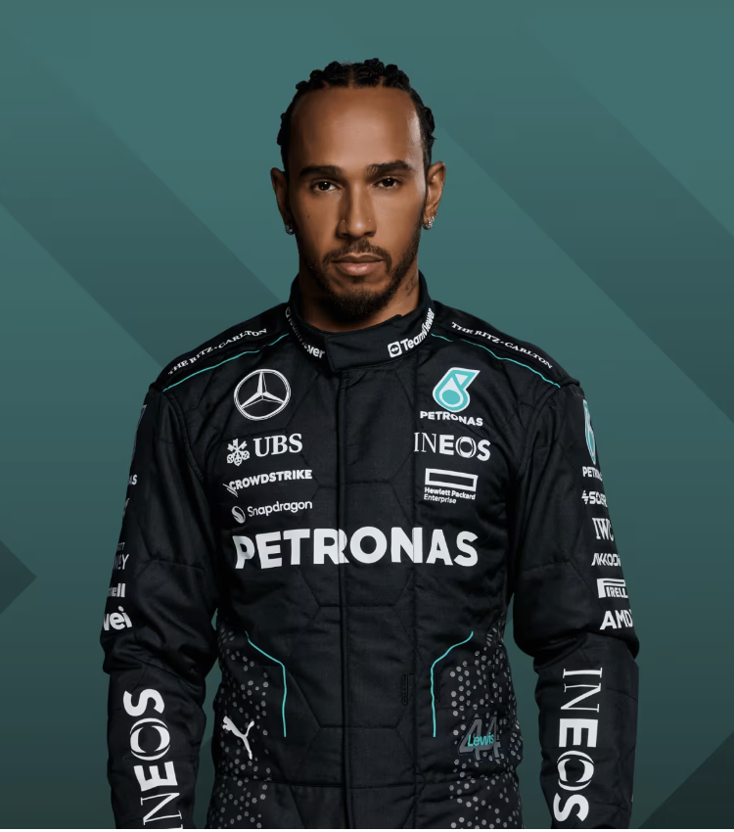
Notable Drivers
Lewis Hamilton
F1’s first black driver
7-time World Champion (tied for the most ever!)
He took his first title in the most dramatic fashion - on the last corner of the last lap of the last race.
Started the Hamilton Commission and Plus 44 foundation to promote diversity in motorsport
Source: Formula1
Notes:
Teacher notes:
Share the information on the slide with students to highlight notable race car drivers of color.

Slide 63
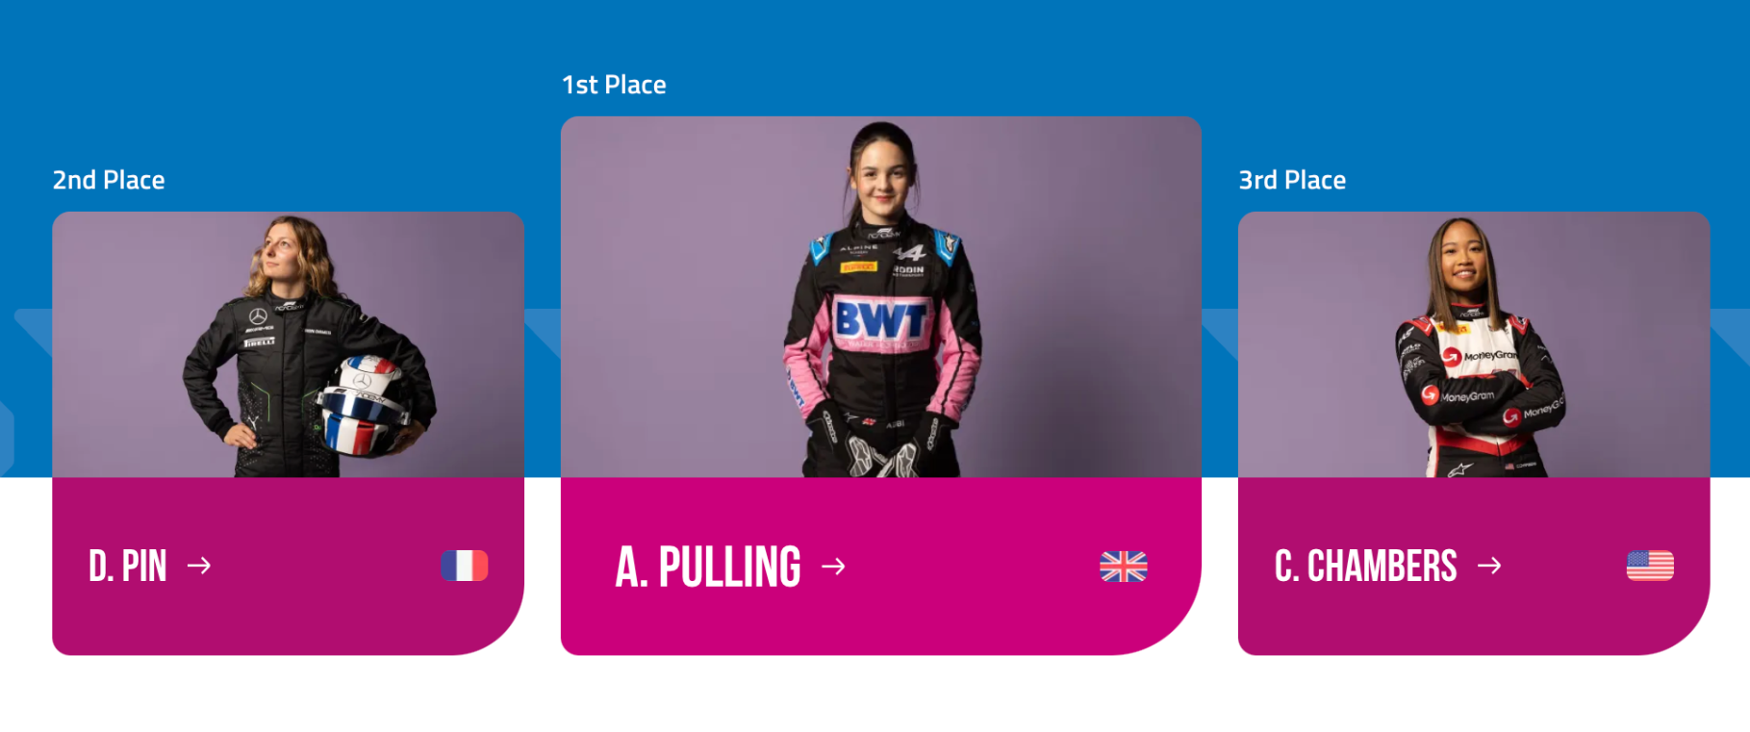
Formula 1 Academy Driving Change!
The F1 Academy is a Formula 1-founded, all-female, single-seater racing championship for junior drivers. The series was launched in 2023 to help female drivers develop their skills and prepare to move up to higher levels of motorsport, such as Formula 2, Formula 3, and Formula 1.
The Academy was founded to champion the next generation of female talent. Through the F1 Academy Racing Series and grassroots initiatives the Academy hopes to make motorsport more diverse, inclusive and accessible.
Source: F1 Academy
Notes:
Teacher notes:
Share the information on the slide with students to highlight notable race car drivers of color.

Slide 64
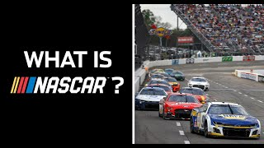
NASCAR Racing
Notes:
Teacher notes:
Show the video on the slide to students in introduce them to NASCAR racing.

Slide 65
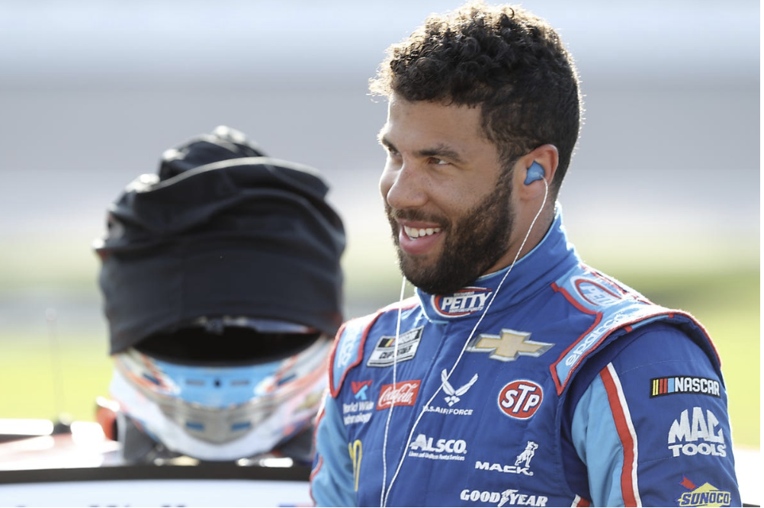
Notable Drivers
William Darrell “Bubba” Wallace Jr is a 28 year old professional stock car driver who made his Cup Series Debut in 2017. He is the first full-time racer of color in the NASCAR Cup Series since the early 1970s. In 2021, he became the second Black Driver to win the NASCAR Cup Series at Talladega Superspeedway.
Source: Atlanta Hyundai
Notes:
Teacher notes:
Share the information on the slide with students to highlight notable race car drivers of color.

Slide 66
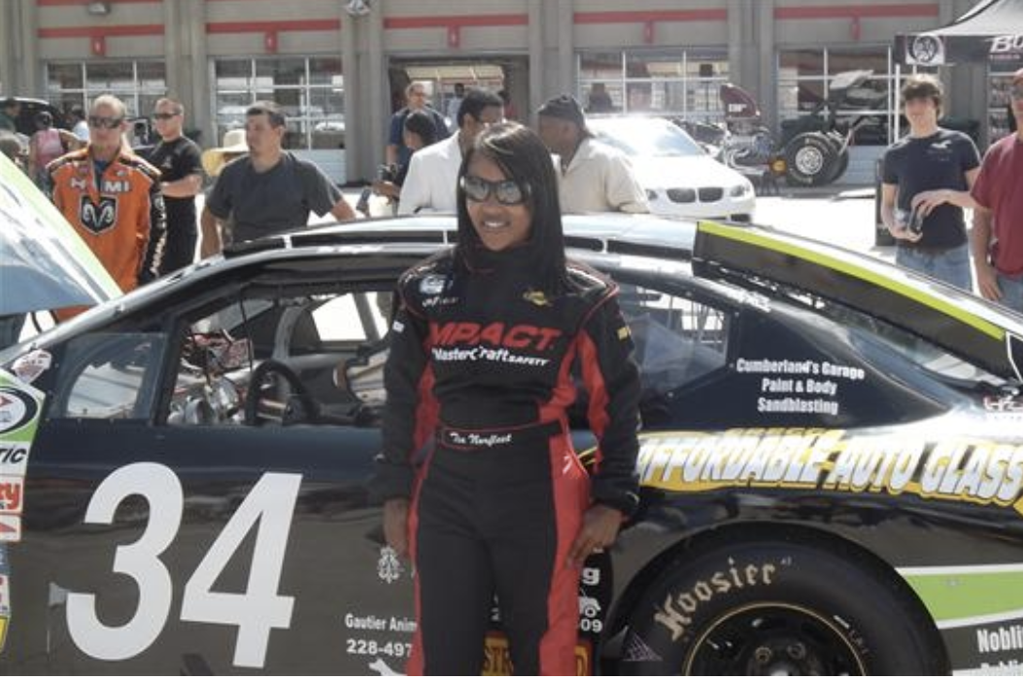
Notable Drivers
Shauntia Latrice “Tia” Norfleet is the daughter of NASCAR driver Bobby Norfleet, and the first and only African American Woman driver to hold a NASCAR license. In addition, she is the first Black Woman to be licensed by the Automobile Racing Club of America. She made her debut in August of 2012 at the Motor Mile Speedway in Virginia.
Source: Atlanta Hyundai
Notes:
Teacher notes:
Share the information on the slide with students to highlight notable race car drivers of color.

Slide 67
Let’s Get Racing!
It’s your turn to drive in the fast lane! You’ve been tasked to join the Formula 1 racing team and must build your own balloon powered race car. Follow the steps below and the instructions on future slides for your shot at a podium finish!
A
Design a Race Track
D
Run Trials
B
Design a Race Car
E
Compete in the Qualifier
C
Build the Race Car
F
Compete in the Grand Prix
Notes:
Teacher notes:
students will work together to build a race track and a balloon powered race car.

Slide 68
ACTIVITY
PLAN
As a class, design a race track for your balloon powered cars…consider variables like hills, length, curves, themes, and more!
Notes:
Teacher notes:
students will work together to build a race track all balloon powered cars will use. The following slides provide details and examples.

Slide 69
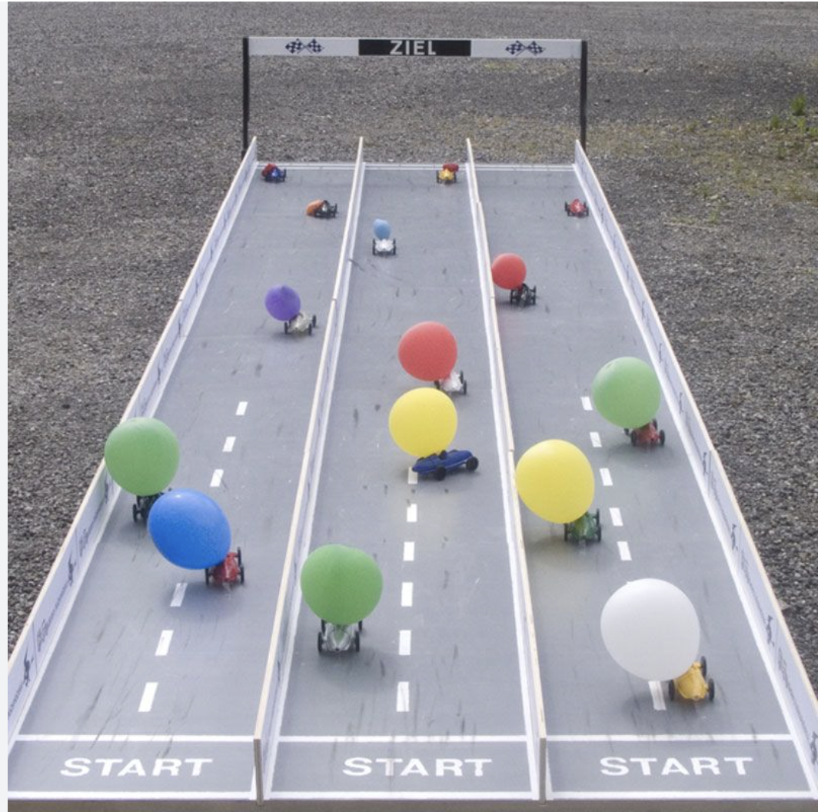
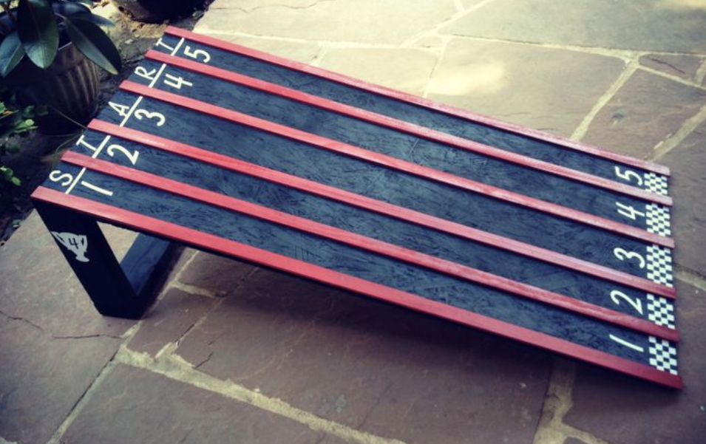
ACTIVITY
Example Race Tracks
Image source
Image source
Notes:
Teacher notes:
Be creative with your race track design!

Slide 70
ACTIVITY
Be Creative!
Use an interesting theme
Consider potential variables:
Uphill track
Bumpers for curved track
Length (short or long)
Use facility allowed materials
Notes:
Teacher notes:
Be creative with your race track design! Use materials that are allowed and themes that are interesting to students. Consider using tape on the floor and using areas that do not contain carpet. Using an uphill track will make it more difficult for the balloon powered cars to complete the track. Using bumpers could be a way to help balloon powered cars to make curves.

Slide 71
EXIT TICKET
Don’t forget to complete your daily learning log!!
Submission
Complete the creation of the race track!
Notes:
Teacher notes:
discuss as a class and/or have students keep a learning journal throughout this initiative
Remind students to complete Daily Learning Log

Slide 72
Lesson 6
Race Car Challenge
Notes:
Unleashed Lesson 6+:
In this lesson, students will plan, design, and build a balloon powered race car. Students can work independently or in a group. Students can submit completed race cars (including designs) to the BreakFree contest.

Slide 73
DO NOW
Plan:
Design and build a balloon powered race car!
Notes:
Teacher notes:
Have students begin class by improving their roller coaster plan/design

Slide 74
OBJECTIVE
Students will
Apply the knowledge gained to build a balloon powered race car
Notes:
Teacher notes:
Review the objectives for the day, so students know what is expected of their learning

Slide 75
AGENDA
Do Now
Introduction of Contest
Activity: Build a Race Car
Exit Ticket
Notes:
Teacher notes:
Review the agenda for the day

Slide 76
Let’s get started...
So far, you have learned about...
Motion
Speed
Forces
Friction
Notes:
Teacher notes:
Introduce the activity to students and show examples on the next few slides.

Slide 77
Formula 1 - The Cars
Notes:
Teacher notes:
Show the video on the slide to students in introduce them to Formula 1 race cars

Slide 78
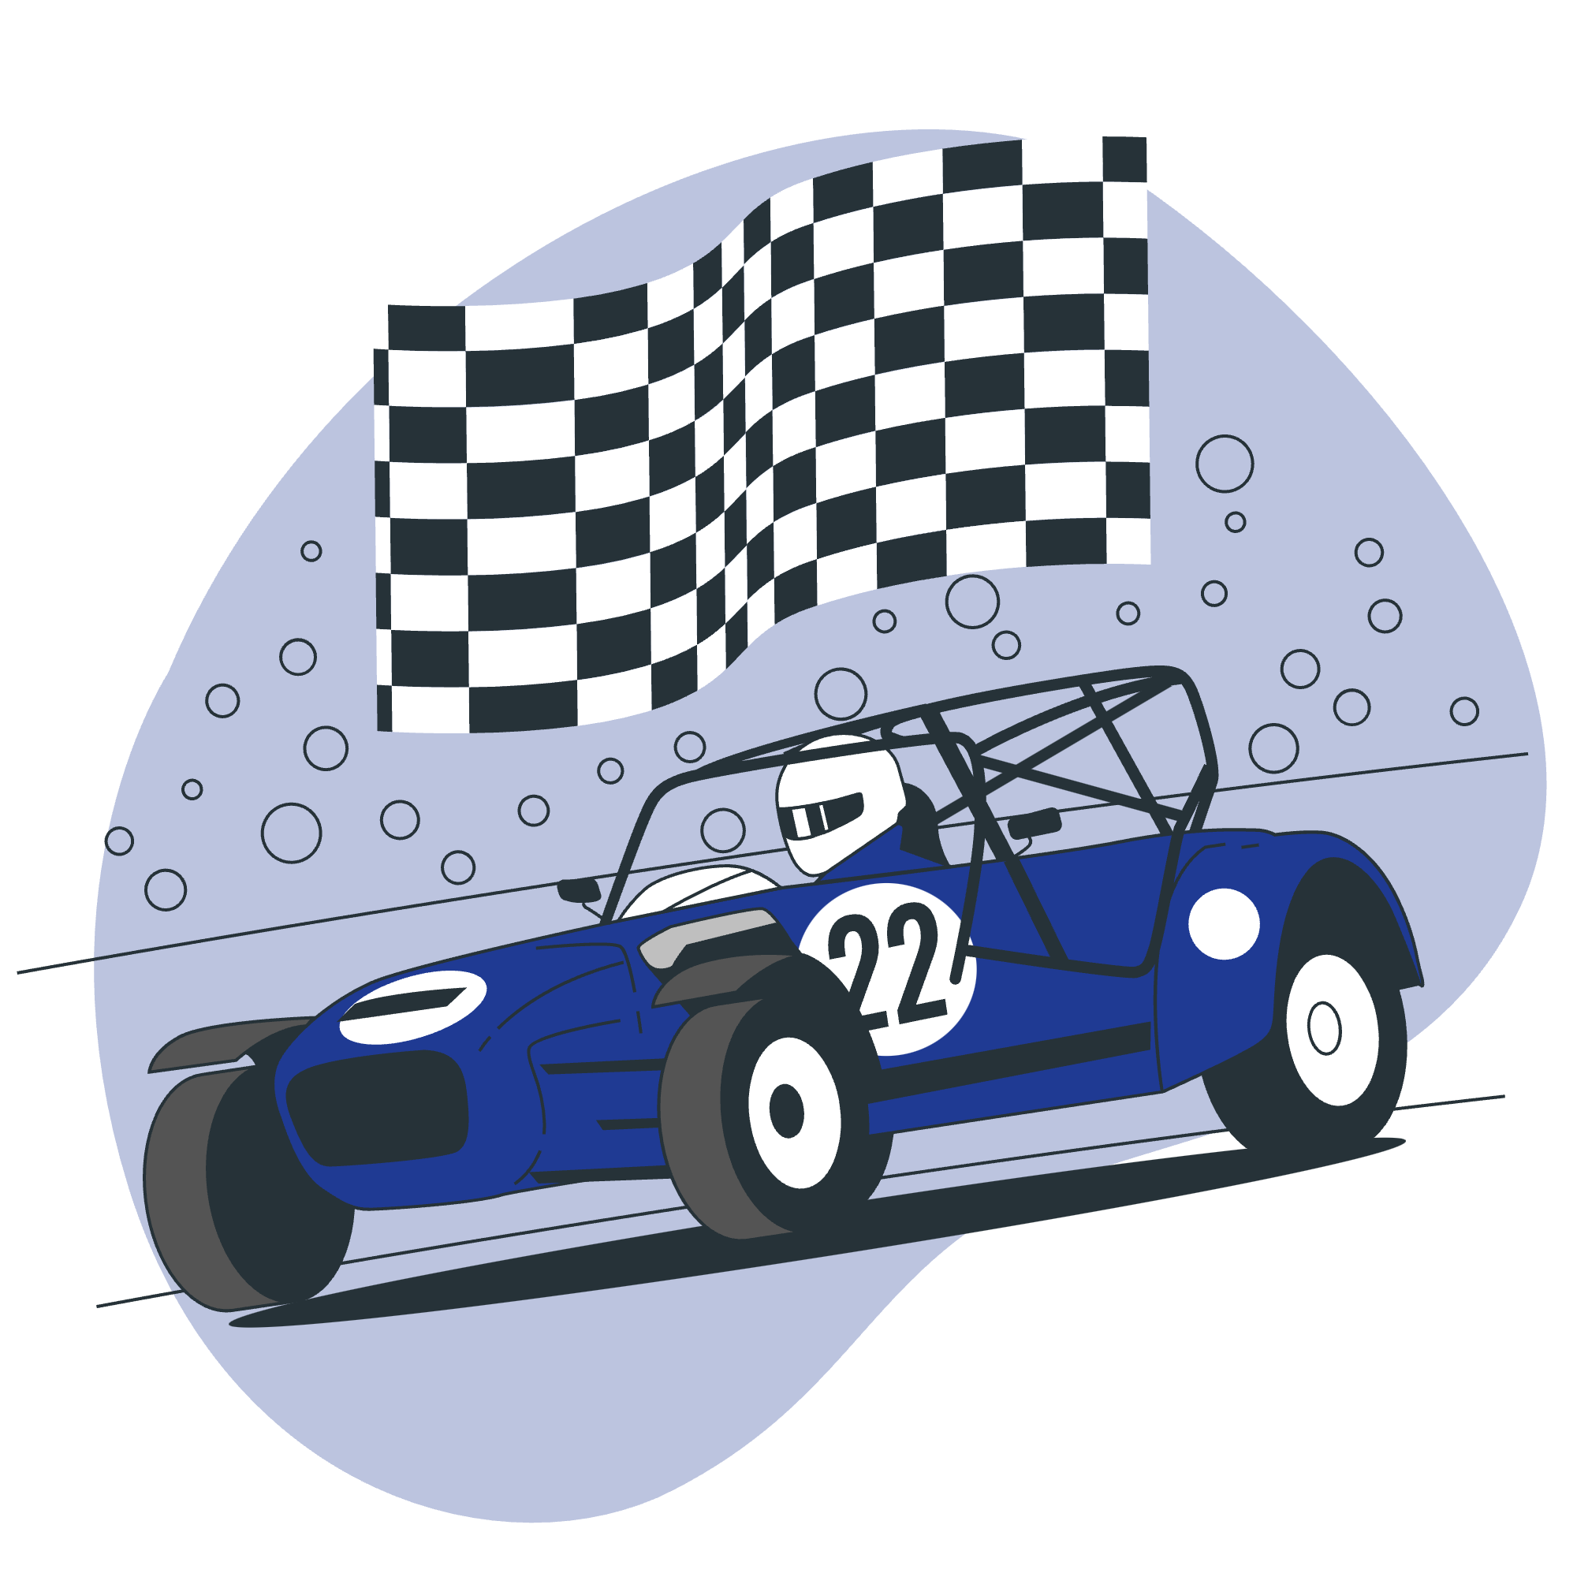
Race Car Challenge
You’ve been tasked with building a new prototype race car for Formula 1.
You will
design a race car
complete the build sheet
run at least three trials
compete in the Qualifier!
The top three race cars will move on to compete in the final Grand Prix!
Notes:
Teacher notes:
students will build a balloon powered race car. Ensure that each student or group of students completes a several trial runs before participating in the qualifier. The top three race cars will move on to compete in the final Grand Prix!
<a href="https://storyset.com/transport">Transport illustrations by Storyset</a>

Slide 79
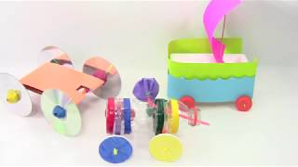
Step 1: Design a Race Car
You’ve been tasked with building a new prototype race car for Formula 1.
What is a balloon powered car? Check out this video ----->
Use the build sheet to start your design!
Notes:
Teacher notes:
Design a race car: Use the video to help students understand how to build a balloon powered race car.
Print the build sheet (linked here as a pdf; linked here as a google doc) so students can complete it as they build.

Slide 80
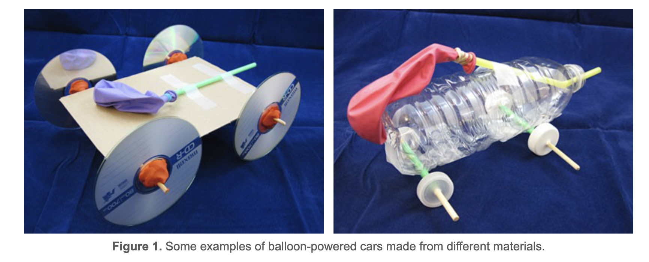
Step 1: Design a Race Car
First build the body of your race car: choose between a water bottle, a tissue box, a piece of cardboard, paper food trays, and more!
Source: Science Buddies
Notes:
Teacher notes:
Provide allowed materials for students to complete their build. Any materials your facility allows can be used for this product.
More instructions are available at this PDF or this PDF.

Slide 81
Step 1: Design a Race Car
Next, select the wheels: choose between bottle caps, CDs, cardboard, and more.
Source: Science Buddies
Notes:
Teacher notes:
Provide allowed materials for students to complete their build. Any materials your facility allows can be used for this product. If using bottle caps - drill the holes before giving to students and use tape if glue is not allowed.

Slide 82
Step 1: Design a Race Car
Next, build the axles: choose between straws, pencils, chopsticks, and more.
Source: Science Buddies
Notes:
Teacher notes:
Provide allowed materials for students to complete their build. Any materials your facility allows can be used for this product. Chopsticks and skewers can usually be used if the ends are flat and not pointed.

Slide 83
Step 1: Design a Race Car
Finally, attach the balloon to the top of your race car!
Be creative…can you add a fun theme, or unique design?
Source: Science Buddies
Notes:
Teacher notes:
Provide allowed materials for students to complete their build. Any materials your facility allows can be used for this product.

Slide 84
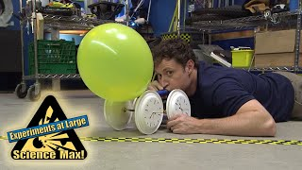
Step 1: Design a Race Car
Check out this video for more ways to build a balloon powered car ----->
Notes:
Teacher notes:
Design a race car: Use the video to help students understand how to build a balloon powered race car.

Slide 85
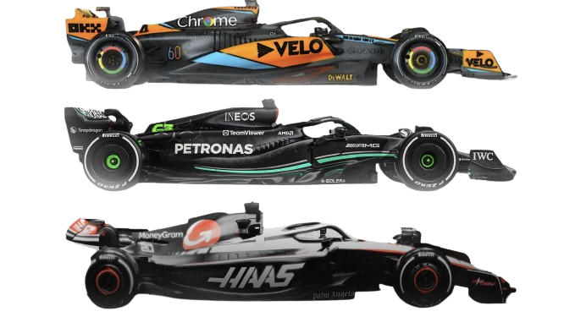
Step 2: Complete the Build Sheet
All good racers have an amazing pit crew! In this contest, you are your own pit crew!
Complete the build sheet provided by drawing a design of your race car, naming the car, adding a brand to the car, and more!
All good race teams have a sponsor! Which brand will be the sponsor of your race car?
Source: Sky Sports
Notes:
Teacher notes:
students will build a balloon powered race car. Ensure that each student or group of students completes a build sheet to ensure they are meeting all requirements of the build. The build sheet will be submitted to the contest along with a video and/or pictures of the race car.
Print the build sheet (linked here as a pdf; linked here as a google doc) so students can complete it as they build.

Slide 86
Step 3: Run at least THREE Trials
Push your car to the limits.
Test your race car on the track at least three times before the Qualifier.
Do you need to make adjustments to the design? Is it fast enough? It is too heavy or too light?
Now is your moment to make changes before the big race!
Notes:
Teacher notes:
Allow students to test their race car at least three times on the race track before competing in the qualifier. Encourage students to make changes to their designs to improve functionality.

Slide 87
Step 4: It’s Time to Qualify!
All racers to the starting line!
All race cars should compete in the qualifier in order to determine the top three cars!
The top three will compete in the final Grand Prix in order to determine the podium finishers.
Notes:
Teacher notes:
Allow each student (either individually or in groups or all at once) to complete the race track with their balloon powered race car in the qualifier. The top three racers will move on to the Grand Prix.

Slide 88
Step 5: Grand Prix
The top three race cars will move on the compete in the final Grand Prix to determine the overall class winner!
Notes:
Teacher notes:
The top three race cars will compete against each other in the final Grand Prix to see who obtain the podium finish! Please note that all race cars will be submitted to the BreakFree Education contest with an image of the car, a video of the car functioning, and the build sheet. If you are able, please provide a prize for the winning race car from the Grand Prix!

Slide 89
EXIT TICKET
Don’t forget to complete your daily learning log!!
Question
Submit your race car to the BreakFree contest!
Notes:
Teacher notes:
Submit ALL student’s race cars to the BreakFree contest (videos and images are welcome) along with the build sheet.
Remind students to complete Daily Learning Log

Slide 90
UNLEASHED

