Slide 1
Unwasted

Slide 2
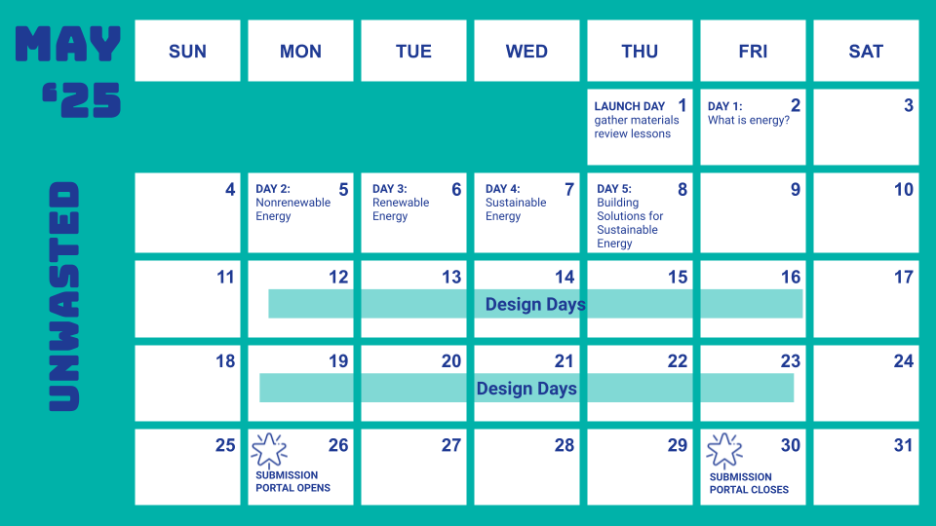
Suggested Calendar
Notes:
Teacher notes:
Please note, this is a suggested calendar. Feel free to adapt to fit your schedule.

Slide 3
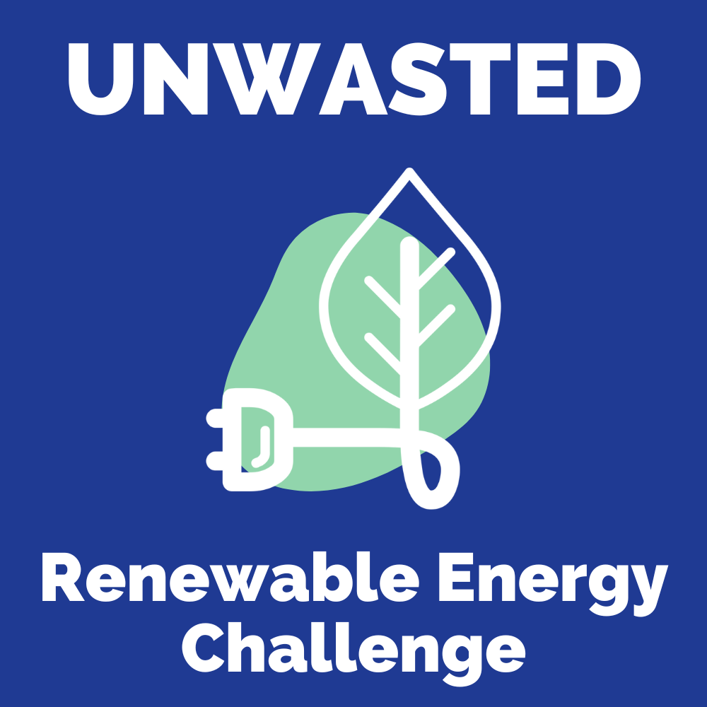
Lesson 1
What is energy?

Slide 4
DO NOW
THINK - PAIR - SHARE
THINK: think about the three energy sources you use daily
PAIR: Rotate through groups (as shown) discussing the three energy sources you listed (or pair with a partner).
SHARE: share what you learned with the class.
(1) COUNT AWAY
(2) ODDS VERSUS EVENS
1
2
3
4
(3) NUMBERS UNITES
EXAMPLES
Notes:
Teacher notes:
discuss as a class and/or have students keep a learning journal throughout this initiative
Explain the do now on the slide to students. Distribute the handout (linked here) to students to complete the THINK section of the do now.
assign a number to students 1, 2, 3, and 4.
Students will rotate through the groups sharing what they learned about motion in the following order:
Count Away (each group has a 1, 2, 3, and 4 represented)
Odds versus Evens: odds & evens together (one group has two 1s and two 3s, another group has two 2s and two 4s, etc)
Numbers Unite: All same numbers together (all 1s, all 2s, all 3s, all 4s)
Students can spend any length of time in each group. The teacher should rotate through the groups to ensure students are on topic. If you do not have enough students for four groups, you can split students into any number of groups that works best. The goal is to have students discussing what they found several times with different students.

Slide 5
AGENDA
Do Now
Introduction of Unwasted
Introduction to Energy Sources
Activity: Energy Source Sort
Exit Ticket
Notes:
Teacher notes:
Review the agenda for the day

Slide 6
OBJECTIVE
Students will
Identify different types of energy sources
Categorize energy sources as renewable or nonrenewable
Explain the basic concepts of renewable and nonrenewable energy sources
Notes:
Teacher notes:
Review the objectives for the day, so students know what is expected of their learning

Slide 7
Introduction
Through this initiative, students will delve into the world of sustainable power sources, exploring the diverse types of renewable energy and their potential to transform our planet. Through hands-on investigations and critical analysis, students will develop the skills to assess the feasibility and impact of various renewable technologies. The culminating experience will challenge students to design their own innovative renewable energy source, applying their knowledge to create a sustainable solution for the future.
Notes:
Explain to students that by the end of this unit, they will be asked to design an example of a clean, renewable energy initiative. Anytime something sparks their imagination, they should make a note of it. Explain BreakFree’s monthly contest and pass out the Note to Students.

Slide 8
What is Energy?
Imagine energy as the stuff that makes things go. It's what allows us to turn on the lights, watch TV, and even charge our phones.
This energy comes from different sources, and we can divide them into two main groups: renewable and nonrenewable.
Renewable Resources
Nonrenewable Resources
Notes:
Teacher notes:
In this lesson, students will learn about both renewable and nonrenewable resources. Explain the content on the slide to students.

Slide 9
What are Nonrenewable Energy Resources?
Nonrenewable energy resources are like a limited edition toy – once they're gone, they're gone! These resources take millions of years to form, so we can't easily replace them. Here are a few examples:
Fossil Fuels: including coal, oil, and natural gas are formed from ancient plants and animals that were buried underground for millions of years. We burn them to create energy, but this also releases pollution into the air.
Nuclear Energy: comes from splitting atoms, which releases a huge amount of energy. It's a powerful source of energy, but it also creates radioactive waste that needs to be carefully stored.
COAL
OIL
NATURAL GAS
ATOMS
Notes:
Teacher notes:
Explain the content on the slide to students.

Slide 10
What are Renewable Energy Resources?
Renewable energy resources are like gifts that keep on giving. They come from natural sources that are constantly being replenished, so we don't have to worry about them running out. Think of them as nature's batteries that recharge themselves! Here are a few examples:
WIND
SOLAR
WATER
GEOTHERMAL
DID YOU KNOW: Some scientists define renewable resources as any resource that naturally replenishes within an average human lifespan, roughly 70 years.
Notes:
Teacher notes:
Explain the content on the slide to students.

Slide 11
NON Renewable Energy Resources
Fossil Fuels
Fossil fuels are like ancient treasures buried deep underground. They formed millions of years ago from the remains of plants and animals. Imagine a world covered in swamps and oceans teeming with life. When those plants and animals died, they sank to the bottom and got covered by layers of mud and sand. Over time, the intense heat and pressure from all those layers turned them into the fossil fuels we use today (coal, oil, natural gas).
Nuclear Energy
Wind
Solar
Water
DID YOU KNOW: it takes millions of years for fossil fuels to form. That's longer than the entire history of humans! So, even though we have quite a bit now, we're using them up much faster than they can be replaced. That's why they're called nonrenewable.
Notes:
Teacher notes:
Explain the content on the slide to students.

Slide 12
NON Renewable Energy Resources
Fossil Fuels
Nuclear energy comes from the core of atoms, specifically uranium atoms. Imagine these atoms as tiny containers packed with a HUGE amount of energy. Nuclear power plants use a process called nuclear fission to release this energy. It's kind of like splitting those tiny containers open and harnessing the power that bursts out. While uranium is found in nature, it's not something that forms quickly. It takes a very long time for it to be created, so we consider it a nonrenewable resource.
PROS:
Tons of power: A small amount of uranium produces a LOT of energy.
Cleaner air: It doesn't release the same kind of air pollution as fossil fuels.
CONS:
Radioactive waste: Nuclear power creates waste that stays dangerous for a long, long time, and we have to figure out safe ways to store it.
Accidents: While rare, accidents at nuclear power plants can be very serious.
Nuclear Energy
Wind
Solar
Water
Notes:
Teacher notes:
Explain the content on the slide to students.

Slide 13
Renewable Energy Resources
Fossil Fuels
Wind energy is basically harnessing the power of the wind to create electricity. You know how the wind can blow you around or make a kite fly? Well, we can use that same power to make energy!
Wind is caused by the sun heating up the Earth unevenly. As long as the sun shines, there will be wind! So, we can keep using wind energy without worrying about it running out. That's what makes it a renewable resource.
Nuclear Energy
Wind
Solar
Water
Did You Know? A wind turbine blade can rival the Statue of Liberty in height, stretching over 90 meters long – equivalent to the length of more than NINE school buses!
Notes:
Teacher notes:
Explain the content on the slide to students.

Slide 14
Renewable Energy Resources
Fossil Fuels
Solar energy is basically harnessing the power of sunlight to create electricity. You know how the sun warms your skin on a sunny day? Well, we can use that same energy to power our homes and schools!
The sun is a giant ball of burning gas that provides a constant source of energy. As long as the sun shines, we can keep using solar energy without worrying about it running out! That's what makes it a renewable resource.
Nuclear Energy
Wind
Solar
Water
Notes:
Teacher notes:
Explain the content on the slide to students.

Slide 15
Renewable Energy Resources
Fossil Fuels
Hydropower power uses the energy of moving water to generate electricity. Think of waterfalls, rivers, and even ocean tides – they all have the potential to create power!
Hydropower relies on the water cycle, which is driven by the sun. The sun's heat causes water to evaporate and form clouds. Then, the water falls back to Earth as rain or snow, filling rivers and lakes. This cycle is constantly repeating, making hydropower a renewable energy source.
Nuclear Energy
Wind
Solar
Water
Notes:
Teacher notes:
Explain the content on the slide to students.

Slide 16
Energy Sources
So, next time you turn on a light or charge a laptop, think about where that energy comes from.
By understanding the difference between renewable and nonrenewable energy resources, we can make smart choices about how we use energy and help protect our planet!
Renewable Resources
Nonrenewable Resources
Notes:
Teacher notes:
Explain the content on the slide to students.

Slide 17
ACTIVITY
Using your handout, label each of the resources below as renewable or nonrenewable energy resources.
Renewable Resources
Nonrenewable Resources
WIND
COAL
OIL
SOLAR
ATOMS
WATER
Fossil Fuels
Geothermal
Nuclear Energy
Natural Gas
Notes:
Teacher notes:
Explain the activity on the slide to students. Distribute the handout (linked here) to students to complete the activity.

Slide 18
EXIT TICKET
Don’t forget to complete your daily learning log!!
Complete the “I Think, Prove It” section to explain what you think about renewable and nonrenewable energy resources.
Notes:
Teacher notes:
discuss as a class and/or have students keep a learning journal throughout this initiative
Explain the exit ticket on the slide to students. Distribute the handout (linked here) to students to complete the exit ticket.
Remind students to complete Daily Learning Log

Slide 19
Lesson 2
Nonrenewable Energy

Slide 20
DO NOW
Quick Write:
Create a list of at least three reasons people use nonrenewable energy resources.
Notes:
Teacher notes:
discuss as a class and/or have students keep a learning journal throughout this initiative

Slide 21
OBJECTIVE
Students will
Define nonrenewable energy resources
Explore the advantages and disadvantages of nonrenewable energy resources
Notes:
Teacher notes:
Review the objectives for the day, so students know what is expected of their learning

Slide 22
AGENDA
Do Now
Introduction of the Impact of Nonrenewable Energy Resources
Activity: Notice and Wonder
Exit Ticket
Notes:
Teacher notes:
Review the agenda for the day

Slide 23
Nonrenewable Energy Resources
What we know so far about nonrenewable energy resources:
Fossil fuels have been super important for powering our world. They're relatively easy to find and use, and they pack a lot of energy. They've helped us build cities, travel the world, and create all sorts of technologies. They're relatively easy to find and use, and they pack a lot of energy. Burning fossil fuels releases pollution into the air, which can cause problems like smog and acid rain. It also releases carbon dioxide, a greenhouse gas that contributes to climate change.
Notes:
Teacher notes:
Explain the content on the slide to students.

Slide 24
Nonrenewable Energy Resources
Other notable facts about nonrenewable energy resources:
Nonrenewable resources formed from the remains of ancient organisms (plants and animals) over millions of years. Talk about old!
Earth has a finite amount of these resources, meaning they can't be easily replaced once they're used up. It's like having a limited-edition toy – once it's gone, it's gone!
Nonrenewable resources like fossil fuels (coal, oil, and natural gas) currently power most of our world, from transportation to electricity generation. We rely on them, but need to find alternatives for the future!
Notes:
Teacher notes:
Explain the content on the slide to students.

Slide 25
Nonrenewable Energy Resources
Advantages of nonrenewable energy resources:
Power plants that use coal, oil, or natural gas can generate electricity around the clock, regardless of the weather. This makes them a reliable source of energy compared to solar or wind, which depend on sunlight or wind conditions.
Fossil fuels pack a lot of energy into a small amount of fuel. This makes them efficient for powering things like airplanes and large industries.
We've built our entire energy system around fossil fuels. We have power plants, pipelines, and transportation systems that are all designed to use them, making them convenient for now.
Notes:
Teacher notes:
Explain the content on the slide to students.

Slide 26
Nonrenewable Energy Resources
Disadvantages of nonrenewable energy resources:
Finite resources: Nonrenewable resources will eventually run out. We are using them up much faster than they can be replenished, which means we need to find alternative energy sources for the future.
Environmental damage: (1) Pollution - burning fossil fuels releases harmful pollutants into the air, causing smog, acid rain, and respiratory problems. (2) Climate Change - they release greenhouse gases, primarily carbon dioxide, which trap heat and contribute to global warming and climate change. (3) Extraction Impacts - mining for coal and drilling for oil and gas can disrupt ecosystems, pollute water sources, and damage habitats.
Health hazards: (1) Air pollution from burning fossil fuels can cause respiratory illnesses, cardiovascular problems, and other health issues. (2) Extraction and transportation of these resources can also pose risks to worker safety and community health.
Economic volatility:: The price of fossil fuels can fluctuate significantly, impacting energy costs for consumers and businesses.
Notes:
Teacher notes:
Explain the content on the slide to students.

Slide 27
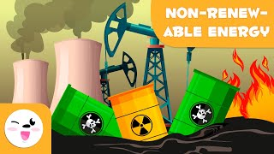
ACTIVITY
Notes:
Teacher notes:
Show the video to students. Distribute the lesson handout (linked here) to students to answer the questions from the video and lesson.
Answers to the handout questions:
Non-renewable energy sources mentioned include coal, oil, natural gas, and nuclear energy. (00:00:24)
Oil is formed by a mixture of hydrocarbons and is used to produce fuels like gasoline. (00:00:44)
Coal is formed by the fossilization of dead plant remains and produces heat when burned. (00:01:05)
Advantages include energy production; disadvantages include handling radioactive waste and environmental risks. (00:01:49)
Transitioning to renewable energy is crucial to reduce environmental harm and achieve world energy objectives. (00:02:11)

Slide 28
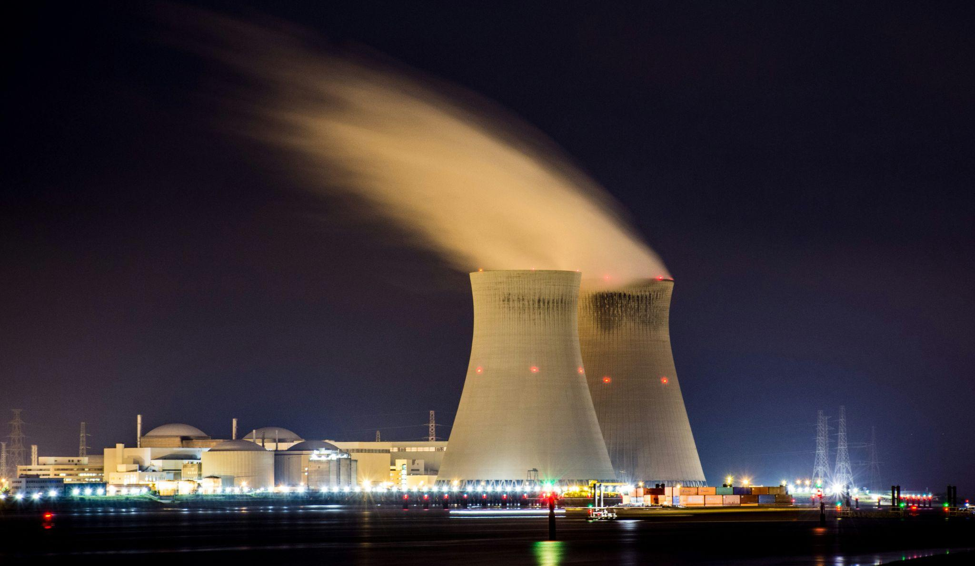
EXIT TICKET
Don’t forget to complete your daily learning log!!
Question
What do you NOTICE and WONDER about this image?
Photo by Nicolas HIPPERT
Notes:
Teacher notes:
discuss as a class and/or have students keep a learning journal throughout this initiative
Explain the exit ticket on the slide to students. Distribute the handout (linked here) to students to complete the exit ticket.
Remind students to complete Daily Learning Log

Slide 29
Lesson 3
Renewable Energy

Slide 30
DO NOW
Quick Task:
Write down everything you already know about renewable energy resources.
Notes:
Teacher notes:
discuss as a class and/or have students keep a learning journal throughout this initiative

Slide 31
OBJECTIVE
Students will
Define renewable resources
Explore the advantages and disadvantages of renewable resources
Notes:
Teacher notes:
Review the objectives for the day, so students know what is expected of their learning

Slide 32
AGENDA
Do Now
Exploring Renewable Energy
Activity: Build a Windmill or Water Wheel
Exit Ticket
Notes:
Teacher notes:
Review the agenda for the day

Slide 33
Renewable Energy Resources
What we know so far about renewable energy resources:
Renewable resources come from sources that naturally replenish themselves, like sunlight, wind, water, and geothermal heat. It's like having a battery that recharges itself! Using renewable energy helps reduce pollution and greenhouse gas emissions, which contribute to climate change. It's a cleaner way to power our world. Renewable resources are sustainable, meaning they won't run out like fossil fuels. This ensures we have energy for future generations.
Notes:
Teacher notes:
Explain the content on the slide to students.

Slide 34
Renewable Energy Resources
Advantages of nonrenewable energy resources:
They produce little to no harmful pollutants or greenhouse gas emissions, helping to improve air quality and combat climate change.
They come from sources that naturally replenish themselves, so we don't have to worry about them running out like fossil fuels.
The renewable energy sector is growing rapidly, creating new jobs in manufacturing, installation, maintenance, and research.
Cleaner air means fewer respiratory problems, cardiovascular diseases, and other health issues associated with fossil fuel pollution.
Notes:
Teacher notes:
Explain the content on the slide to students.

Slide 35
Renewable Energy Resources
Disadvantages of nonrenewable energy resources:
Solar power relies on sunlight, wind power on wind, and hydropower on water availability. These sources can be inconsistent and unpredictable, making it difficult to provide a steady energy supply.
Building renewable energy facilities like solar farms or wind turbines often requires a significant initial investment, which can be a barrier for individuals and communities.
Not all regions have equal access to renewable energy resources. Some areas may be better suited for solar power, while others are more suitable for wind or hydropower.
Notes:
Teacher notes:
Explain the content on the slide to students.

Slide 36
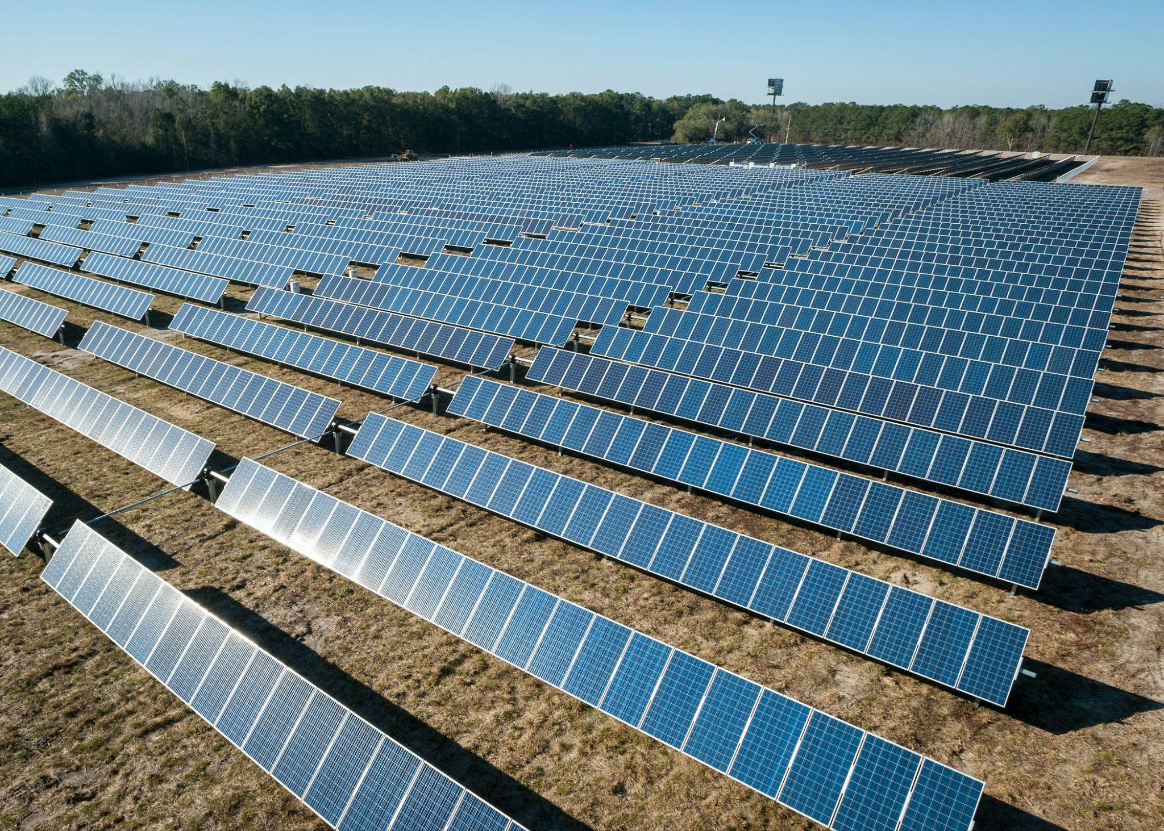
Renewable Energy Resources
Solar panels are like super-efficient sunbathers! They love soaking up those direct rays, so sunny days without clouds, rain, or fog are when they produce the most power.
While getting your own solar panels can be a bit pricey upfront, the cool thing is that you can buy, install, and manage them yourself. Plus, there are programs that can help homeowners with the costs, making it easier to go solar!
Photo by American Public Power Association
Notes:
Teacher notes:
Explain the content on the slide to students.

Slide 37
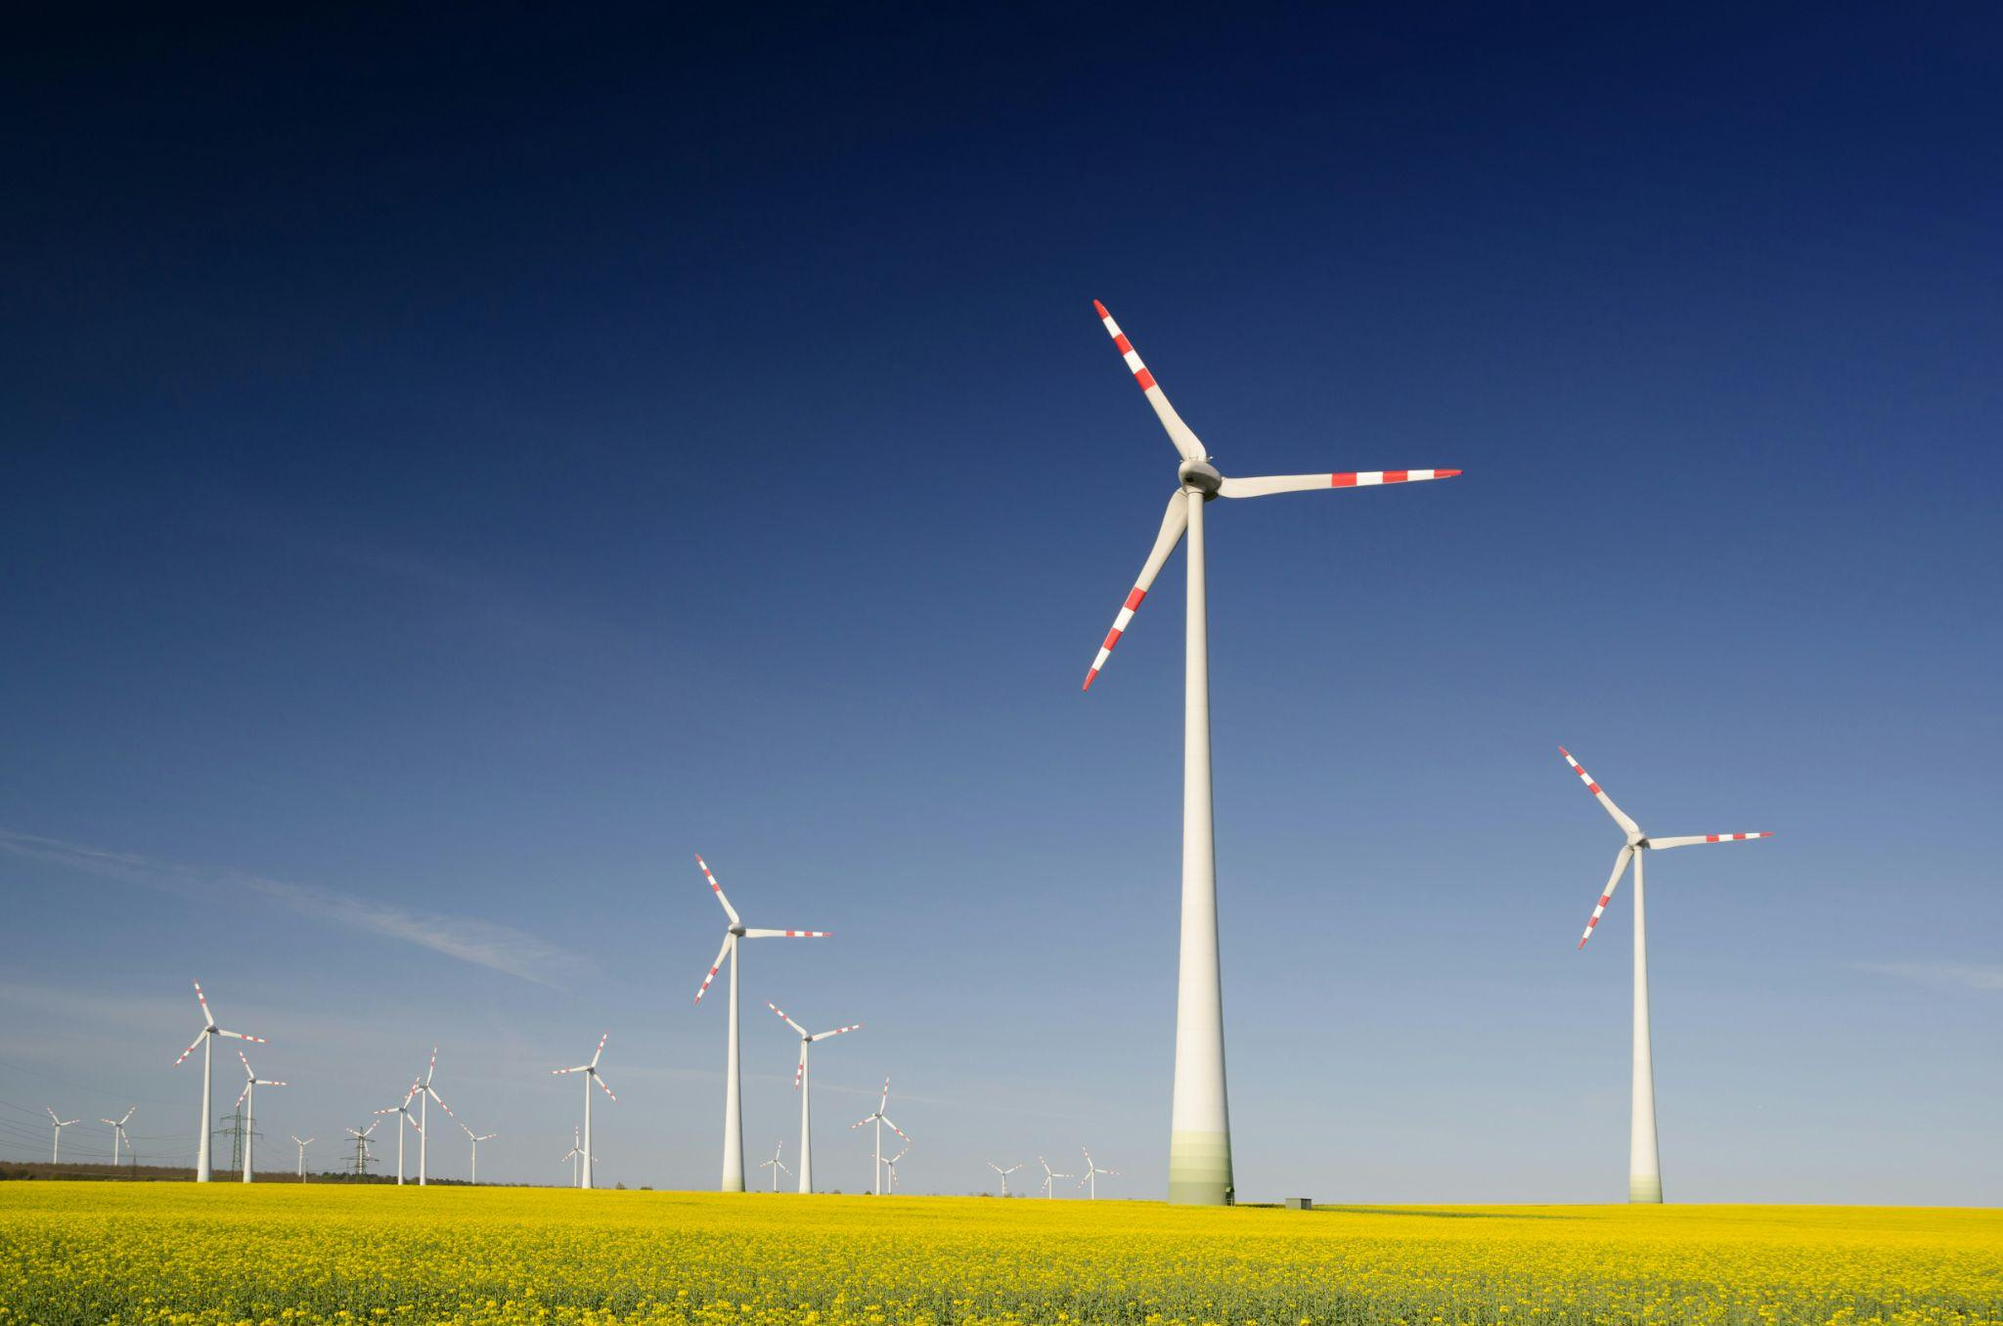
Renewable Energy Resources
Wind farms are like giant pinwheels, and those pinwheels need a lot of elbow room! To build a wind farm, you need space not just for the towering turbines themselves, but also for roads to get to them and for all the trucks and equipment during construction.
Each turbine can need up to 80 acres of land – that's like 60 football fields! Ideally, this land would be nice and flat, but even if it's farmland, farmers can still grow crops or graze animals around the turbines. It's like a win-win for clean energy and agriculture!
Photo by Zbynek Burival
Notes:
Teacher notes:
Explain the content on the slide to students.

Slide 38
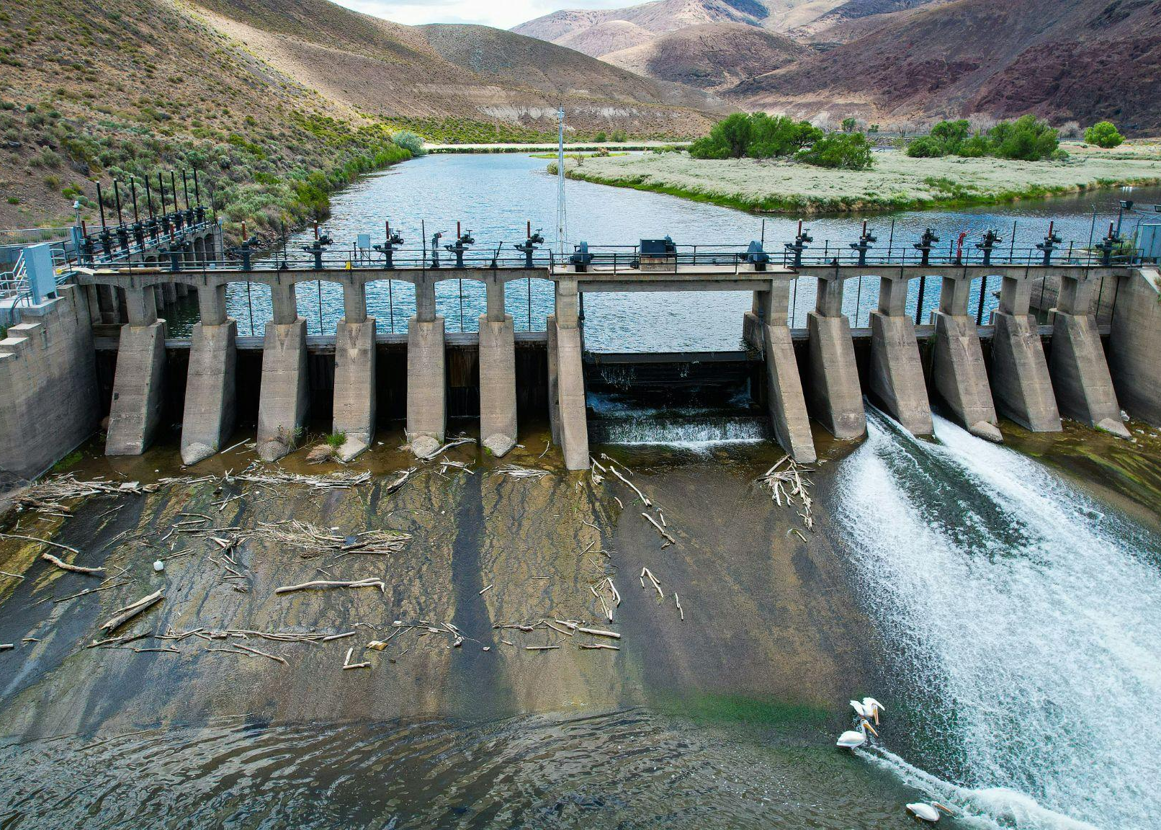
Renewable Energy Resources
Think of hydroelectric dams like giant water slides! They need a good drop to get the water flowing with enough force to create electricity.
This difference in height between where the water enters and exits the dam is called the "head." The water upstream, waiting at the top of the slide, is called the "headwater." The water downstream, after it has zoomed down the slide, is the "tailwater." The dam acts like a gate, separating these two levels of water.
Photo by Manny Becerra
Notes:
Teacher notes:
Explain the content on the slide to students.

Slide 39
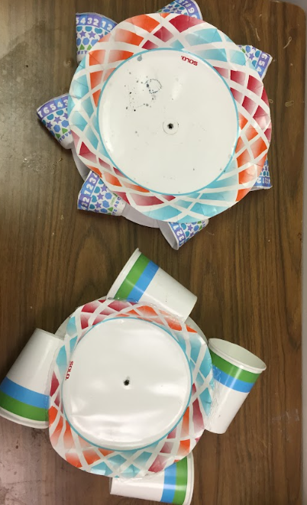
ACTIVITY
The Challenge: Design and create a water wheel or a windmill or something of your choice. Think about the different components you will need. What is essential to making it work?
The Variables: What are the parts that might change how effective it is? What will have the most effect on your outcome? (different cup/blade sizes, tape vs glue, angle of cups/blades, etc)
The Plan: Sketch a quick plan for your design.
The Build: Build your design using allowed materials.
The Test: Test your design to see how many revolutions your build can complete in one minute. (the waterwheel only gets two official tests to conserve water)
Notes:
Teacher notes:
Pass out allowed materials to students and help them build with a windmill or a water wheel.
Materials:
Paper Plates
Paper Cups (various sizes)
Hot glue guns and glue sticks (alternative: Tape)
Straws of Kebab sticks

Slide 40
EXIT TICKET
Don’t forget to complete your daily learning log!!
What improvements would you make to your windmill or water wheel?
Notes:
Teacher notes:
discuss as a class and/or have students keep a learning journal throughout this initiative
Explain the exit ticket on the slide to students. Distribute the handout (linked here) to students to complete the exit ticket.
Remind students to complete Daily Learning Log

Slide 41
Lesson 4
Sustainable Energy

Slide 42
DO NOW
Mystery Energy Source:
Try to guess the energy source is based on the clues below. Write your guess on your handout. Clue 1: This energy source can be found in your kitchen. Clue 2: It comes from something we often throw away after meals. Clue 3: It can be used to create fuel for cars or even generate electricity.
Notes:
Teacher notes:
Explain the do now on the slide to students. Distribute the handout (linked here) to students to complete the do now.
Answer: Food waste or biofuel

Slide 43
OBJECTIVE
Students will
Describe unconventional types of renewable energy
Notes:
Teacher notes:
Review the objectives for the day, so students know what is expected of their learning

Slide 44
AGENDA
Do Now
Introduction of Unconventional Energy Resources
Activity: Design a New Energy Resource
Exit Ticket
Notes:
Teacher notes:
Review the agenda for the day

Slide 45
Unconventional Energy Resources
Tidal Energy
Tidal energy harnesses the power of the ocean's tides, those regular rises and falls in sea level caused by the moon's gravity. Special underwater turbines are placed in areas with strong tides. As the tide rushes in and out, it spins the turbine blades, generating electricity. This renewable energy source is predictable and reliable, but suitable locations are limited.
Piezoelectric Energy
Algae Biofuel
Space-based Solar Power
Notes:
Teacher notes:
Explain the content on the slide to students.

Slide 46
Unconventional Energy Resources
Tidal Energy
Piezoelectric energy is a bit like magic! It's the ability of certain materials to create an electric charge when they are squeezed or stretched. Imagine crystals or special ceramics that generate a tiny spark of electricity when you press on them. This energy can be harnessed to power small devices, like sensors or even wearable technology, using vibrations from everyday actions like walking or closing a door. It's a cool way to capture energy that would otherwise be wasted!
Piezoelectric Energy
Algae Biofuel
Space-based Solar Power
Notes:
Teacher notes:
Explain the content on the slide to students.

Slide 47
Unconventional Energy Resources
Tidal Energy
Algae biofuel is a type of renewable energy that comes from, you guessed it, algae! These tiny aquatic plants can grow incredibly fast, and some types produce oils that can be turned into fuel for cars, trucks, and even airplanes. It's like a tiny underwater oil well! Algae biofuel is considered carbon-neutral because the algae absorb carbon dioxide as they grow, offsetting the emissions released when the fuel is burned. This makes it a promising alternative to fossil fuels, and scientists are working on ways to produce it efficiently and affordably.
Piezoelectric Energy
Algae Biofuel
Space-based Solar Power
Notes:
Teacher notes:
Explain the content on the slide to students.

Slide 48
Unconventional Energy Resources
Tidal Energy
Imagine giant solar panels in space, soaking up the sun's energy 24/7 without being blocked by clouds or nighttime! That's the idea behind space-based solar power. These orbiting solar power stations would capture sunlight and beam it down to Earth as microwaves, which would then be converted into electricity. This technology could provide a constant and abundant source of clean energy, but it's still in the early stages of development and faces challenges like high costs and the complexity of building and launching such massive structures into space.
Piezoelectric Energy
Algae Biofuel
Space-based Solar Power
Notes:
Teacher notes:
Explain the content on the slide to students.

Slide 49
ACTIVITY
Design your own unconventional energy resource by drawing it in your handout.
Notes:
Teacher notes:
students will design and build a new energy resource on the lesson handout. Distribute the handout (linked here) to students to complete the activity.

Slide 50
EXIT TICKET
Don’t forget to complete your daily learning log!!
Share you newly designed energy source with the class.
Notes:
Teacher notes:
discuss as a class and/or have students keep a learning journal throughout this initiative
Remind students to complete Daily Learning Log

Slide 51
Lesson 5
Building Solutions for Sustainable Energy
Notes:
Unleashed Lesson 1:

Slide 52
OBJECTIVE
Students will
Design and build a new energy resource using allowed materials
Notes:
Teacher notes:
Review the objectives for the day, so students know what is expected of their learning

Slide 53
AGENDA
Do Now
Introduction of Energy Resource contest
Activity: Design and Build a new Energy Resource
Exit Ticket
Notes:
Teacher notes:
Review the agenda for the day

Slide 54
DO NOW
Would you rather use only renewable energy resources or nonrenewable energy resources forever?
Notes:
Teacher notes:
discuss as a class and/or have students keep a learning journal throughout this initiative
Explain the do now on the slide to students. Distribute the handout (linked here) to students to complete the do now.

Slide 55
Energy Resource Challenge
You’ve been tasked with building a new energy resource!
You will
Design a new energy resource
Obtain peer feedback
Share resource with your classmates
Submit to the BreakFree contest!
Notes:
Teacher notes:
students will design a build a new energy resource individually or in groups of up to three.

Slide 56
Peer Feedback
Pair up together and provide feedback with these three prompts:
LIKE
WISH
WONDER
What do you like?
positive comments
What do you wish?
positives critiques
What do you wonder?
questions you have
Notes:
Teacher notes:
Explain the feedback process on the slide to students. Distribute the handout (linked here) to students to complete the peer feedback.

Slide 57
EXIT TICKET
Don’t forget to complete your daily learning log!!
Question
Submit your energy design to the BreakFree contest!
Notes:
Teacher notes:
Submit ALL student’s designs to the BreakFree contest (videos and images are welcome).
Remind students to complete Daily Learning Log

Slide 58
Unwasted

