Slide 1



Undivided
Civic Engagement

Slide 2


Day 1
Unit Launch & Introduction

Slide 3


Do Now: Three Words Association Activity
Using a pen and pencil, write the first three words (people, places, adjectives, etc.) or phrases that you associate with the following topics: Gun Control Community Advocacy Safety The 1970’s
Notes:
Warm up and Prime to the topics they will be exploring over the next couple days with this activity.
Feel free to swap out different words as you see fit
This can be a silent activity until you have asked students to write down their words for each topic, or you can have students volunteer to share what they wrote as you go along

Slide 4


Agenda
Do Now: Word Association Game
Unit Introduction: Expectations, focus, & goals
Reading Kickoff: Read aloud & begin Policy Perspective handout
Closing
Notes:
Key Notes:
Note: Given choice of how to read the chapter with students, this lesson can be broken into two days, or any reading that is not completed in class may be assigned as homework

Slide 5


Objectives
Students will be able to:
Introduce the Undivided unit
Use critical listening skills to learn about the life and work of Locking Up Our Own author, James Forman, Jr.
Begin reading Chapter 2 of Locking Up Our Own

Slide 6


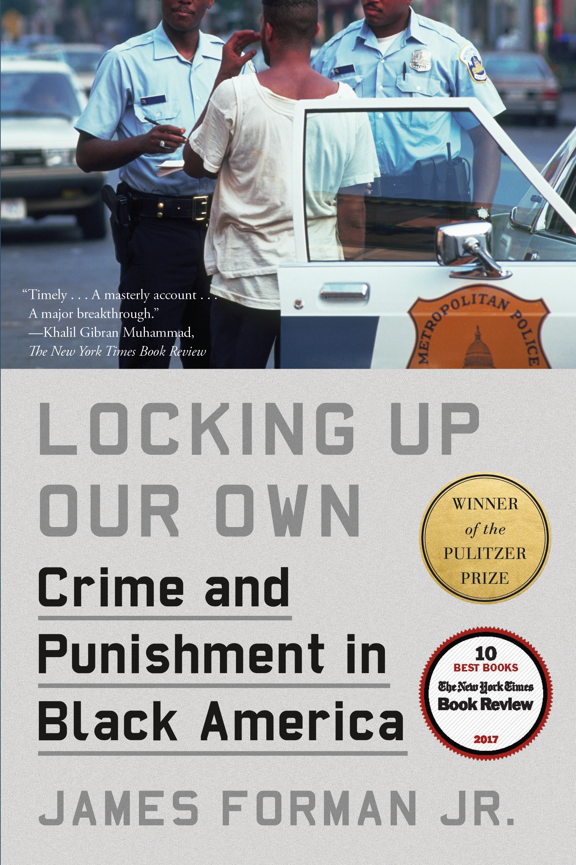
Introduction: What is Locking Up Our Own?
Over the next several days, we will be reading a Chapter from the book, Locking Up Our Own, by James Forman, Jr. and using it to explore gun control both in 1970’s Washington, DC and today across America
Notes:
Tell students they will be exploring a chapter from the book Locking Up Our Own by James Forman, Jr. Explain that the book’s genre is nonfiction.

Slide 7


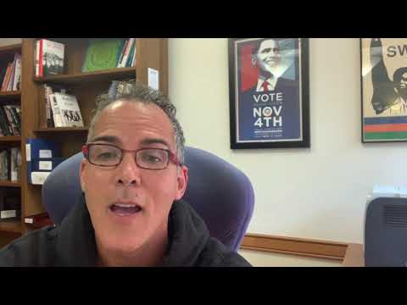
Activity
LAUNCH VIDEO!
Notes:
Share this 1.5 minute video with your class to launch the initiative

Slide 8
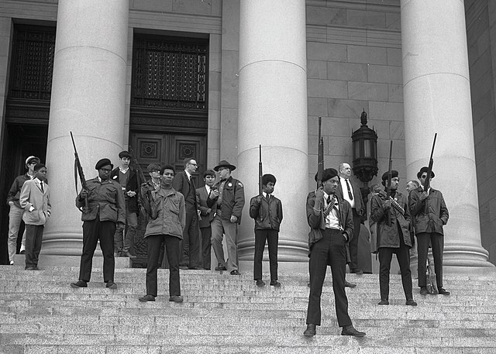
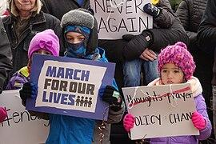
Introduction: What to Expect
Throughout this unit we will:
Read and analyze Chapter Two of the book Locking Up Our Own to identifying key policy perspectives on gun control
Prepare for and participate in a mock city council meeting
Learn about gun control in American today and how to advocate for changes in our community
Source: Black Panther Demonstration. CIR Online via Wikimedia commons; Photo courtesy of the State Governors’ Negative Collection, 1949-1975, Washington State Archives.
Source: Mark for our lives. Susan Ruggles from Milwaukee, USA

Slide 9
Goals of this Unit
By the end of this unit, our goal is to be able to answer the following questions:
How and why did African American leaders differ in their response to gun control measures?
What are the best ways to reduce gun violence today?
How can young people play a role in efforts to reduce gun violence?

Slide 10
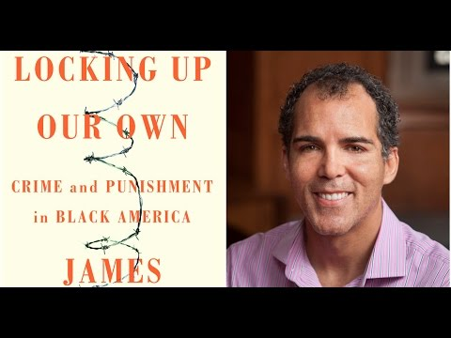
Getting to Know the Author: James Forman, Jr.
Be sure to use your Listening Log and take notes!
Notes:
Provide each student with a copy of the Listening Log. Explain to the class how each student will fill out their log with their reactions to media that introduces them to the book and James Forman, Jr.
Watch a 3½ minute video of the author that provides a sense of the book’s topic, themes and thesis so they can better appreciate the author’s purpose for writing. Instruct students to use the log while watching. (Note: The video link is 5 minutes and 40 seconds, but we recommend stopping at 3:32)

Slide 11
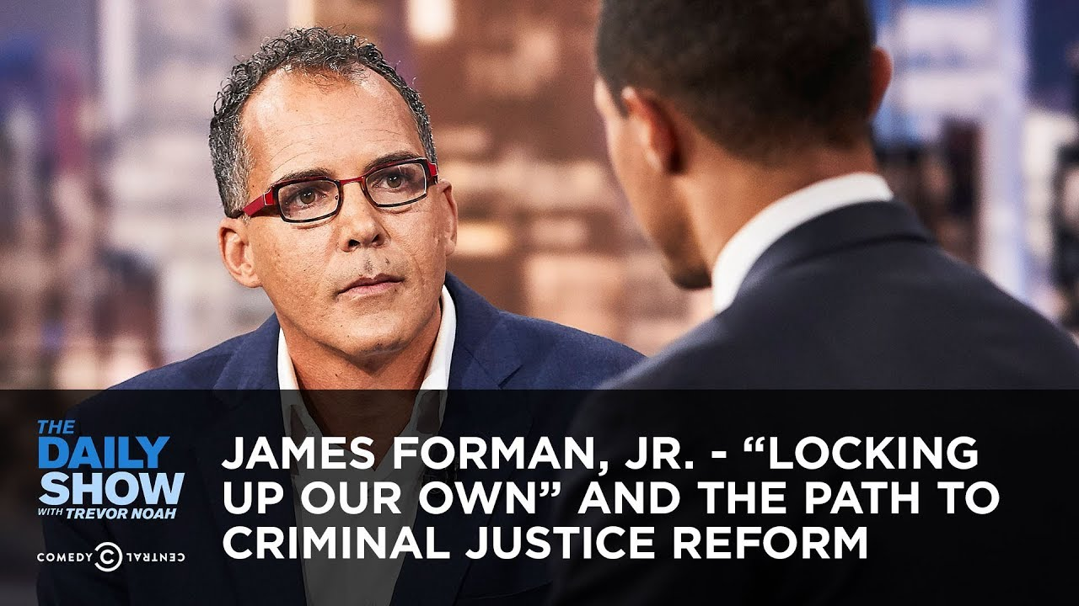

Getting to Know the Author: James Forman, Jr.
Be sure to use your Listening Log and take notes!
Notes:
1. Play a 1 minute audio clip which further expands on the author’s motivation. In this clip, Forman explains how he wants to help readers understand the complexity of African American opinion about the criminal justice system.

Slide 12
Getting to Know the Author: What did you learn?
What are 3 things we learned about the author?
What are 3 things we want to learn more about as we read the book chapter?
Any other thoughts or questions?
Notes:
1. Ask students to share the reactions and views by sharing what they added to their listening logs.
2. Ask students why they think James Forman Jr. wrote the book

Slide 13
Jumping Into Chapter Two!
Before we begin reading…
  Keep an eye out for facts or statistics that prove there was a gun violence problem in Washington, DC during the 1970’s
  Look for key characters (city council members and other politicians) and their policy perspectives on how to deal with DC’s gun violence
Use your Policy Perspective Identification Log!
Notes:
1. Tell students that as they read this chapter, they’ll need to start identifying the different policy perspectives on gun control. Hand out the Policy Perspective Log and show them how to use it.
You can define policy perspective as a “plan of action for addressing a concern, adopted by an individual, government, or group.”
2. Together, identify some of the examples of gun violence that has led the city council to call for a vote on gun control and add to Log (See pages 46-50)
Note: the first policy perspective is on page 55, you can choose to read to that point to show students how to write policy perspectives in the log together
3. Students can read independently, in pairs or aloud as a class, or you can break up the reading by doing a combination of these. We have provided a reading strategies guide with the following information:
Students who read the chapter independently should take Thinking Notes.
Students reading in pairs should use the Say Something strategy.
Use Shared Reading strategies if you read the chapter, or parts of it, aloud as a whole class.

Slide 14
Chapter Two!
Policy Perspective or Facts | What do you know about this policy perspective?
Facts/Statistics that prove gun violence was a problem
Policy #1 Leader: John Wilson Name:
Notes:
As you begin reading, complete the first row of the log together
You can leave this on the projector as students read independently/in groups to remind them of the process

Slide 15







Exit Ticket: Interest Survey
On a scale from 1 to 5, how interested are you in learning more about gun control and continuing this unit?
Thank you, next
Seems boring
This will be alright
I think I’m gonna like this
Super-Duper Excited

Slide 16
Day 2
Reading Chapter 2

Slide 17
Do Now
Answer the following question about the Author. Write your answer on a slip of paper to submit later with our closing question. Why did James Forman Jr. write Locking Up Our Own? To show the complexity of crime and punishment in the Black community To create a greater understanding of mass incarceration in America To discuss how/why people within the Black community have different opinions on how to deal with crime All of the above
Notes:
1. Provide students with a slip of paper for them to write down their answer to both this Do Now, as well as their closing question at the end of this lesson.

Slide 18
Agenda
Do Now: Multiple-Choice Review Question
Read Chapter 2
Closing
Notes:
Key Notes:
Note: Given choice of how to read the chapter with students, this lesson can be broken into two days, or any reading that is not completed in class may be assigned as homework

Slide 19
Let’s Read
Open your reading to where you left off before.
Remember,
Look for key characters (city council members and other politicians) and their policy perspectives on how to deal with DC’s gun violence
Use your Policy Perspective Identification Log!

Slide 20
Exit Ticket: : Fill-in-the-Blank
Complete the following sentence: “Gun control debates of the 1970’s are like ____________ because __________________________________.”
Notes:
1. Ask students to write their answers on the same slip of paper as the Do Now and collect their answers.

Slide 21
Day 3
Preparing for Mock City Council Meeting

Slide 22
Do Now: Gallery Walk
Complete the Gallery Walk & share your opinions!
Notes:
Click here to access Gallery Walk prompts

Slide 23
Do Now: Gallery Walk
Between 1960 and 1969, the DC’s murder rate tripled. In 1974, more than 60% of the 407 murders involved firearms. National polls showed that blacks were more fearful than whites. Gun crime was concentrated among poor blacks, who were forced into living conditions that generated violence. Do you agree or disagree with then DC Council member John Wilson’s proposal to deal with this “crime crisis”: Ban the sale, purchase and possession of all guns in the city Current gun owners would be obligated to turn in their weapons Anyone who failed to turn in their firearm would face possible prison time for a first conviction and a mandatory prison term for a second. People caught with a gun will have to serve 10 to 12 months, no ifs, ands or buts.

Slide 24
Do Now: Gallery Walk
Doug Moore claimed that blacks need guns for self-defense against violent whites. Rev. Russ Meeks argued that Congress should “attack the social causes of crime and not the ownership of weapons.” Do you agree or disagree with Moore and Meeks that the solution to decrease violent crimes occurring in our poor, black neighborhoods was not to take away the guns but to fix the problems of prejudice that result in poverty, poor housing, lack of available jobs available to blacks, etc?

Slide 25
Do Now: Gallery Walk
“Restricting guns is a necessary part of reducing crime.” Do you agree or disagree with this statement?

Slide 26
Agenda
Do Now: Gallery Walk
Introduction to City Council Meetings
Role Assignments & Instructions
Policy Proposal Preparation
Closing

Slide 27
Objectives
Students will be able to:
Use textual analysis to determine opinions on policy proposals
Learn about City Councils and upcoming mock city council meeting

Slide 28
What is A City Council?
A city council is the legislative body that governs a city-- a group of people who come together to consult, deliberate, and make decisions for a city.
The council looks to the city's goals, major projects, and needs to develop policy and laws that will help the city
A city council meeting is when councilmembers propose ideas and then vote on enacting those ideas into policy. The public is invited to ask questions or raise concerns

Slide 29
Our Mock City Council Meeting
It’s June, 1975, and the chair of the D.C. City Council has called an Emergency Hearing on Gun Violence in Washington, D.C.
We’ll divide into groups and take on roles of the City Council members described in the book
Each City Councilmember will make a 3-4 minute speech advocating for their policy proposal to end gun violence
Community members will ask Councilmembers questions about their policies
Our meeting will end with a final City Council Vote on what gun control policy to adopt
Notes:
1. Tell your students that you are going to divide them into groups, and each group will research their role to participate in a hearing. We propose dividing the students into six groups, but you can reduce or increase this number as you see fit. The groups can (but don’t have to be) the same size. In our experience, group 6 (other City Council members) is the one that can be expanded the most.
2. Teacher can also decide to play the role of the City Council Chair (group 1) to facilitate the meeting and keep things moving

Slide 30
Our Mock City Council Meeting
The groups:
Group 1: City Council Chair
Group 2: Councilmember John Wilson
Group 3: Councilmember John Conyers
Group 4: Detroit Mayor Doug Moore
Group 5: Congressman Coleman Young
Group 6: Additional City Council members
Opens/facilitates meeting and voting
Gives a 3-4 minute speech making a policy proposal
Asks questions to Councilmembers
Notes:
1. Assign students to roles in whatever way you see fit. (We like to put the roles in a paper bag or some other container and pass them around the room for students to choose.)

Slide 31

What is A City Council?
In your groups:
Read through Role Assignment
Start to think about who will be speaking for the group during the mock meeting (will one person speak? Will you divide the speech up?)
Notes:
1. Provide each group with copies of their Group Assignments, and allow them to read through it as a group.

Slide 32
Exit Ticket: Reflection
With a partner discuss the following questions: Do you think gun violence in America is the same, more, or less than in the 1970’s? What makes you have that opinion?

Slide 33
Day 4
Preparing for Mock City Council Meeting
Notes:
Key Notes:
The bulk of this lesson will be to prepare for the upcoming hearing. Working in groups, students are assigned a figure from Washington D.C.’s gun control debates of the 1970s. With the book as a guide, each group must adopt their assigned figure’s message and prepare a specific gun policy proposal that they will advocate for during the mock City Council Meeting tomorrow.

Slide 34
Do Now
Write down three qualities of a good speaker
Notes:
1. Make sure students have an index card or slip of paper to write on

Slide 35
Agenda
Do Now
Policy Proposal Speech Preparation
Closing

Slide 36
Objectives
Students will be able to:
Use textual analysis to craft arguments, rebuttals and questions regarding policy proposals in Chapter 2
Prepare for a mock City Council hearing in small groups

Slide 37
Our Mock City Council Meeting
The groups:
Group 1: City Council Chair
Group 2: Councilmember John Wilson
Group 3: Councilmember John Conyers
Group 4: Detroit Mayor Doug Moore
Group 5: Congressman Coleman Young
Group 6: Additional City Council members
Opens/facilitates meeting and voting
Gives a 3-4 minute speech making a policy proposal
Asks questions to Councilmembers
Notes:
1. Remind students how the mock city council meeting will run and make sure each group has their assigned role instructions.

Slide 38
Our Mock City Council Meeting
In your groups:
Read through Role Assignment
Use Chapter 2 and your Policy Log to complete the Legislative Proposal Worksheet and write your speech
Identify who will be speaking tomorrow (will one person speak? Will you divide the speech up?)
Notes:
1. Have the groups separate to work together to prepare for the hearing. They should plan to use Chapter 2 as a resource for proposals and general information on their position, as well as the Policy Log that they completed yesterday. As they research, encourage your students to begin filling out the Legislative Proposal Worksheet, which will be their guide when it is their turn to speak.
2. When working in groups, students can take on roles: one person will be the speaker in tomorrow’s mock meeting (you will present your group’ speech to the class), one person will be the discussion leader (You will guide the group in responding to the questions that are asked and you will write down the responses to the questions on the group handout), and one person (or more) will be the researcher (you will find where your policy is discussed in the book and pull out key terms or phrases to use in your groups speech)

Slide 39
Our Mock City Council Meeting
When using the Legislative Proposal Worksheet and preparing your speech:
State your name and your involvement in the issue.
Present your opinion based on the perspective of your character.
Give evidence that supports your opinion.
Employ ‘devil’s advocate’ strategies to argue against the proposal or the positions of fellow attendees. (This section is adaptable based on what is said at the meeting.)
Conclude your speech by thanking the school board for initiating the town hall meeting.

Slide 40
Exit Ticket
Turn in your Policy Proposal Worksheets
Notes:
1. Choose a closing (this or next slide): Reflection or Fill-in-the-Blank

Slide 41
Day 5
Mock City Council Meeting
Notes:
Key Notes:
This class is dedicated to the mock City Council meeting. Using the prepared policy proposals from yesterday, students will take on their assigned role and advocate for their proposal. By examining the spirited debates of 1970s Washington D.C., students are asked to explain how community members with the common end goal of stopping gun violence could support completely dissimilar policy actions.

Slide 42
Do Now
Sit in your assigned seats for the mock city council!

Slide 43
Agenda
Do Now
Reflection Question Preview
Mock City Council Meeting
Closing

Slide 44
Objectives
Students will be able to:
Participate in a mock city council meeting

Slide 45
Instruction
Did the proposals you heard satisfy you?
Were there other proposals to reduce gun violence that you would have liked to have heard?
What would YOU propose if you were a City Council member?

Slide 46
City Council Meeting Agenda
Call Meeting to Order (Group 1- City Council Chair)
Opening Statements of the Witnesses (Groups 2-5)
Questions from City Council members (Group 6)
Voting (all groups)
Notes:
Start class with The Opening Statements of the Witnesses.
Have the Council Chair call the hearing to order.
Each witness should testify, and you will need to enforce the time limit. If you have a stopwatch or clock that everybody can see that can also be helpful.
Make sure to have all the witnesses testify before getting questions from the council members. Otherwise, you run the risk of running out of time before all the witnesses can testify.
Questions from City Council member
Once the witnesses have testified, it is time for the council members to ask questions. The Council Chair is instructed to encourage other council members to ask questions before asking one him/herself. This is only fair given that the chair will have had a chance to speak already in the opening remarks.
You should encourage council members to be similarly courteous; once they have asked a question, they should allow others to participate before asking a follow-up.
Voting
After questions are completed, the Council Chair should announce that each of the proposals is going to be voted on. You might consider writing the proposals on a board so that the council can see them.

Slide 47
City Council Meeting Voting
Proposal 1 (from John Wilson)--Prohibit the sale, manufacture, or possession of handguns.
Proposal 2 (from Coleman Young)--Impose a 2-year mandatory minimum sentence for anybody who commits a crime while armed with a gun.
Proposal 3 (from John Conyers)--Massive infusion of resources into poor communities, with a particular focus on schools, jobs, and housing
Notes:
1. Have council members vote on each of the proposals. (We prefer to encourage students to vote their own opinions, though you might also decide to have them vote as they would imagine their assigned council member might vote.) Note that they don’t have to choose between the 3 proposals. The can vote yes on all three, no on all three, or yes on some and no on others. Finally, because the voting is fun and educational, we encourage you to allow Rep. Conyers and Mayor Young to vote as if they were members of the D.C. Council, though in real life they wouldn’t have a vote of course.
2. Tally the votes and see what you passed! If possible, record the outcome somewhere on your classroom wall as a way of memorializing the hearing. Note: if dealing with time constraints, you can wait to announce the voting results until the next class, after you’ve had time to tally.

Slide 48
Exit Ticket
Complete the Peer Evaluation Form to assess your group’s performance and effort
Notes:
1. Provide students with the Peer Evaluation Form and have them complete it and submit.

Slide 49
Day 6
Debrief of Mock City Council Meeting

Slide 50
Do Now: Write A Slogan
Imagine you are an elected official and you are trying to get your community to focus on gun violence and the need for gun control policy. Create a short slogan or hashtag to use.

Slide 51
Agenda
Do Now
Voting Results
Reflection & Debrief
Closing
Notes:
Note: remove ‘voting results’ if you’ve already done this

Slide 52
Objectives
Students will be able to:
Debrief and reflect on the mock city council hearing and the proposals made by the characters

Slide 53
Debrief: Reflection Questions
Consider this question:
Did the proposals you heard yesterday satisfy you?
Notes:
Note: These prompts tie directly into the material for the next class, where students will be asked to express their own views about how best to reduce gun violence.

Slide 54
Debrief: Reflection Questions
Consider this question:
Were there other proposals to reduce gun violence that you would have liked to have heard?
Notes:
Note: These prompts tie directly into the material for the next class, where students will be asked to express their own views about how best to reduce gun violence.

Slide 55
Debrief: Reflection Questions
Consider this question:
What would YOU propose if you were a City Council member?
Notes:
Note: These prompts tie directly into the material for the next class, where students will be asked to express their own views about how best to reduce gun violence.

Slide 56
Exit Ticket
Respond to the questions on your exit slip and submit before leaving
Notes:
1. Handout exit slips with feedback questions on the unit fo far or today’s discussion. You can use this sample exit slip if you choose.

Slide 57
Day 7
Current Gun Control Movement and Student Activism
Notes:
Key Notes:
This lesson brings the gun control debate into the present, and recent activism by student groups across the country provides for rich content. Much of this lesson asks students to engage in active listening while watching videos or reading the March For Our Lives statement, with a discussion section tomorrow. For the lesson to be successful, it’s important that students think about how the different forms of gun violence in different contexts are portrayed by the media, political leaders, their communities, and the students themselves.

Slide 58
Do Now: Quick Journaling
Using a pencil and paper, respond the the following: What do you know about the school shooting that happened at Marjory Stoneman Douglas High School in Parkland, Florida on February 14, 2018, and the #NeverAgain movement that started after it?

Slide 59
Agenda
Do Now: Quick Journaling
Review success/failure of gun control initiatives of 1970s
Learn about March for Our Lives and the #NeverAgain movement
Closing

Slide 60
Objectives
Students will be able to:
Make connections between the current and past gun control debate and problem of gun violence
Examine how the dynamics of inclusion and intersectionality are shaping youth-led activism around gun violence

Slide 61
March For Our Lives: What was it?
March 24, 2018 was the largest day of protest against gun violence, and one of the largest protests of any kind in American history
A total of 1.2 - 2 million people participated in over 800 events across the country
Let’s learn some more…
Notes:
1. Tell students that the March for Our Lives on March 24, 2018 was the largest day of protest against gun violence, and one of the largest protests of any kind in American history. The march was student-led, with over 800 events occurring that day in support. In total, these events had an estimated attendance of 1.2 to 2 million people. Tell students that now, you’ll study more about the march and its effects through these two videos.
2. Pass out the Listening Log to be used while watching the videos after looking through the next slides of photos.

Slide 62
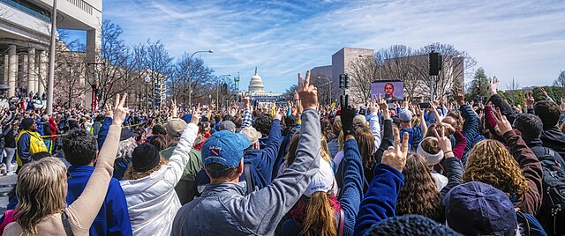
March for Our Lives, 2018
On 24 March 2018 In DC and other cities, hundreds of thousands of students and others marched to demand common sense gun control in the wake of deadly school shootings in the U.S.
Source: Mobilus In Mobili via Wikimedia Commons

Slide 63
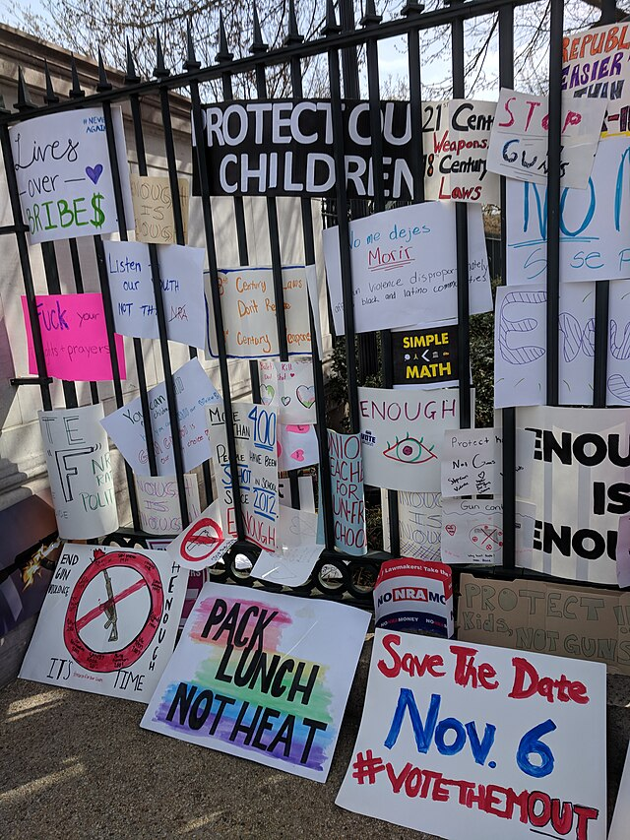
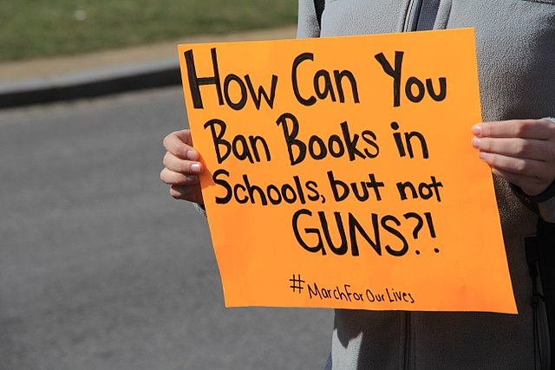
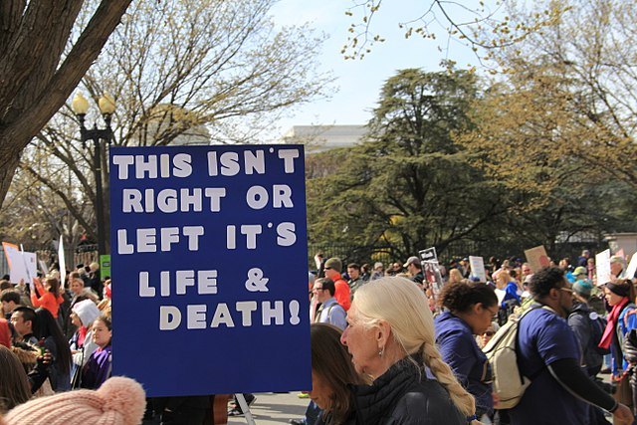
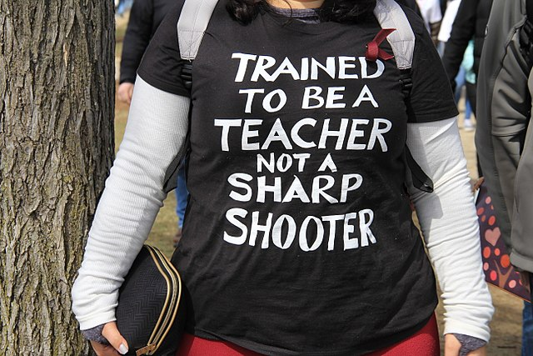
March for Our Lives, 2018
Source: Ziggyfan23 via Wikimedia Commons
Source: Ziggyfan23 via Wikimedia Commons
Source: Bohemian Baltimore via Wikimedia Commons
Source: Ziggyfan23 via Wikimedia Commons

Slide 64
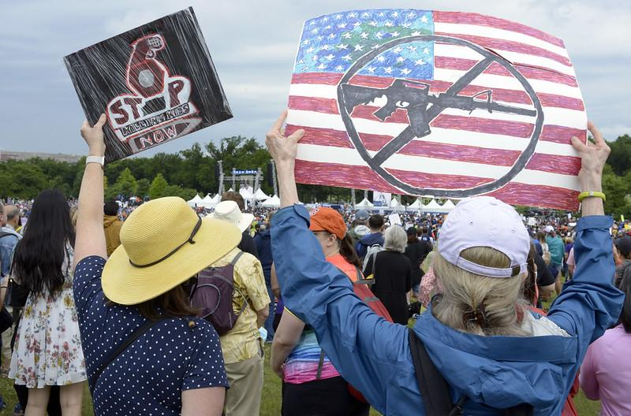
March For Our Lives: On-Going
March for Our Lives continues to march to support the reimagining of public safety. There were numerous March for Our Lives events after the Uvalde shooting in May 2022.
Source: Stephen Melkisethian
Notes:
1. Tell students that the March for Our Lives event has continued since 2018 including marching after the Uvalde shooting in May of 2022.

Slide 65
Mini Discussion
Did you see these marches?
Have you followed any of the news of the activism?
How did seeing the student activism make you feel?
Notes:
Allow students to briefly reflect on the photos
Pass out the Listening Log to be used while watching the videos after looking through the next slides of photos.

Slide 66
Exit Ticket: 3-2-1
Write down… 3 things you learned today, 2 things you have a question about, and 1 thing you want your teacher to know
Notes:
1. Provide exit slip or index card for students

Slide 67
Day 8
Discussion on Current Gun Control Movement
and Student Activism

Slide 68
Do Now: Quick Journaling
Using a pencil and paper, respond to the following question. (You may either write or draw an image to convey your answer.) What does it mean to be an ‘activist’?

Slide 69
Agenda
Do Now: Quick Journaling
Class Discussion: the role of student activism in the current gun control debate
Closing

Slide 70
Objectives
Students will be able to:
Examine how the dynamics of inclusion and intersectionality are shaping youth-led activism around gun violence
Discuss the role of student activism in today’s gun control debate

Slide 71
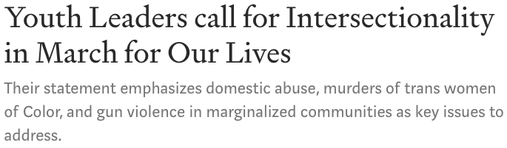
March for Our Lives: Student Statement
Read the student-written statement on March for Our Lives
What does “intersectionality” mean?
Notes:
1. Provide students with a copy of the Statement on March for Our Lives written by student leaders Zyahna Bryant and Fré Halverson-Taylor. Read it aloud, as a class. (To note: this powerful statement repeats many of the themes of the above videos and discussion, but we believe it’s worth including in your class).
2. Define intersectionality for your students. You can use the following definition: “An intersectional approach to gun control demands that we look for solutions that take into account all aspects of one's experiences of oppression (race, class, gender, education level) as well as the systems that produce and perpetuate that oppression in order to understand how those forces intersect and create barriers to justice.”

Slide 72
March for Our Lives: An Intersectional Approach
An intersectional approach to gun control demands that we look for solutions that take into account
  all aspects of one's experiences of oppression (race, class, gender, education level), and
  the systems that produce and perpetuate that oppression in order to understand how those forces intersect and create barriers to justice

Slide 73
March for Our Lives: Discussion
Which group of students--Parkland or Chicago--do you identify with more?
What are some of the differences you saw between the violence in the lives of the Parkland students and violence in the lives of the Chicago students?
What are some of the similarities?
How do you think differences in how gun violence impacts those communities might affect the kinds of solutions different groups would push for?
Notes:
1. Have students reflect on the photos and videos about the #NeverAgain movement, and the students of Parkland and Chicago. Using their Listening Logs, you could have a class discussion, have students talk in pairs, or ask for written responses.
2. Optional: pass out the discussion questions so students have a moment to read through them before offering their thoughts. You can have students begin in groups working down the page of discussion questions before coming together as a class to share out.

Slide 74
March for Our Lives: Discussion
Is March for Our Lives something that should be expanded to include other issues or causes? What causes would you suggest and why?
Has gun violence had an impact in your life--either in your family, friend group, or community?
  What was the impact?
  Who do you blame for what happened? Is the government responsible in any way? Is there anything the government could do through its laws to make violence like that less likely?
Notes:
Note: The second question here may be sensitive for your students. Depending on the norms of your class, this might be a good place to remind students that if something feels too personal or uncomfortable they don’t have to talk about it. Additionally, use your discretion as to whether to omit the question in its entirety.

Slide 75
Exit Ticket
How can you be an activist today?

Slide 76
Day 9
Current Gun Control Policy Ideas

Slide 77
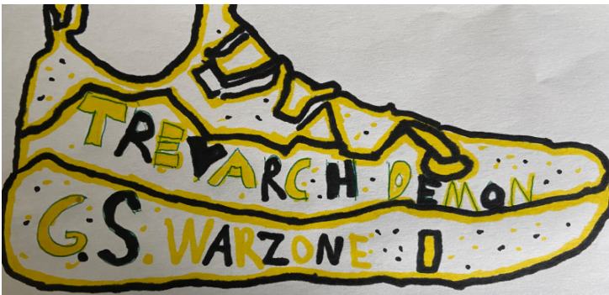
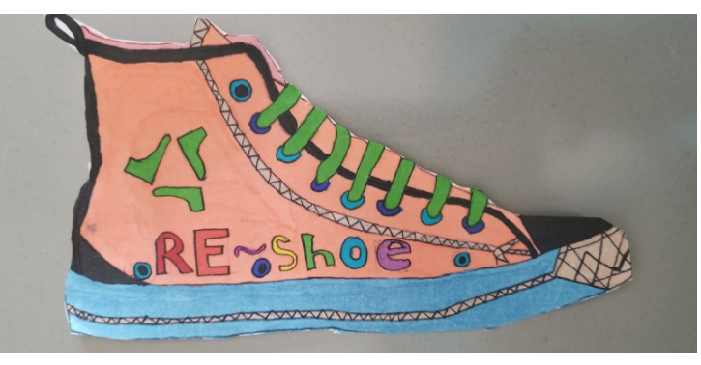
Do Now: March Shoe Design
Showing empathy for others means that we place ourselves in their shoes. Encourage people to address gun violence issues by writing a letter to a politician and designing your own shoes for a March for our Lives event. Be Creative!
Notes:
Note: Students will have a second opportunity to work on their shoe design in tomorrow’s lesson. BreakFree will host a competition for students to submit their final design to win prizes! (see last slides for more information)

Slide 78
Agenda
Do Now: March Shoe Design
Review policy ideas to address gun violence
Activity: write a letter to a politician
Closing
Notes:
1. Start class by explaining that today, you will use what you learned last class about the tactics and agenda of the March for Our Lives movement to learn more about current gun violence policies. Students will individually determine what they believe is an important policy to decrease violence, and will then express their views by writing a letter to a politician.

Slide 79
Objectives
Students will be able to:
Analyze and respond to various policy ideas to reduce gun violence
Begin to determine what you believe is the best approach to reducing gun violence

Slide 80
Policy Ideas for Addressing Gun Violence
Fund gun violence research
Mandate universal background checks
Arm school personnel and prepare schools against shootings
Limit firing power on the streets
Fund intervention programs
Restrict gun trafficking
Remember to use your Policy Idea Assessment handout
Notes:
1. Review the six recent policies and proposals to address gun violence. Explain to students they will choose one of these proposals to use when designing their shoe. To make this exercise more relevant to your class or community, you could add proposals that are specific to your local context. These could range from state initiatives to city actions to school-related policies.
2. Distribute the Policy Idea Assessment handout and have students fill it out as you introduce the six ideas
3. Make connections: Many of the six proposals are rooted in ideas similar to policy proposals in the 1970s, debated in Lesson 2’s City Council hearing. You can guide students to look at policies they may agree with, based on their views on Chapter 2 and its characters:
John Wilson would have likely supported proposal 4, banning semi-automatic assault weapons and high-capacity magazines.
If you agree with John Conyers that addressing root causes is essential, you may agree with proposal 5, which would fund intervention programs.
Proposal 3, arming teachers and preparing schools against shootings, is an idea that Doug Moore supporters may like.
Students who think we need to learn more about the problem before we determine solutions should look at proposal 1, to fund gun violence research.
4. Note: You may refer to the more detailed information sheets on the six policy ideas before presenting these to your students. Additionally, you may choose to have a couple copies of the sheets available for students to refer to when writing their letter.

Slide 81
Policy #1: Fund Gun Violence Research
We must provide the CDC (Centers for Disease Control and Prevention) with funding to research gun violence as a public health issue. This research is important so that we can create successful policies to combat future gun violence. More than 100 medical organizations have called on Congress to restore funding.
Some of the topics that need more research include nonfatal firearm injuries, shootings by law enforcement, and gun ownership.
Research on other leading causes of death has led to huge innovation and decreased fatality. For example, research on motor vehicle accidents has led to safer highways equipped with guardrails and barriers, laws requiring seat belts, and criminalizing unsafe driving.
Notes:
Note: Students who think we need to learn more about the problem before we determine solutions will identify with this idea, to fund gun violence research.

Slide 82
Policy #2: Mandate Universal Background Checks
It’s too easy for the wrong people to obtain a firearm. Federal law only requires a background check if you purchase a gun from a licensed dealer. We must close the private sale loophole and make sure all sales undergo a background check.
This loophole allows dangerous people to buy guns from unlicensed sellers without a background check, no questions asked.
Background checks keep guns out of the hands of people with dangerous histories, and have blocked more than 3.5 million sales to prohibited purchasers since 1994.

Slide 83
Policy #3: Arm School Personnel and Prepare Schools
School shootings are common. When this occurs, a quick and timely response by law enforcement is hoped for. However, trained school personnel can also serve a vital role. As the first to face the threat, they can lead and implement protocols designed to save lives. School security must also include best practices in security infrastructure, technology, personnel, training, and policy.
The presence of a security guard or off-duty policeman when there is an active shooter is mostly ineffective unless the security officer is armed.
For selected school staff members to be armed on school property, states will have to change current legal restrictions that prevent anyone other than a law enforcement officer or licensed security guard to carry a firearm in a school
Notes:
Note: Proposal 3, arming teachers and preparing schools against shootings, is an idea that Doug Moore supporters may like.

Slide 84
Policy #4: Limit Firing Power on the Streets
We must ban semi-automatic assault weapons and prohibit the production and sale of these weapons. We also need a solution for dealing with assault rifles that are already owned, such as a buyback program or registration.
High-capacity magazines that hold more than 10 rounds serve only one purpose – to shoot as many bullets as possible, in the shortest amount of time. These are used in most mass shootings and need to be banned.
A review of mass shootings between 2009 and 2015 found that 155% more people were shot and 47% more were killed when assault weapons or large-capacity magazines were used.
Polling consistently shows that a strong majority of Americans support laws banning large capacity ammunition magazines and assault weapons.
Notes:
Note: John Wilson would have likely supported proposal 4, banning semi-automatic assault weapons and high-capacity magazines.

Slide 85
Policy #5: Fund Intervention Programs
A comprehensive approach to reducing gun violence requires not just new policies, but investment in programs that address the root causes of this violence.
To reduce gun violence, we must invest in evidence-based violence reduction strategies that engage all community stakeholders. Program models such as Group Violence Intervention, Cure Violence, and Hospital-based Violence Intervention have proven to be successful
Richmond, California: A comprehensive strategy to address gun violence in Richmond by using elements of all three types of intervention programs resulted in a 71% reduction in gun violence leading to injury or death from 2007 to 2016.
Notes:
Note: If students agreed with John Conyers that addressing root causes is essential, they may agree with proposal 5, which would fund intervention programs.

Slide 86
Policy #6: Restrict Gun Trafficking
Guns move from states with weak gun laws to states with stronger laws. That illegal gun trafficking creates easy access to guns. Yet, there is no federal law specifically targeting gun trafficking.
Gun traffickers often falsely claim guns they purchased were lost/stolen to hide their involvement in crime. Laws that require the reporting of lost/stolen guns to law enforcement can provide a check against this behavior.
Gun traffickers often buy large quantities of guns at once in order to supply them to prohibited persons. Laws limiting the number of guns that may be purchased in a single transaction help deter this conduct.

Slide 87
Policy Ideas for Addressing Gun Violence
How would you rank these six ideas?
Discuss with a partner what your ranking is. What which one are you most passionate about? What one are you least passionate about? Why?

Slide 88

Policy in Action
Put what you’ve learned in action and write a letter to a politician!
Choose one of the policies discussed today and write a letter to a politician. If needed, please use the provided template.
Notes:
Click here to access a template for the letter to the politician. This letter will be submitted to BreakFree along with student shoe designs but we also encourage you to send the letter to the selected politician.

Slide 89
Exit Ticket
Complete and turn in your policy idea assessment & your letter to a politician!

Slide 90
Day 10
Complete the March Shoe Design
Notes:
Key Notes:
Today, students will use the discussions around policy ideas from previous lessons to guide their own activism shoe on gun violence. Students will make complete their shoe designs.

Slide 91
Do Now: March Shoe Design (continued)
Use the templates provided to design your own shoe! Incorporate one of the gun safety policies discussed yesterday! Be Creative!
Notes:
Note: Students will complete their shoe designs. You can use the templates provided (click here for a google slide deck and click here for a pdf version).

Slide 92
Agenda
Do Now: March Shoe Design
Introduce assignment: Design your Shoe
Closing
Notes:
1. Start class by explaining that today, you will use what you learned last class about the tactics and agenda of the March for Our Lives movement to understand what kind of action and activism is needed to limit gun violence. Students will individually determine what they believe is an important policy to decrease violence, and will then express their views by designing a shoe for the March Shoe Design challenge.

Slide 93
Objectives
Students will be able to:
Apply ideas about what kind of action and activism is needed to limit gun violence by designing their own shoes for the March Shoe Design challenge.

Slide 94

Activity
In closing, imagine if you are walking in a #neveragain March for our Lives event. Share your shoe design with the class and discuss how the world would be different if your ideas were put into policy.

Slide 95
Exit Ticket
SUBMIT your shoe design & your letter to a politician to the BreakFree Education competition!
Notes:
Teacher notes:
collect student artwork & written letters and submit them to the portal!!

