Slide 1
Unsung
Optional Lessons
Notes:
Access the Teacher Lesson Plans here

Slide 2
What is Tempo?
Math Lesson
Notes:
View Lesson Plan here

Slide 3
Do Now
Do you prefer fast or slow songs? Why?
Notes:
As students enter classroom, have the Do Now prompt on the screen for them to respond to in their journals, handout, or piece of paper.

Slide 4
Agenda
What is tempo?
How to calculate tempo
Song examples
Applying tempo
Tempo in Soundtrap
Exit Ticket
Notes:
Review the agenda for the day

Slide 5
Objectives
Students will be able to
Calculate the tempo of songs
Analyze the effectiveness of different tempo speeds on a song
Experiment with tempo using technology
Notes:
Review the objectives for the day, so students know what is expected of their learning

Slide 6
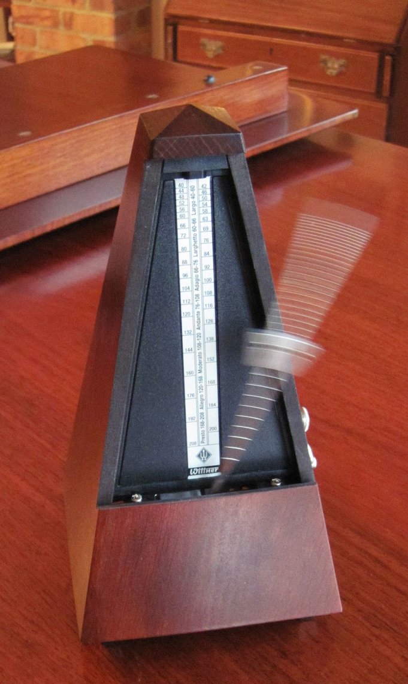
What is tempo?
Tempo is the number of beats per minute in music.
You can find the tempo of any song by doing some simple calculations!
How do you think you find the tempo of a song?
Why does tempo matter?
Did you know?
A great instrumentalist can perform a piece of music at a wide variety of tempos. To truly control her instrument, she must be able to play a passage just as compellingly at rapid speed as she might at a
languid speed, and vice
versa. For centuries,
musicians have practiced
playing at a variety of tempos
by using a device known as a
metronome, which produces
a click at a regular interval of
time.
Notes:
Ask students how they might find tempo based on the definition of tempo.
Distribute the handout for calculations:

Slide 7
How to calculate tempo
Listen to a short clip or sample of a song.
First determine the length of the sample.
Next, figure out how many samples would fit in a minute.
60 ÷ length of the sample (l) = # samples in a minute (m)
60 ÷ l = m
Count the number of beats in the sample.
Next, find the # of beats per minute or BPM.
BPM= # beats in the sample (b) x #samples in a minute (m)
BPM= b x m
Notes:
Review the steps to calculating tempo with students
Tell them that on the next few slides they will be using these equations to determine tempos of songs
*To make this lesson more challenging, use the full length songs and choose a sample in the middle of the song or before showing students how to figure out tempo. To find the length of a sample if it is in the middle of a song, subtract the end time from the start time of the sample clip or use a stopwatch. In the following slides, the sample lengths have been provided for you.

Slide 8
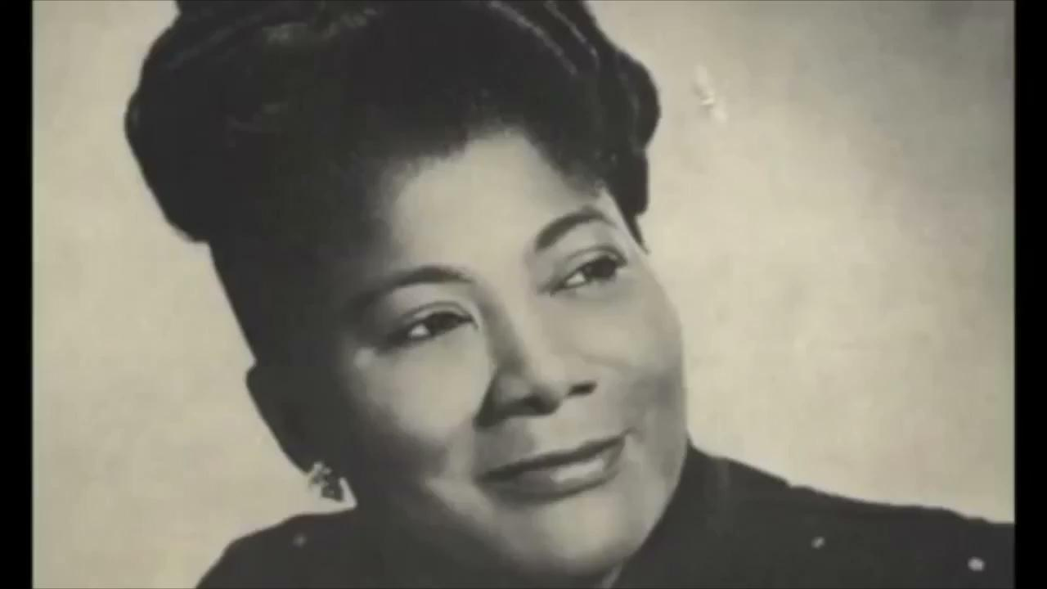
We Shall Overcome (Mahalia Jackson)
Length of the sample- 12 Seconds
How many samples would fit in a minute?
How many beats are in this sample?
What is the BPM?
Notes:
Students will count the number of beats.
Click to play the clip- You may need to play it a couple of times and have students compare how many beats they counted.
Clip link: https://drive.google.com/file/d/1nPIwCLOUl7msbLdu4Rs5DS0JBHsgSZ8-/view?resourcekey
Have students follow the steps on slide 2 on their handouts.
60/12=5
# beats= 16
16x5=80
bpm= 80

Slide 9
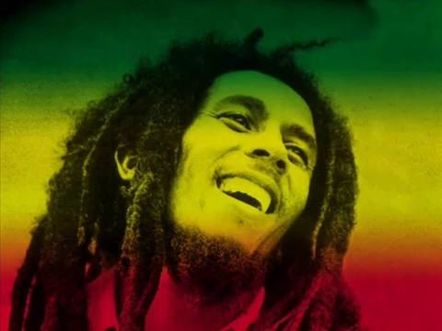
Get Up, Stand Up (Bob Marley)
Length of the sample- 11 Seconds
How many samples would fit in a minute?
How many beats are in this sample?
What is the BPM?
Notes:
Students will count the number of beats.
Click to play the clip- You may need to play it a couple of times and have students compare how many beats they counted.
Video llink: https://drive.google.com/drive/folders/17-ekBI6zWKbWq2Ooj-flcTg5n_75herH
Have students follow the steps on slide 2 on their handouts.

Slide 10
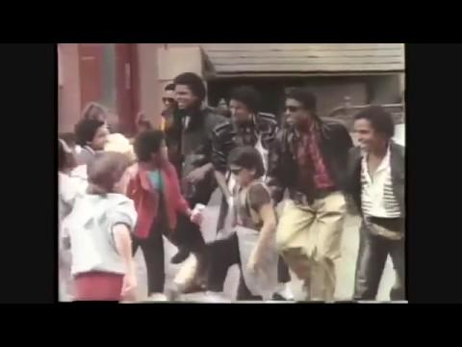
We Didn’t Start the Fire (Billy Joel)
Length of the sample- 11 Seconds
How many samples would fit in a minute?
How many beats are in this sample?
What is the BPM?
Notes:
Students will count the number of beats.
Click to play the clip- You may need to play it a couple of times and have students compare how many beats they counted.
Video link: https://drive.google.com/drive/folders/17-ekBI6zWKbWq2Ooj-flcTg5n_75herH
Have students follow the steps on slide 2 on their handouts.

Slide 11
Discussion: applying tempo
What is the most effective tempo for a protest song? What makes you think that?
How does tempo impact the song overall?
Notes:
Have students reflect on the calculations they just completed in partners, whole group, or small group discussion.

Slide 12
Tempo in SoundTrap
You can use the tempo and metronome features in SoundTrap to customize and adjust tempo.
Try it out. What happens when you increase the tempo? Decrease?
Notes:
Explain that students can use the tempo tool in Soundtrap to adjust their beats per minute.
Note: If students haven’t started their songs in SoundTrap yet, hold off on this slide until they become more comfortable with the technology.

Slide 13
Exit Ticket:
How might you incorporate what you learned about tempo into your song?
Notes:
Before students leave class, ask them to complete the exit ticket on a piece of paper or submit one through your virtual classroom.

Slide 14
We Didn’t Start the Fire
Song Analysis & Writing
Notes:
Optional Lesson: Exploring Billy Joel’s Song, We Didn’t Start the Fire
View Lesson Plan here

Slide 15
Do Now
Do you think songs can impact current events? Why or why not?
Notes:
As students enter classroom, have the Do Now prompt on the screen for them to respond to in their journals, handout, or piece of paper.

Slide 16
Agenda
Do Now
Listen to Billy Joel’s We Didn’t Start the Fire
Write Your Own Song!
Exit Ticket
Notes:
Review the agenda for the day

Slide 17
Objectives
Students will be able to
Analyze a song for historical relevance and themes of change/continuity.
Apply knowledge of song structure to create an original version.
Notes:
Review the objectives for the day, so students know what is expected of their learning

Slide 18
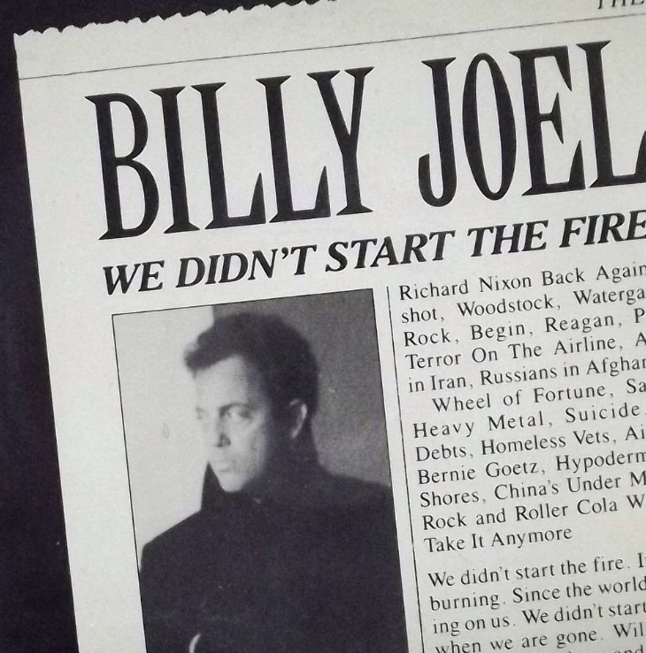
Billy Joel
“What I’m trying to get across is that we didn’t start this stuff, we inherited it”
(Rolling Stone, 16 November 1989)
Notes:
Introduce students to Billy Joel’s song and tell them you will be exploring the song in today’s lesson.
There have been a lot of questions surrounding Billy Joel’s meaning in the song, We Didn’t Start the Fire. This is the only quote he released on the topic.

Slide 19
We Didn’t Start the Fire
Listen and Watch the video for We Didn’t Start the Fire. Click here for the lyrics.
This video was made to show each reference in the video so that a modern day viewer could understand all of the references in the song.
Notes:
Show the video of the song and pull up the lyrics for students to read.
***Please preview this video before showing it to make sure it fits your classroom expectations. Alternatively, you can simply play the song for students and show them the lyrics.
Video link: https://www.youtube.com/watch?v=9p3DzUwxI0o
SS connection- what has changed since this song was written? What has stayed the same?

Slide 20
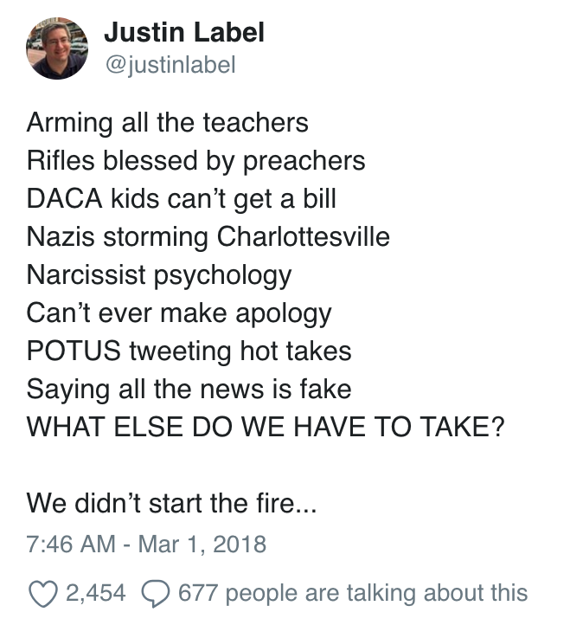
We Didn’t Start the Fire - Today
The message that Billy Joel wrote in 1989 is still ringing true today. Do you think this tweet captures the 2018 version of the song?
Assignment:
Write your own verse of We Didn’t Start the Fire sharing your message about Youth Justice.
If you need help with the syllables click on this worksheet.
Notes:
Explain that the tweet on the left shows how We Didn’t Start the Fire can be rewritten to tackle modern issues.
Instruct students to use the worksheet in PDF to write their own verse by breaking up the syllables. Please share your verses with us!

Slide 21
Exit Ticket:
What did you learn today?
Notes:
Before students leave class, ask them to complete the exit ticket on a piece of paper or submit one through your virtual classroom.

